Slide 1

TIARA-PP
WP Leaders meeting
R. Aleksan
November 13th, 2009
Budget
Schedule
Budget
Guidelines

Slide 2
Schedule
Date | Deliverable | Responsible persons
25/9/2009 | Finalization of the Proposal Editing Group | Coordinator
2/10/2009 | Formation of Editing Group for each WP | WP PE
5/10/2009 | Meeting of Proposal Editing Group (Coordinator+WP leaders) | Coordinator+WP PE
 | Presentation of Draft Structure of the WP sections for the proposal | WP PE
12/10/2009 | Initial version of the WP sections for the proposal, including detailed description, task breakdown, list of deliverables and milestones, Gantt chart | WP PE
 | Initial version of the general sections for the proposal | Coordinator
14/10/2009 | Meeting of Proposal Editing Group (Coordinator+WP leaders) | Coordinator+WP PE
28/10/2009 | Advanced WP documents, (description, task, deliverables, milestones, Gantt | WP PE
2/11/2009 | Meeting of TIARA Contractors + Proposal Editing Group (Coordinator+WP leaders) | Contractors + Coordinator+WP PE
9/11/2009 | Final WP documents, including description, task breakdown, list of deliverables and milestones, Gantt chart | WP PE
13/11/2009 | Meeting of Proposal Editing Group (Coordinator+WP leaders) | Coordinator+WP PE
 | Initial integration of the full TIARA proposal | Coordinator
20/11/2009 | Reserved date for meeting of Proposal Editing Group (backup; will be used in case of crisis) | Coordinator+WP PE
25/11/2009 | Final integration of all section of the proposal ready | Coordinator
 | Initial Electronic submission of TIARA-PP | Coordinator
2/12/2009 | Final minor correction & Final Electronic submission of TIARA-PP | Coordinator

Slide 3
Summary Personnel
p.-m. | WP1 | WP2 | WP3 | WP4 | WP5 | WP6 | WP7 | WP8 | WP9 | WP10 | sum
CEA | 90 | 20 | 6 | 6 | 4 | 4 | 0 | 0 | 0 | 0 | 130
CERN | 0 | 12 | 15 | 13 | 8 | 16 | 12 | 12 | 0 | 15 | 103
CNRS | 0 | 8 | 6 | 6 | 8 | 16 | 0 | 0 | 3 | 32 | 79
CIEMAT | 0 | 8 | 6 | 6 | 8 | 4 | 0 | 0 | 0 | 0 | 32
DESY | 0 | 12 | 6 | 6 | 0 | 18 | 0 | 0 | 0 | 0 | 42
GSI | 0 | 8 | 6 | 13 | 4 | 4 | 0 | 0 | 0 | 0 | 35
INFN | 0 | 12 | 6 | 15 | 4 | 4 | 6 | 0 | 60 | 0 | 107
PSI | 0 | 8 | 13 | 6 | 4 | 4 | 36 | 0 | 24 | 12 | 107
STFC | 0 | 12 | 6 | 6 | 16 | 4 | 0 | 30 | 0 | 0 | 74
UPP | 0 | 8 | 6 | 6 | 4 | 4 | 12 | 0 | 0 | 8 | 48
IFJ PAN | 0 | 8 | 6 | 6 | 4 | 4 | 0 | 0 | 0 | 0 | 28
Total | 90 | 116 | 82 | 89 | 64 | 82 | 66 | 42 | 87 | 67 | 785

Slide 4
Total Costs
Total cost (k€) | WP1 | WP2 | WP3 | WP4 | WP5 | WP6 | WP7 | WP8 | WP9 | WP10 | sum
CEA | 1008 | 310 | 81 | 81 | 53 | 58 | 0 | 0 | 0 | 0 | 1591,84
CERN | 0 | 215 | 344 | 215 | 143 | 271 | 180 | 188 | 0 | 226 | 1782,72
CNRS | 0 | 113 | 86 | 67 | 113 | 205 | 0 | 0 | 24 | 256 | 863,68
CIEMAT | 0 | 79 | 61 | 49 | 79 | 45 | 0 | 0 | 0 | 0 | 313,10
DESY | 0 | 155 | 79 | 79 | 0 | 298 | 0 | 0 | 0 | 0 | 611,36
GSI | 0 | 98 | 74 | 154 | 49 | 54 | 0 | 0 | 0 | 0 | 428,80
INFN | 0 | 134 | 69 | 243 | 45 | 52 | 50 | 0 | 1139 | 0 | 1733,12
PSI | 0 | 93 | 146 | 71 | 47 | 52 | 821 | 0 | 228 | 114 | 1572,12
STFC | 0 | 122 | 62 | 70 | 199 | 46 | 0 | 365 | 0 | 0 | 863,30
UPP | 0 | 74 | 58 | 58 | 37 | 45 | 77 | 0 | 0 | 51 | 399,36
IFJ PAN | 0 | 74 | 58 | 58 | 37 | 45 | 0 | 0 | 0 | 0 | 271,36
Total | 1008 | 1467 | 1119 | 1145 | 802 | 1171 | 1128 | 553 | 1391 | 647 | 10431

Slide 5
TIARA Budget

Slide 6
Guidelines for
final write up
Text: ARIAL 11pt
Organization
Formation of TIC (TIARA Infrastructure Committee?
Leaders of WP3 , WP7, WP8, WP9, WP10
Draw lessons on collaborative upgrade of R&D infrast.
Manpower
only round numbers
In WP (3-6) may be too low

Slide 7
Guidelines for
final write up
Travel & Other (for WP2-6)
Should we foresee additional travel for inviting experts
and some funding organizing special event (industry day…)
Text :
Objective: write first the main objectives
Work description: indicate the task when detailing the work
Deliverable/Milestones code: D/M«WP# ». #D/M (ex D2.1)
Gantt Chart:
start date 1/1/2010
no dates nor items on chart
Indicate task and D/M # in 2 column (see WP2)
Indicate also task and D/M # in text (see WP2)
Indicate « input from » on left and/or « output to » on right

Slide 8
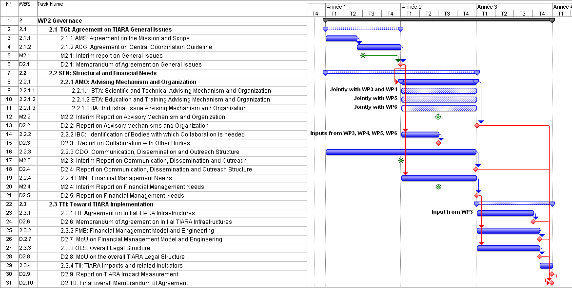
Guidelines for
final write up

Slide 9
Subgroup
Working in subgroups
O. Bruning is referee for WP4
F. Cervelli is referee for WP3
P. Burrows is referee for WP2
W. Singer is referee for WP5
R. Aleksan is referee for WP6
E. Jensen is referee for WP8
K. Long is referee for WP10
M. Biagini is referee for WP7
S. Bousson is referee for WP9
G1: WP3+WP4
G2: WP2+WP5+WP6
G3: WP7+W8+WP9+WP10

