Slide 1

TIARA-PP
WP Leaders meeting
R. Aleksan
November 13th, 2009
Work Package 2
Changes
Deliverables
Schedule
Budget

Slide 2
WP Tasks
Task | Description
2.1 | Agreement on TIARA General Issues
2.1.1 | - Agreement on the Mission and Scope
2.1.2 | - Agreement on Central Coordination Guidelines
2.2 | Structural and Financial Needs
2.2.1 | - Advising Mechanisms and Organization
2.2.1.1 | - Scientific & Technical Advising mechanism and Organization
2.2.1.2 | - Education &Training Advising mechanism and Organization
2.2.1.3 | - Industrial Issue Advising mechanism and Organization
2.2.2 | - Identification of the Bodies with which Collaboration is needed
2.2.3 | - Enabling efficient communication, dissemination and outreach
2.2.4 | - Financial Management Needs
2.3 | Toward the TIARA Implementation
2.3.1 | - Agreement on Initial TIARA Infrastructures
2.3.2 | - Financial Management Model and Engineering
2.3.3 | - Overall Legal Structure
2.3.4 | - TIARA Impact and related Indicators
No change

Slide 3
WP deliverables
Deliverables (brief description and month of delivery)
Num | Nat |  | Description | month
D2.1 | O |  | Memorandum of Agreement on General Issues | 12
D2.2 | R |  | Report on Advisory Mechanisms and Organization | 18
D2.3 | R |  | Report on Collaboration with Other Bodies | 18
D2.4 | R |  | Report on Communication, Dissemination and Outreach Structure | 24
D2.5 | R |  | Report on Financial Management Needs | 24
D2.6 | O |  | Memorandum of Agreement on Initial TIARA Infrastructures | 24
D2.7 | R |  | MoU on Financial Model and Engineering | 30
D2.8 | R |  | MoU on Legal Issues and Documents | 30
D2.9 | R |  | Report on TIARA Impact Measurement | 34
D2.10 | O |  | Final Memorandum of Agreement | 36

Slide 4
WP deliverables

Slide 5
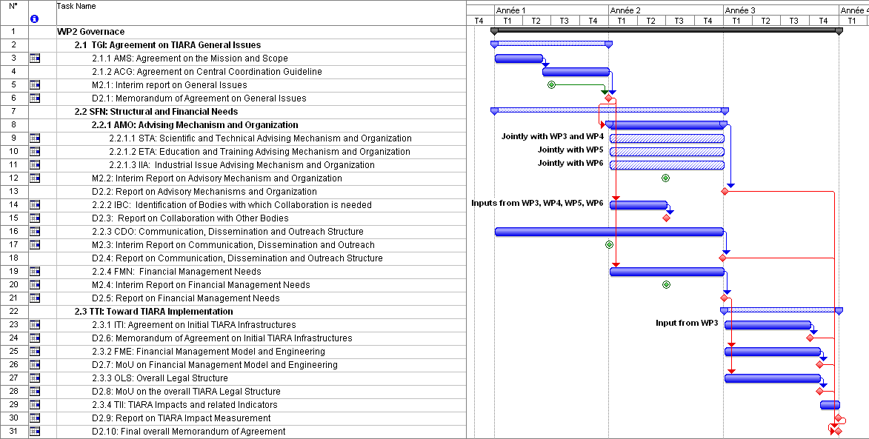
TIARA schedule
Input from
WP3-6 ?
Input
from WP3?

Slide 6
Costs
Participant number | 1 | 2 | 3 | 4 | 5 | 6 | 7 | 8 | 9 | 10 | 11
Participant short name | CEA | CERN | CNRS | CIEMAT | DESY | GSI | INFN | PSI | STFC | UU | IFJ
Person-months per participant: | 20 | 12 | 8 | 8 | 12 | 8 | 12 | 8 | 12 | 8 | 8
Travels | 36 | 27 | 18 | 18 | 27 | 18 | 27 | 18 | 27 | 18 | 18
Other (k€) | 50?
 | Contacts
CEA | Roy.aleksan@cea.fr
CERN | Steve.myers@cern.ch
CNRS | muller@ipno.in2P3.fr
CIEMAT | Ramon.gavela@ciemat.es
DESY | karsten.wurr@desy.de
GSI | H.Eickhoff@gsi.de
INFN | vacchi@ts.infn.it
PSI | Leonid.rivkin@psi.ch
STFC | John.womersley@stfc.ac.uk
Uppsala | Tord.Ekelof@physics.uu.se
Person-month | 116,00
cost manpower (k€) | 714,74
Consumable (k€) | 50,00
Travel (k€) | 201,60
Indirect cost (k€) | 501,06
total (k€) | 1467,40

