Slide 1

TIARA-PP
WP Leaders meeting
R. Aleksan
November 13th, 2009
Work Package 1
Changes
Deliverables
Schedule
Budget

Slide 2
WP Tasks
Task | Description
1.1 | Coordination of the Consortium
1.1.1 | - Reporting to the EC
1.1.2 | - Reporting to the Consortium Governing Bodies
1.1.3 | - Coordination and Monitoring of the Project
1.1.4 | - Management of the Budget
1.2 | Communication, Dissemination and Outreach
1.2.1 | - Communication and Dissemination within the consortium
1.2.2 | - Dissemination and Outreach toward the Communities and people at large
No change

Slide 3
WP deliverables
Deliverables (brief description and month of delivery)
Num | Nat | Short name | Description | month
D1.1 | O | WebPub | Overall Web Site Frame ready | 0
D1.2 | O | ConsAgrmnt | Consortium Agreement between participants ready | 0
D1.3 | O | Contract | Contract of the Consortium with the EC signed | 1
D1.4 | O | KickMeet | Organization of the Kickoff meeting | 1
D1.5 | O | WebInt | Internal Web Site Frame Ready | 2
D1.6 | R | MidRep | Midterm Report | 18
D1.7 | R | FinRep | Final Report | 36

Slide 4
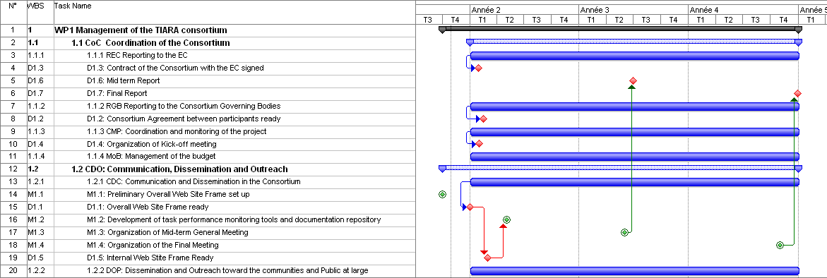
TIARA schedule
Mid-term
Final reports
Web Site
External and Internal
3 general meetings
with 2 town meetings

Slide 5
Costs
Participant number | 1 | 2 | 3 | 4 | 5 | 6 | 7 | 8 | 9 | 10 | 11
Participant short name | CEA | CERN | CNRS | CIEMAT | DESY | GSI | INFN | PSI | STFC | UU | IFJ
Person-months per participant: | 90
Travels | 125
Other (k€) | 100
Project Management (WP1)
Project Office (7.5 person-year)
TIARA-PP Coordinator
Deputy PO and Dissemination
Web master
Assistant financial matters
Assistant legal matters
Administrative assistant
Person-month | 90,00
cost manpower (k€) | 489,60
Consumable (k€) | 100,00
Travel (k€) | 100,00
Indirect cost (k€) | 318,24
total (k€) | 1007,84

