Slide 1

TIARA
WP leaders meeting
R. Aleksan
October 14th, 2009
Work Packages
WP management
WP1
Schedule
Conclusion

Slide 2
TIARA management
WP-leaders:
General WPs
  WP2: R. Aleksan (CEA, F)
  WP3: O. Brüning (CERN, Int.)
  WP4: F. Cervelli (INFN, I)
  WP5: P. Burrows (STFC, UK)
  WP6: W. Singer (DESY, DE)
Candidate Specific WPs (proposed by the projets)
  WP7 (CLIC): E. Jensen (CERN, Int.)
  WP8 (n-facility): K. Long (STFC, UK)
  WP9 (Super-B): M. Biagini (INFN, I)
  WP10 (EURISOL): P. Bousson (CNRS, F)
WP Deputies and contacts names being finalized

Slide 3
TIARA management
(cont’d)
 | WP2 | WP3 | WP4 | WP5 | WP6
WP lead | R. Aleksan | O. Bruning | F. Cervelli | P. Burrows | W. Singer
Contacts
CEA | Roy.aleksan@cea.fr | Antoine.dael@cea.fr | Olivier.napoly@cea.fr | ? | ?
CERN | Steve.myers@cern.ch | Oliver.bruning@cern.ch | Jean-pierre.koutchouk@cern.ch | Daniel.brandt@cern.ch | Lucio.rossi@cern.ch
CNRS | muller@ipno.in2P3.fr | laune@ipno.in2p3.fr | Jean-marc.filhol@synchrotron-soleil.fr | muller@ipno.in2p3.fr | msoberman@admin.in2p3.fr
CIEMAT | Ramon.gavela@ciemat.es | angel.ibarra@ciemat.es | Luis.garcia@ciemat.es | marisa.marco@ciemat.es | eduardo.molina@ciemat.es
DESY | karsten.wurr@desy.de | Hans.Weise@desy.de | Lutz.Lilje@desy.de | -- | Waldermar.singer@desy.de
GSI | H.Eickhoff@gsi.de | P.Spiller@gsi.de | H.Eickhoff@gsi.de | O.Boine-Frankenheim@gsi.de | U.Weinrich@gsi.de
INFN | vacchi@ts.infn.it | Franco.cervelli@pi.infn.it | Franco.cervelli@pi.infn.it | ? | ?
PSI | Leonid.rivkin@psi.ch | hans.braun@cern.ch | Terry.Garvey@psi.ch | Leonid.rivkin@psi.ch | Robert.Rudolph@psi.ch
STFC | John.womersley@stfc.ac.uk | swapan@cockcroft.ac.uk | mike.poole@stfc.ac.uk | p.burrows1@physics.ox.ac.uk | peter.mcintosh@stfc.ac.uk
Uppsala | Tord.Ekelof@physics.uu.se | Steinar.stapnes@cern.ch | volker.ziemann@fysast.uu.se | sverker.werin@maxlab.lu.se (tbc) | Hannu.Juuso@tekes.fi

Slide 4
TIARA management
(WP1)
Deliverables (brief description and month of delivery)
Num | Nat | Short name | Description | month
D1.1 | O | WebPub | Overall Web Site Frame ready | 0
D1.2 | O | ConsAgrmnt | Consortium Agreement between participants ready | 0
D1.3 | O | Contract | Contract of the Consortium with the EC signed | 1
D1.4 | O | KickMeet | Organization of the Kickoff meeting | 1
D1.5 | O | WebInt | Internal Web Site Frame Ready | 2
D1.6 | R | MidRep | Midterm Report | 18
D1.7 | R | FinRep | Final Report | 36
Milestones
Num | Nat | Short name | Description | month
M1.1 | O | WebPub | Preliminary Overall Web Site Frame set up | -3
M1.2 | O | MidMeet | Organization of Midterm General Meeting | 17
M1.3 | O | FinMeet | Organization of Final General Meeting | 34
In addition a Gantt chart is requested

Slide 5
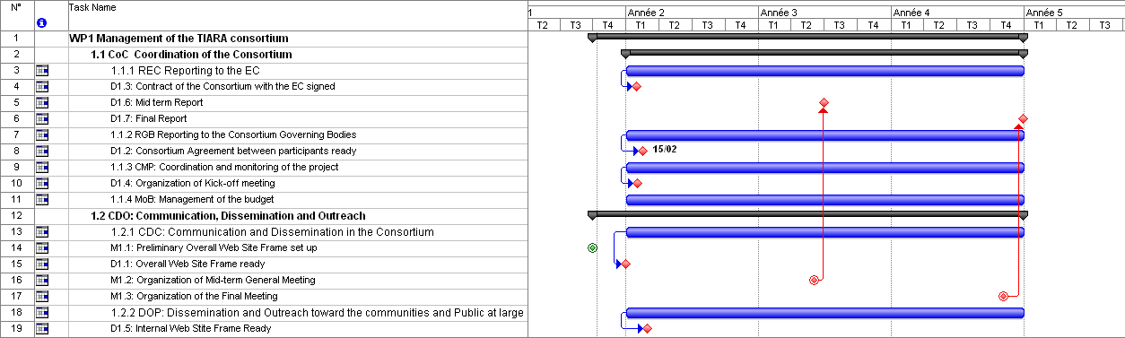
TIARA management
(WP1)
Web Site
External and Internal
3 general meetings
with 2 town meetings

Slide 6
TIARA management
Milestone&schedule
Date | Deliverable | Responsible persons
25/9/2009 | Finalization of the Proposal Editing Group | Coordinator
2/10/2009 | Formation of Editing Group for each WP | WP PE
5/10/2009 | Meeting of Proposal Editing Group (Coordinator+WP leaders) | Coordinator+WP PE
 | Presentation of Draft Structure of the WP sections for the proposal | WP PE
12/10/2009 | Initial version of the WP sections for the proposal, including detailed description, task breakdown, list of deliverables and milestones, Gantt chart | WP PE
 | Initial version of the general sections for the proposal | Coordinator
14/10/2009 | Meeting of Proposal Editing Group (Coordinator+WP leaders) | Coordinator+WP PE
28/10/2009 | Advanced WP documents, (description, task, deliverables, milestones, Gantt | WP PE
2/11/2009 | Meeting of TIARA Contractors + Proposal Editing Group (Coordinator+WP leaders) | Contractors + Coordinator+WP PE
9/11/2009 | Final WP documents, including description, task breakdown, list of deliverables and milestones, Gantt chart | WP PE
16/11/2009 | Meeting of Proposal Editing Group (Coordinator+WP leaders) | Coordinator+WP PE
 | Initial integration of the full TIARA proposal | Coordinator
23/11/2009 | Reserved date for meeting of Proposal Editing Group (backup; will be used in case of crisis) | Coordinator+WP PE
25/11/2009 | Final integration of all section of the proposal ready | Coordinator
 | Initial Electronic submission of TIARA-PP | Coordinator
2/12/2009 | Final minor correction & Final Electronic submission of TIARA-PP | Coordinator

Slide 7

Conclusions
TIARA is on the way to develop an ambitious structure,
which is aiming at strengthening accelerator R&D is a
sustainable and comprehensive way
The challenge is huge!!!
We have now a lot of work ahead of us to make a strong
proposal for FP7 Preparatory Phase
It will require strong commitment from all of us
With TIARA
Accelerator science could be a powerful mean
toward scientific, technical
and industrial breakthroughs… i.e toward
building a society and economy of knowledge

