Slide 1

TIARA
WP leaders meeting
R. Aleksan
October 14th, 2009
WP2
WP2

Slide 2
TIARA management
(cont’d)
WP2
Task Num | Short Name | Description
2.1 | TGI | Agreement on TIARA General Issues
2.1.1 | AMS | Agreement on the Mission and Scope
2.1.2 | ACG | Agreement on Central Coordination Guidelines
2.2 | SFN | Structural and Financial Needs
2.2.1 | AMO | Advising Mechanisms and Organization
2.2.1.1 | STA | Scientific & Technical Advising mechanism and Organization
2.2.1.2 | ETA | Education &Training Advising mechanism and Organization
2.2.1.3 | IIA | Industrial Issue Advising mechanism and Organization
2.2.2 | IBC | Identification of the Bodies with which Collaboration is needed
2.2.3 | CDO | Enabling efficient communication, dissemination and outreach
2.2.4 | FMN | Financial Management Needs
2.3 | TTI | Toward the TIARA Implementation
2.3.1 | ITI | Agreement on Initial TIARA Infrastructures
2.3.2 | FME | Financial Management Model and Engineering
2.3.3 | OLS | Overall Legal Structure
2.3.4 | TII | TIARA Impact and related Indicators

Slide 3
TIARA management
(cont’d)
WP2
Management perimeter of TIARA (1 deliverable + 1 milestone)
  Term of reference (domain of competence, scientific and technical fields involved, type of R&D infrastructures, type of R&D programme), nature of TIARA actions, general membership criteria…
  General Guidelines for Central coordination: Expertise, Term and Location
Determination of structural and Financial needs to achieve TIARA objectives (4 deliv. +3 milestones)
  For addressing scientific and technical issues (with inputs from WP3 and WP4)
  For addressing education and training aspects (with inputs from WP5)
  For handling legal, financial and administrative matters
  Interactions with other bodies (NuPECC, EUROFEL…)
  For enabling efficient dissemination and outreach
  Financial Management Needs
Implementation of TIARA (5 deliverables)
  Initial TIARA Infrastructures
  Financing model and engineering for supporting TIARA activities (infrastructures, R&D programs, education&training, collaboration with industry)
  Overall legal structure of the central coordination (need to include EC in the work) including reporting and organization chart
  Impact of TIARA and related indicators…

Slide 4
TIARA management
(WP2)
Deliverables (brief description and month of delivery)
Num | Nat | Short name | Description | month
D2.1 | O | MoA-GI | Memorandum of Agreement on General Issues | 12
D2.2 | R | AMO | Report on Advisory Mechanisms and Organization | 18
D2.3 | R | COB | Report on Collaboration with Other Bodies | 18
D2.4 | R | CDO | Report on Communication, Dissemination and Outreach Structure | 24
D2.5 | R | FMN | Report on Financial Management Needs | 24
D2.6 | O | MoA-ITI | Memorandum of Agreement on Initial TIARA Infrastructures | 24
D2.7 | R | FIE | Report on Financial Model and Engineering | 30
D2.8 | R | LID | Report on Legal Issues and Documents | 30
D2.9 | R | TIM | Report on TIARA Impact Measurement | 34
D2.10 | O | FinMoA | Final Memorandum of Agreement | 36
Milestones
Num | Nat | Short name | Description | month
M2.1 | R | Int-GI | Interim Report on General Issues | 6
M2.2 | R | Int-AMO | Interim report of Advisory Mechanisms and Organization | 18
M2.3 | R | Int-CDO | Interim Report on Communication, Dissemination & Outreach | 12
M2.4 | R | Int-FMN | Interim Report on Financial Management Needs | 18

Slide 5
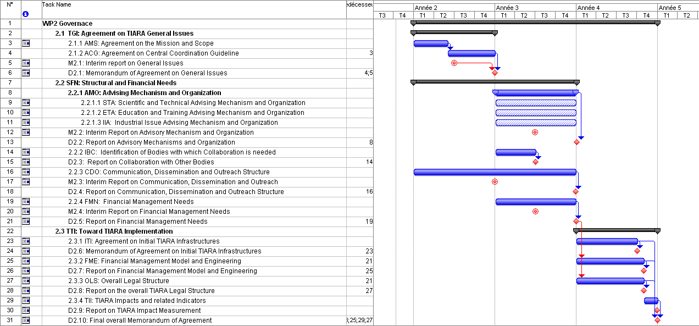
TIARA management
(WP2)

