Slide 1
TIARA – WP6
Involving Industry in TIARA
Lucio Rossi (WPD)
CERN

Slide 2
WP6 – Description of work
The central objective of WP6 is to bring together research institutes and universities working in the field of accelerator technology and industrial companies interested both in supplying products to scientific projects based on this technology and in supplying an accelerators user community (industrial accelerators, medical accelerators).
The aim is to create a framework intellectually and economically attractive to develop industrial products both for the research facilities and medical and industrial accelerators. The WP6 activity has to increase the speed of the R&D industrialization, facilitate the technology and knowledge transfer, cost optimization.
The main task of this work package is to identify and organize long term collaboration between the TIARA Consortium and industry and lay the groundwork for a permanent and closer association on the basis of long term mutual interest for all the sectors above.

Slide 3
WP6.1 - Establishing efficient communication with industry
The accelerators industry sectors relevant for TIARA has to be defined, industry need has to be understood and a formal liaison between TIARA and the industry will be established.
Creation of the web-based data base collecting the information about industrial technology and industrial application in the accelerating area will be an important tool for defining the industry sectors relevant for TIARA.
An open and recognized way of communication will allow also to industry to give their inputs to the technology programs and the most useful direction for industrial-medical applications.

Slide 4
WP6.2 - Establishing a joint framework for developing joint R&D projects and industrializing recent technologies
The joint framework has to be established for the construction of accelerator components and test systems and for the development of industrial accelerators. Protecting of IPR (intellectual property rights) in technology transfer plays a very important role for industry and will be investigated also in relation with the open access style typical of the research funded by public money. The main issues of intellectual property policy will be: exchange of knowledge and confidentiality, who owns knowledge, who owns inventions, under what condition a license can be granted etc.

Slide 5
WP6.3 -Sharing R&D infrastructures and developing joint R&D infrastructures
The rules for sharing R&D infrastructures will be established. A financial model for joint R&D infrastructures will be developed. The industry infrastructures and accelerator R&D infrastructure complexes have to be integrated. Rules governing the access by industry to research facility will be defined, too.
The existing examples of the infrastructure sharing will be analyzed (for example the access today granted in existing synchrotron radiation facilities, neutron and irradiation facilities), the alternatives will be taken into consideration and on this base the general model will be developed.

Slide 6
WP6.4 - Definition of a technology Roadmap for the development of future accelerator components in industry
The critical requirements and their targets (costs, reliability etc.) have to be identified.
The technology alternatives that can satisfy the targets must be identified and the cost (material and human resources) evaluated. The timeline from each alternative has to be identified. The best information has to be consolidated and consensus from many experts both from industries and laboratories-universities has to be developed.
Finally, a mechanism to decide which technology alternative has to be pursue will be proposed.

Slide 7
WP6.5 - Definition of the best model for associating industry to TIARA and definition of the appropriate structure
The models (in which industry are associated to accelerator R&D and infrastructure) already used in other areas, like USA and Japan, will be examined and evaluated.
Finally a proposal for Europe will be suggested, taking into account its peculiarity of having strong National Institutes or Agencies already with Technology Transfer and close association to Industry

Slide 8
WP 6 participants and resources
The extra wrt to standard is 9 p-m (Desy), 12 p-m (CERN), 9 p-m (IN2P3)
This corresponds to 2 FTE-years in order to have professinal work for
Data base
Study models of dissemination in Industry
Study models of funding R&D in Industry (example: DOE-SBIR and others)
Having advice also form legal people/service about IPR and open access

Slide 9
WP6 : structure
Waldemar Singer (Desy): WP Leader
Lucio Rossi (Cern) : WP Deputy leader
Marcel Soberman (In2p3): WP Deputy leader
(CEA) ?
U. Weinrich (GSI): participant
Eduardo Molina (Ciemat): participant
Robert Rudolph (PSI) : participant
Peter Mcintosh (STCF) : participant
Hannu Juuso (Tekes) : participant

Slide 10
WP 6 : task description
Task breakdown
Task Num | Short Name | Description
6.1 | 6.1_CMT | Establish a sustainable Communication Mechanism and related Tools with industry
6.1.1 | 6.1_LTI | Establishing a formal Liaison between TIARA and the relevant Industry
6.1.2 | 6.1_INA | Understanding the Industry Needs for Accelerators and related Accelerator R&D infrastructures and Programs.
6.2 | 6.2_FPT | Define and establish a most appropriate Framework for developing joint R&D Projects and industrializing recent Technologies
6.2.1 | 6.2_JRD | Identifying the topics that are most appropriate for Joint R&D concerning accelerator components and test systems
6.2.2 | 6.2_MIA | Identifying recent technologies that can be used for the development of Medical and Industrial Accelerators
6.2.3 | 6.2_ | Studying how to enforce the IPR within this joint framework
6.3 | 6.3_SDI | Sharing R&D Infrastructures and Developing joint R&D Infrastructures
6.3.1 | 6.3_CRI | Determining the Criteria and establishing the Rules for sharing R&D Infrastructures
6.3.2 | 6.3_FMI | Proposing Financial Models for developing joint R&D Infrastructures
6.3.3 | 6.3_IIL | Integrating Industry infrastructures with Laboratories accelerator R&D Infrastructures
6.4 | 6.4_TRI | Developing a Technology Roadmap for the development of future accelerator components in Industry
6.4.1 | 6.4_ICR | Identify the critical requirements and their targets (costs, reliability etc.)
6.4.2 | 6.4_ITA | Identify the technology alternatives and give recommendation what alternative should be pursued
6.5 | 6.5_ | Defining the best model for Associating Industry to TIARA and propose the appropriate structure to implementation

Slide 11
WP6 deliverables & Milestone
^{[1]} CA for Consortium Agreement, C for Contract, R for Report, P for prototype
Deliverables
Num | Nat | Short name | Description | month
1 | R | CTR | Communication Mechanism and related Tools Report (task 6.1) | 24
2 | R | PTR | Framework for developing joint R&D projects and industrializing recent technologies Report (task 6.2) | 18
3 | R | SDR | Sharing R&D Infrastructures and Developing joint R&D Infrastructures Report (task 6.3) | 24
4 | R | TRR | Technology Roadmap Report (task 6.4) | 24
5 | R | AIR | Associating Industry to TIARA (task 6.5) | 36
Milestones
Num | Nat | Short name | Description | month
1 | R |  | Communication mechanism is established | 24
2 | R | FJP | Framework for joint R&D projects is established | 18
3 | R |  | Sharing infrastructure model is proposed | 24
4 | R |  | Roadmap is determined | 18
5 | R | MIT | Model for associating industry and TIARA is proposed | 36

Slide 12
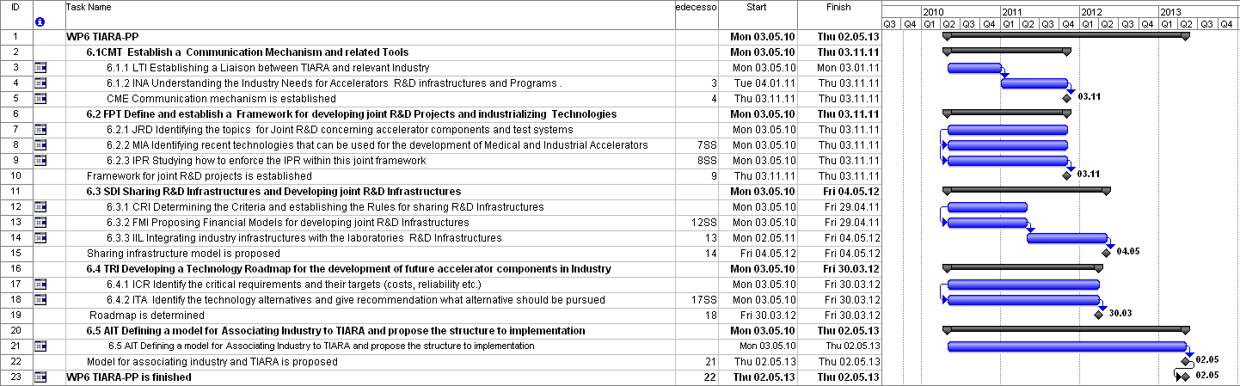
Time plan

