Slide 1

TIARA
TPB meeting
R. Aleksan
November 2nd, 2009
TIARA website: http://www.eu-tiara.eu
D−31
Meeting Objectives
Management
Missing elements
Conclusion

Slide 2
Meeting Objectives
September 18th : TIARA has been presented to the
CERN Council at the European session of the Council with
presence of R. J. Smits (Dir. research programmes and capacity within DG Research)
CERN council
  has appreciated and supported the TIARA project
  has unanimously approved the submission of TIARA proposal
  as a CNI-Preparatory Phase (Deadline on December 3, 2009 )
Today
Review the action items decided at the previous meeting
Decide the final list of Work Packages
Decide the work plan of the WP (tasks, deliverables)
Agree on costing guidelines and pending issues

Slide 3


Action items from
September 2nd
Reexamine project before submission
P
Being done today
Work packages
P
WP1 to WP6 should be kept
« Specific » technical WP s should be still examine and fulfill guidelines
i.e. improve/develop critical R&D infrastructures and/or be useful to
non-particle physics projects
Final decision today on WP7 to WP10
Contractors seeking the associated labs/universities/industrial partners
P
Partial Feeback only; from
Scandinavia: Lund, Stockholm, Oslo, Helsinki, Jyväskylä, Aarhus
France: Soleil, GANIL, 2 Greek Uni. wish to be associated
Should get a list of associates from all Contractors by November 6th
(TPB resp.) with agreed contact names and main WP interest
to establish an initial list in the proposal.
Proposal: State that list will be updated if the proposal is accepted

Slide 4
Action items from
September 2nd
Proposed format for list of associated partners.
Examples:
Organisation (Name, city, country) | Short Name | Short description (i.e. fields of excellence) and specific roles in the consortium | Affiliated to
Helsinki Institute of Physics, Helsinki, Finland | HIP | Fields of excellence: Beam diagnostics tools and instrumentation. HEPH is assisted by a consortium of Finnish institutes and industry with expertise in RF measurements, automation and vacuum related mechanics and welding. Specific contribution to: WP6 Contact Name: ------------- | UPP
E2V Technologies Ltd, Chelmsford, UK | E2V | Fields of excellence: Design and manufacture of RF, microwave and switching devices, sensors, power supplies, etc. Specific contribution to: WP6 Contact Name: -------------- | STFC

Slide 5
Action items from
September 2nd (cont’d)
Number | Organization Name | Country | Cost model
1 (coordinator) | CEA | France | actual
2 | CERN | International | 60%
3 | CNRS/IN2P3 | France | 60%
4 | CIEMAT | Spain | actual
5 | DESY | Germany | 60%
6 | GSI | Germany | actual
7 | INFN | Italy | 60%
8 | PSI | Switzerland | 20%
9 | STFC | UK | actual
10 | Uppsala Uni. (rep. Scand. Consortium) | Sweden | 60%
Investigation of one Polish participant (as entry point for a consortium)
P
On-going discussions involving Krakow, Warsaw, Wroclaw and Lodz
Advise needed from TPB on whether should be included

Slide 6
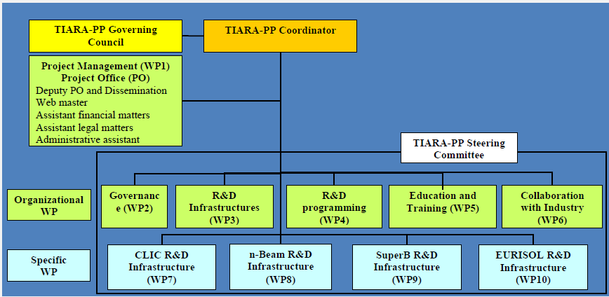
Organization
General structure (approved by the TPB and the CERN council)
My cost estimate of TIARA-PP is 10 +- 2 M€
Maximum EC contribution: 6M€ ; What should TIARA-PP request ?
Proposal : WP1-6 :WP7-n = 75% :25% = 4.5:1.5 M€

Slide 7
Organization (cont’d)
In PP guidelines, there are different types of WP:
MGT, COOR, SUPP, RTD (implications are financial)
Cost eligible for reimbursement
MGT: 100% of costs (direct + indirect full or flat rate)
COORD, SUPP: 100% of costs (direct + indirect 7% flat rate)
RTD: 75% of costs (direct + indirect full or flat rate)
In TIARA, 3 categories of WP
1. Management of TIARA-PP
WP1: Management of the consortium (MGT)
Objective: Organization of the Preparatory Phase work,
Dissemination and outreach

Slide 8
Organization (cont’d)
2. General TIARA issues
WP2: Governance of TIARA (SUPP)
Objective: Developing governance allow one to involve as many fields as possible
WP3: Accelerator R&D Infrastructures in Europe (SUPP)
Objective: Integrating and optimizing European Infrastructures for accelerator R&D
WP4: Joint R&D programming (COORD)
Objective: Defining a Joint R&D Programme in the field of accelerator science
WP5: Education and Training for accelerator sciences (SUPP)
Objective: Promoting education and training for accelerator research in Europe
WP6: Collaboration with Industry (SUPP)
Objective: Investigating how industry can be involved in the programs, projects and actions carried out by TIARA

Slide 9
Organization (cont’d)
3. Specific R&D infrastructure issues
WP7-WPn: Specific R&D infrastructures (RTD)
The aim of these WPs is to identify and organize the infrastructures and the critical
R&D program needed to develop further some specific large scale facilities. It could
include some very limited critical hardware work related to the R&D infrastructures.
Indeed, there exist specific and immediate needs for organizing R&D infrastructures
and projects that are important present challenges for TIARA in relation to emerging large
accelerator facilities.
The aim of these WPs is to bring the corresponding infrastructures up to date for
implementing the key R&D programme, which is essential for the technology
to reach maturity for the construction of the corresponding large scale facility.
These work packages will work in close interactions with WP3.
4 potential areas related to large scale facilities have been identified:
CLIC, intense ν−beam facility, Super-B, EURISOL
Decision to include them depends on their proposal and their coherent
integration within the TIARA objective

Slide 10
WP Management
WP-leaders:
General WPs
  WP2: R. Aleksan (CEA, F)
  WP3: O. Brüning (CERN, Int.)
  WP4: F. Cervelli (INFN, I)
  WP5: P. Burrows (STFC, UK)
  WP6: W. Singer (DESY, DE)
Candidate Specific WPs (proposed by the projets)
  WP7 (CLIC): E. Jensen (CERN, Int.)
  WP8 (n-facility): K. Long (STFC, UK)
  WP9 (Super-B): M. Biagini (INFN, I)
  WP10 (EURISOL): P. Bousson (CNRS, F)

Slide 11
Management
WP-contacts
 | WP2 | WP3 | WP4 | WP5 | WP6
WP lead | R. Aleksan | O. Bruning | F. Cervelli | P. Burrows | W. Singer
Contacts
CEA | Roy.aleksan@cea.fr | Antoine.dael@cea.fr | Olivier.napoly@cea.fr | Pierre.vedrine@cea.fr | Philippe.Rebourgeard@cea.fr
CERN | Steve.myers@cern.ch | Oliver.bruning@cern.ch | Jean-pierre.koutchouk@cern.ch | Daniel.brandt@cern.ch | Lucio.rossi@cern.ch
CNRS | muller@ipno.in2P3.fr | laune@ipno.in2p3.fr | Jean-marc.filhol@synchrotron-soleil.fr | muller@ipno.in2p3.fr | msoberman@admin.in2p3.fr
CIEMAT | Ramon.gavela@ciemat.es | angel.ibarra@ciemat.es | Luis.garcia@ciemat.es | marisa.marco@ciemat.es | eduardo.molina@ciemat.es
DESY | karsten.wurr@desy.de | Hans.Weise@desy.de | Lutz.Lilje@desy.de | -- | Waldermar.singer@desy.de
GSI | H.Eickhoff@gsi.de | P.Spiller@gsi.de | H.Eickhoff@gsi.de | O.Boine-Frankenheim@gsi.de | U.Weinrich@gsi.de
INFN | vacchi@ts.infn.it | Franco.cervelli@pi.infn.it | Franco.cervelli@pi.infn.it | vittorio.vaccaro@na.infn.it | giacomo.cuttone@lns.infn.it
PSI | Leonid.rivkin@psi.ch | hans.braun@psi.ch | Terry.Garvey@psi.ch | Leonid.rivkin@psi.ch | Robert.Rudolph@psi.ch
STFC | John.womersley@stfc.ac.uk | swapan@cockcroft.ac.uk | mike.poole@stfc.ac.uk | p.burrows1@physics.ox.ac.uk | peter.mcintosh@stfc.ac.uk
Uppsala | Tord.Ekelof@physics.uu.se | roger.ruber@fysast.uu.se | volker.ziemann@fysast.uu.se | Sören Pape Möller fyssp@phys.au.dk | Kenneth.osterberg@helsinki.fi

Slide 12
Management (cont’d)
Date | Deliverable | Responsible persons
25/9/2009 | Finalization of the Proposal Editing Group | Coordinator
2/10/2009 | Formation of Editing Group for each WP | WP PE
5/10/2009 | Meeting of Proposal Editing Group (Coordinator+WP leaders) | Coordinator+WP PE
 | Presentation of Draft Structure of the WP sections for the proposal | WP PE
12/10/2009 | Initial version of the WP sections for the proposal, including detailed description, task breakdown, list of deliverables and milestones, Gantt chart | WP PE
 | Initial version of the general sections for the proposal | Coordinator
14/10/2009 | Meeting of Proposal Editing Group (Coordinator+WP leaders) | Coordinator+WP PE
28/10/2009 | Advanced WP documents, (description, task, deliverables, milestones, Gantt | WP PE
2/11/2009 | Meeting of TIARA Contractors + Proposal Editing Group (Coordinator+WP leaders) | Contractors + Coordinator+WP PE
9/11/2009 | Final WP documents, including description, task breakdown, list of deliverables and milestones, Gantt chart | WP PE
13/11/2009 | Meeting of Proposal Editing Group (Coordinator+WP leaders) | Coordinator+WP PE
 | Initial integration of the full TIARA proposal | Coordinator
20/11/2009 | Reserved date for meeting of Proposal Editing Group (backup; will be used in case of crisis) | Coordinator+WP PE
25/11/2009 | Final integration of all section of the proposal ready | Coordinator
 | Initial Electronic submission of TIARA-PP | Coordinator
2/12/2009 | Final minor correction & Final Electronic submission of TIARA-PP | Coordinator

Slide 13
Missing elements
Costing
Each WP leader has to determine manpower
i.e. commitment to the WP tasks
Proposed deadline : November, 10
  (Contacts /TPB + WP leaders resp.)
Proposed guidelines to be used (direct costs)
Type of personnel | Person-month
Senior physicist/engineer | 6.5 k€
Physicist/engineer | 5.0 k€
Technician/postdoc | 4.0 k€
PhD student | 2.5 k€
1 travel (fare+2day per-diem) | 0.8 k€

Slide 14
Missing elements
Costing (cont’d)
With present (incomplete) information,
total number of person-month is 668.6
p.-m. | WP1 | WP2 | WP3 | WP4 | WP5 | WP6 | WP7 | WP8 | WP9 | WP10 | sum
CEA | 90 | 20 | 5,5 | 5,5 | 3,6 | 5,1 | 0 | 0 | 0 | 0 | 129,7
CERN | 0 | 12 | 14,5 | 12,7 | 7,2 | 18,5 | 12 | 11 | 0 | 0 | 87,9
CNRS | 0 | 8 | 5,5 | 5,5 | 7,2 | 18,2 | 0 | 0 | 3 | 0 | 47,4
CIEMAT | 0 | 8 | 5,5 | 5,5 | 7,2 | 5,1 | 0 | 0 | 0 | 0 | 31,3
DESY | 0 | 12 | 5,5 | 5,5 | 0 | 21 | 0 | 0 | 0 | 0 | 44
GSI | 0 | 8 | 5,5 | 12,7 | 3,6 | 5,1 | 0 | 0 | 0 | 0 | 34,9
INFN | 0 | 12 | 5,5 | 14,5 | 3,6 | 5,1 | 6 | 0 | 60 | 0 | 106,7
PSI | 0 | 8 | 12,7 | 5,5 | 3,6 | 5,1 | 36 | 0 | 12 | 0 | 82,9
STFC | 0 | 12 | 5,5 | 5,5 | 12 | 5,1 | 0 | 24 | 0 | 0 | 64,1
UPP | 0 | 8 | 5,5 | 5,5 | 3,6 | 5,1 | 12 | 0 | 0 | 0 | 39,7
Total | 90 | 108 | 71,2 | 78,4 | 51,6 | 93,4 | 66 | 35 | 75 | 0 | 668,6

Slide 15
Missing elements
Costing (cont’d)
With present (incomplete) information,
total cost (including indirects) is 8404
k€ | WP1 | WP2 | WP3 | WP4 | WP5 | WP6 | WP7 | WP8 | WP9 | WP10 | sum
CEA | 920 | 230 | 57 | 57 | 37 | 53 | 0 | 0 | 0 | 0 | 1354
CERN | 0 | 148 | 151 | 132 | 75 | 192 | 125 | 194 | 0 | 0 | 1017
CNRS | 0 | 99 | 57 | 57 | 75 | 189 | 0 | 0 | 31 | 0 | 508
CIEMAT | 0 | 93 | 57 | 57 | 75 | 53 | 0 | 0 | 0 | 0 | 335
DESY | 0 | 148 | 57 | 57 | 0 | 218 | 0 | 0 | 0 | 0 | 481
GSI | 0 | 93 | 57 | 132 | 37 | 53 | 0 | 0 | 0 | 0 | 373
INFN | 0 | 148 | 57 | 151 | 37 | 53 | 62 | 0 | 1264 | 0 | 1773
PSI | 0 | 95 | 132 | 57 | 37 | 53 | 854 | 0 | 125 | 0 | 1354
STFC | 0 | 139 | 57 | 57 | 125 | 53 | 0 | 350 | 0 | 0 | 781
UPP | 0 | 99 | 57 | 57 | 37 | 53 | 125 | 0 | 0 | 0 | 428
Total | 920 | 1290 | 740 | 815 | 537 | 971 | 1166 | 544 | 1420 | 0 | 8404

Slide 16
Missing elements (cont’d)
Description TIARA-PP participants
Brief description of each legal entity (1/2 page max)
Proposed deadline : November, 6 (TPB resp.)
The main tasks they have been attributed,
a Proposed deadline : November, 13 (WP leaders resp.)
Support letters from funding agencies and Ministries
Essential part of the proposal
a Proposed deadline : November, 20 (TPB resp.)

Slide 17
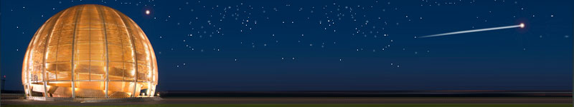
Conclusions
Despites an “impossible” time schedule, significant progress
has been achieved by the TIARA-PP team for the preparing
the TIARA-PP proposal
However, there is still a lot to be done and the success relies
critically on the commitment of the involved
parties and their ability to deliver their part in due time
as established in the schedule
With TIARA
Accelerator science could be a powerful mean
toward scientific, technical
and industrial breakthroughs…

