Slide 1

TIARA-PP
TPB meeting
R. Aleksan
November 2th, 2009
Work Package 1
Objectives
Deliverables
Schedule

Slide 2
Objectives
Management of the TIARA-PP consortium
Task | Description
1.1 | Coordination of the Consortium
1.1.1 | - Reporting to the EC
1.1.2 | - Reporting to the Consortium Governing Bodies
1.1.3 | - Coordination and Monitoring of the Project
1.1.4 | - Management of the Budget
1.2 | Communication, Dissemination and Outreach
1.2.1 | - Communication and Dissemination within the consortium
1.2.2 | - Dissemination and Outreach toward the Communities and people at large
Project Management (WP1)
Project Office (7.5 person-year)
TIARA-PP Coordinator
Deputy PO and Dissemination
Web master
Assistant financial matters
Assistant legal matters
Administrative assistant
1 Participant
CEA

Slide 3
WP deliverables
Deliverables (brief description and month of delivery)
Num | Nat | Short name | Description | month
D1.1 | O | WebPub | Overall Web Site Frame ready | 0
D1.2 | O | ConsAgrmnt | Consortium Agreement between participants ready | 0
D1.3 | O | Contract | Contract of the Consortium with the EC signed | 1
D1.4 | O | KickMeet | Organization of the Kickoff meeting | 1
D1.5 | O | WebInt | Internal Web Site Frame Ready | 2
D1.6 | R | MidRep | Midterm Report | 18
D1.7 | R | FinRep | Final Report | 36
Milestones
Num | Nat | Short name | Description | month
M1.1 | O | WebPub | Preliminary Overall Web Site Frame set up | -3
M1.2 | O | MidMeet | Organization of Midterm General Meeting | 17
M1.3 | O | FinMeet | Organization of Final General Meeting | 34

Slide 4
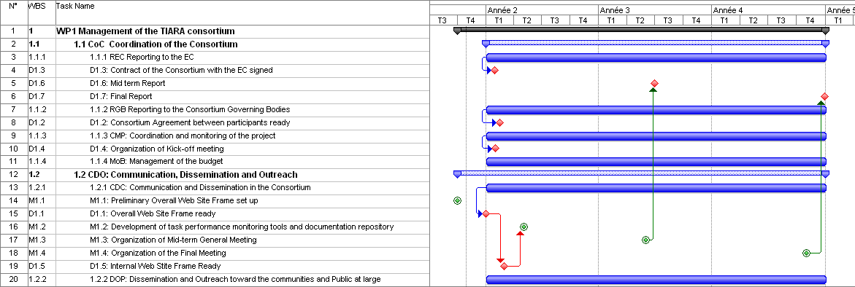
TIARA management
Mid-term
Final reports
Web Site
External and Internal
3 general meetings
with 2 town meetings

Slide 5
TIARA management

