Slide 1
TIARA: WP8: Neutrino facility:

Slide 2
Overview:
Principal objectives:
  Upgrade to power infrastructure for the Muon Ionisation Cooling Experiment (MICE) facility at Rutherford Appleton Laboratory
  Upgrade to the infrastructure for the Horn Focussing Test Facility at CERN
  Required to allow the critical R&D for future super-beam and Neutrino Factory accelerator R&D in Europe
Work package manager:
  K. Long – Imperial
Deputies:
  S. Griffiths – Daresbury Laboratory
  A. Moss – Daresbury Laboratory
  A. Pardons – CERN

Slide 3
Principal tasks:
WP8.1: Upgrade to MICE facility power infrastructure
  The work within this task will be to coordinate the work at CERN, DL, and RAL on the specification, procurement, and implementation of the MICE sub-station upgrade and on the specification, procurement, implementation, and commissioning of the RF power distribution system.
    WP8.1.1: Sub-station upgrade
      Power to the MICE Hall is supplied via an aging 1.25 MVA sub-station. In order for the MICE facility to accommodate the MICE experiment an upgrade to the capacity of the substation will be required.
    WP2.1.2: RF power infrastructure
      The principal aim of this subtask is to deliver the complete design of the RF power distribution system for Steps V and VI of the MICE experiment. The work will proceed by reviewing the layout and RF power requirements of the MICE experiment in order to produce a specification documents.
WP8.2: Upower upgrade to CERN Horn Focussing Test Facility
  The work within this task will be to coordinate the activities at CERN, DL and RAL on the specification, and implementation studies of a high-current fast rise-time power supply and the cooling system and test area infrastructure upgrade to allow testing horn prototypes designed for future neutrino beams.
    WP8.2.1: Horn power supply design and upgrade
      The current horn test facility at CERN that has been used to electrically and hydraulically test the CNGS neutrino horns at 180kA with a pulse frequency of 0.3 Hz. The work to be carried out in this sub-task will be to define the specifications of such a power supply and use the same components to upgrade the existing system but at the lower frequency of ~1Hz.
    WP8.2.1: Horn cooling system and test area infrastructure upgrade
      Necessary modifications to the cooling system for the future neutrino beam horns compared to that of CNGS, include the design and installation of a more powerful heat exchanger, connections of the circuit to standard chilled and demineralised water circuits and the implementation of a new and complete control system interlocked with the power supply.

Slide 4
Deliverables:

Slide 5
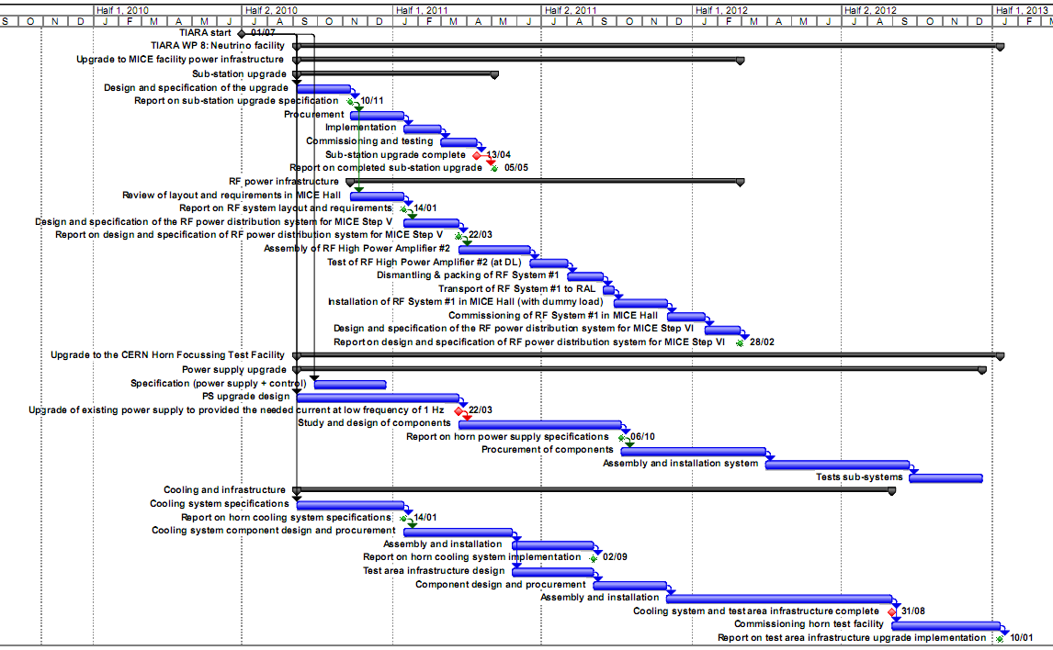
Schedule:

