Slide 1
WP7 – SVET
Upgrade of SLS Vertical Emittance Tuning
Erk Jensen, CERN/BE-RF
Future Linear collider (e.g. CLIC) damping rings and light sources will have to operate with extremely small emittances at high currents. This requires R&D in the IBS (Intra-Beam Scattering) dominated regime.
The Swiss Light Source (SLS) gets close to the required performance; however, some essential elements of SLS require upgrade in order to enable this dedicated R&D program.
To identify these key elements and to implement this necessary upgrade of SLS is the objective of work package 7 (SVET).
WP Coordinator: Erk Jensen/CERN, deputy: Andreas Streun/PSI
Partners: CERN,INFN(LNF),PSI,U-Lund(Maxlab)

Slide 2

WP7 (SVET): Tasks
Task 1: What are the present limits?
  Betatron coupling, girder and BPM alignment, skew quadrupoles, instrumentation
Task 2: Specify the upgrades
  Improved alignment, correction knobs and feedback algorithms, magnet trimming
Task 3: Implement the upgrades
Task 4: Commissioning
  at nominal (2.4 GeV) and reduced energy (1.5 GeV)

Slide 3
WP7 (SVET): Partners
CERN (Erk Jensen, Yannis Pappaphilippou)
PSI (Andreas Streun)
INFN/LNF (Marica Biagini, Alessandro Drago)
University of Lund/Maxlab (Åke Andersson)

Slide 4
WP7 (SVET): Deliverables
^{[1]} CA for Consortium Agreement, C for Contract, GM for General Meeting, R for Report, P for prototype
Deliverables
Num | Nat | Short name | Description | month
7.1 | R |  | Report on existing hardware limitations and needed upgrades. | 17
7.2 | R |  | Specifications | 21
7.3 | P |  | Hardware installed | 28
7.4 | R |  | Final report | 36

Slide 5
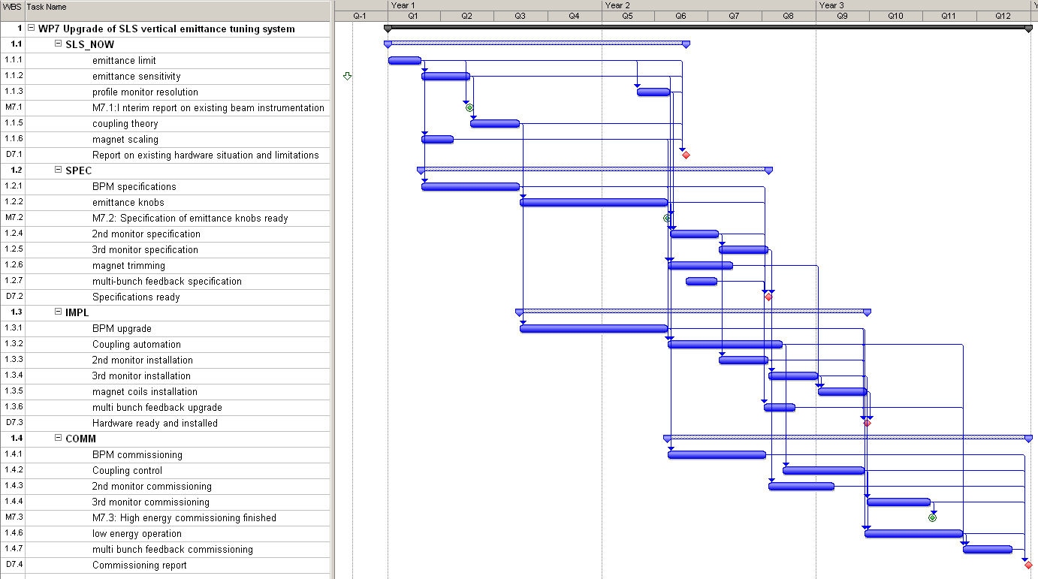
WP7 (SVET): Gantt chart

