Slide 1
WP3
Accelerator R&D Infrastructures
Oliver Brüning, CERN/BE-ABP
(reported by Erk Jensen, CERN/BE-RF)
Objectives: Integrating and optimizing the European infrastructures for accelerator R&D
The main objectives of WP3 are to make sure that the needs of a broad user community of accelerator R&D infrastructures are adequately taken into account in the construction and operation of the TIARA distributed infrastructure.
WP Coordinator: Oliver Brüning/CERN, deputy: Hans Braun/PSI
Partners: all (CEA, CERN, CNRS, CIEMAT, DESY, GSI, INFN, PSI, STFC, UU)

Slide 2

WP3: Tasks
Task 1: Survey the existing accelerator R&D infrastructures and those under development. Evaluation of the Capacities and Cost estimation of their utilization.
Task 2: Assessing the current, medium- and long-term accelerator R&D infrastructure needs (will require input from WP4 and WP6), Compare these needs with the existing infrastructure and Analyze discrepancies between the two.
Task 3: Definition of the appropriate Structure for ensuring the Sustainability of the evaluation and recommendations procedures within TIARA and determination of common Costing methods for the upgrade and construction of individual large infrastructures (including costing of full accelerator facility).
Task 4: Ensuring Access to the TIARA accelerator R&D Infrastructures.
Task 5: Joining the TIARA distributed accelerator R&D Infrastructure.

Slide 3
WP3 : Partners
CEA (Antoine Daël)
CERN (Oliver Brüning, WP coordinator)
CNRS (Bernard Laune)
CIEMAT (Angel Ibarra Sanchez)
DESY (Hans Weise)
GSI (Peter Spiller)
INFN (Franco Cerfelli)
PSI (Hans Braun, WP deputy coordinator)
STFC (Swapan Chattopadhyay)
UU (Roger Ruber)

Slide 4
WP3: Deliverables
^{[1]} CA for Consortium Agreement, C for Contract, GM for General Meeting, R for Report, P for prototype
^{[1]} R for Report, DB for Database
Deliverables
Num | Nat | Short name | Description | month
1 | R | ARA | Identification of key Accelerator Research Areas. (joint with WP4 & 6) | 3
2 | R | ISR | Infrastructure Survey Report (subtask 3.1.1). | 12
3 | DB | IWD | Infrastructure Web-based Database. | 16
4 | R | INR | Infrastructure Need and Resource comparison. | 24
5 | R | IAR | Infrastructure Access Report (task 3.4). | 24
6 | R | RUC | Report on potential Upgrades and/or Construction of New R&D Infrastructures in Europe. | 30
7 | R | JTI | Joining the TIARA distributed accelerator R&D Infrastructure and defining structures for sustaining and maintaining the Infrastructure data base. | 33

Slide 5
WP3: Accelerator Research Areas
Initial draft list ...
RF accelerating system test and development (cryogenic and room temperature)
Magnet test and characterization (cryogenic and room temperature)
Beam instrumentation
Beam physics
Advanced acceleration methods like plasma laser acceleration
Medical accelerator systems
High power targetry
Development, assessment and testing of radiation hard electronics and materials
Material research
Precision tooling and manufacturing
Alignment and survey techniques for precision alignment
…

Slide 6
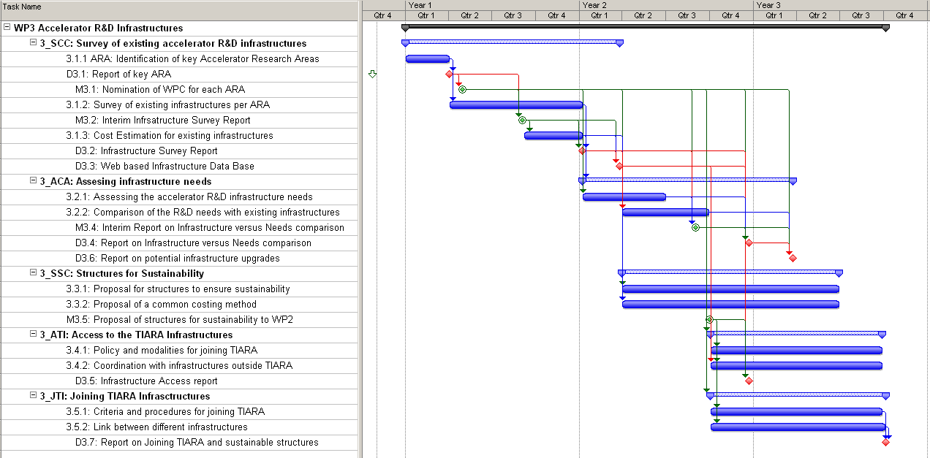
WP3: Gantt chart
input needed
from WP4,6
input needed
from WP4,6

