Slide 1

MICE RF System
Andrew Moss
ASTeC
Collaboration meeting CM29
15th - 18th February 2011

Slide 2
contents
TIARA milestones
High power amplifier testing
  Results so far
  Next steps
  Plan
Hall layout
  First attempts of CAD modelling
  Optimisation
  plan

Slide 3
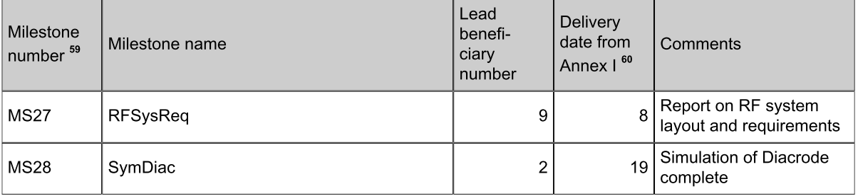
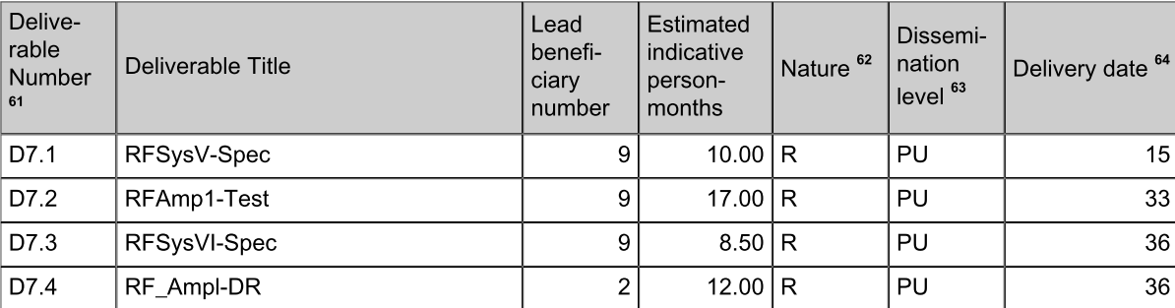
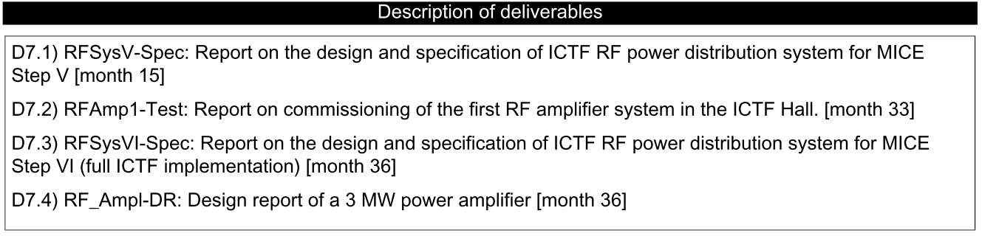
TIARA deliverables and milestones

Slide 4
Amplifier status
First medium power (300kW) amplifier and power supply system tested 2008
Refurbishment and rebuild of first high power (2MW) amplifier complete October 2009
Power supplies for first 2MW amp operational
Two further 300kW amplifiers awaiting repair
Two refurbished 2MW CERN amplifiers partly tested, awaiting assembly and high power test
Still need to build 3 more sets of power supplies
One more 300kW amplifier to buy/acquire

Slide 5
RF system components
Master Oscillator
Controls etc
DL Test System
At present
Not found
Auxiliary Systems
300 kW Amplifier
300 kW Amplifier
300 kW Amplifier
300 kW Amplifier
Auxiliary Systems
HT Supplies
2 MW Amplifier
2 MW Amplifier
2 MW Amplifier
2 MW Amplifier
HT Supplies
Daresbury
LBNL
CERN
201 MHz Cavity Module
201 MHz Cavity Module

Slide 6
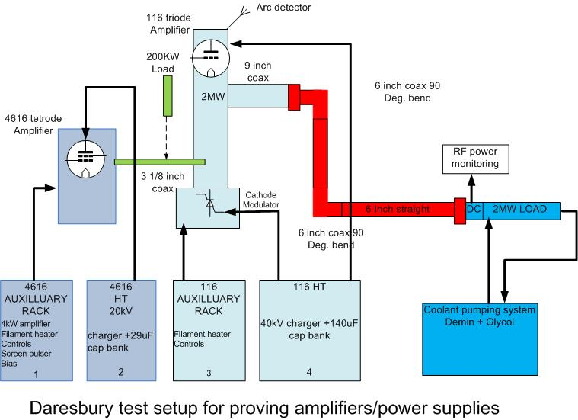
Test system at Daresbury

Slide 7
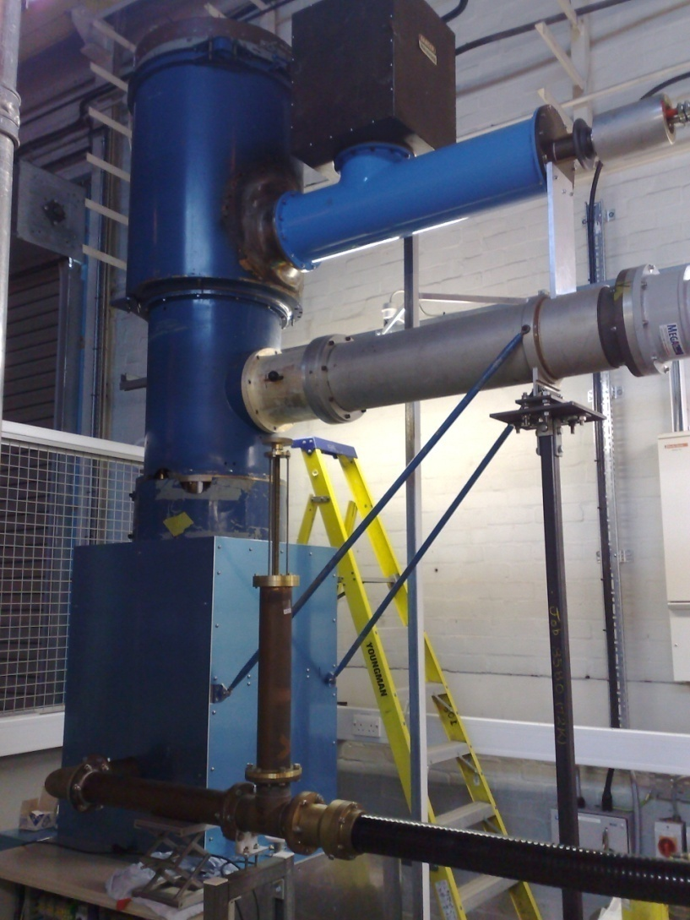
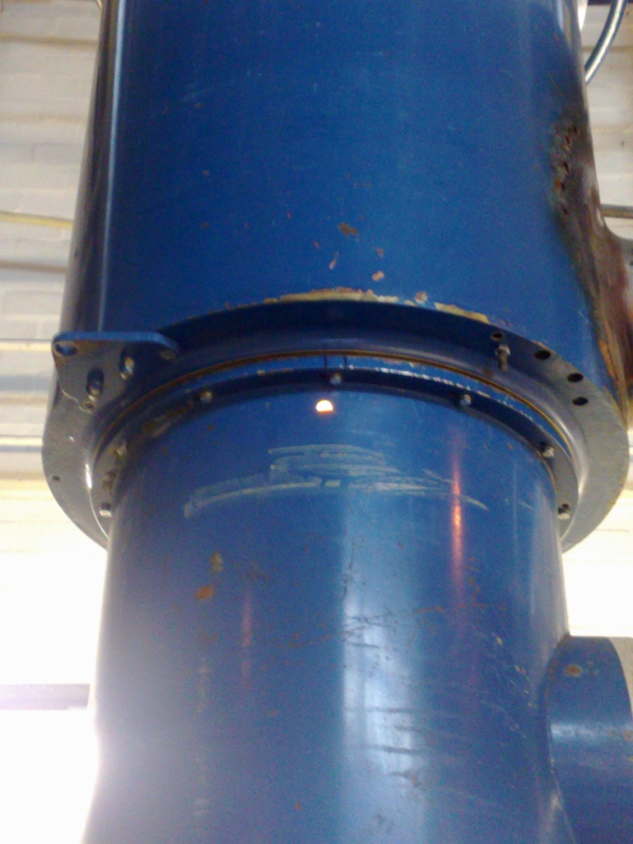
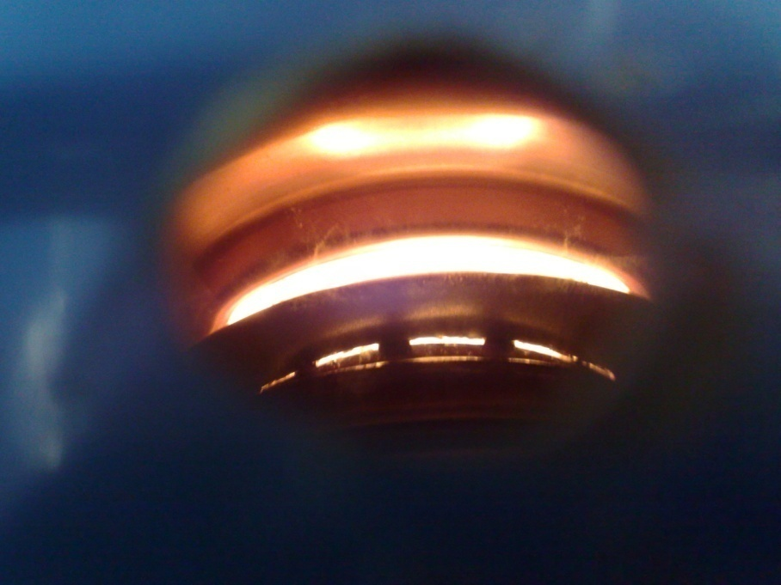
High power amplifier status
Final electrical checks September 2010 – crowbar/cathode modulator systems
Amplifier connected to test load via coax
Filament test to 500A on tube

Slide 8
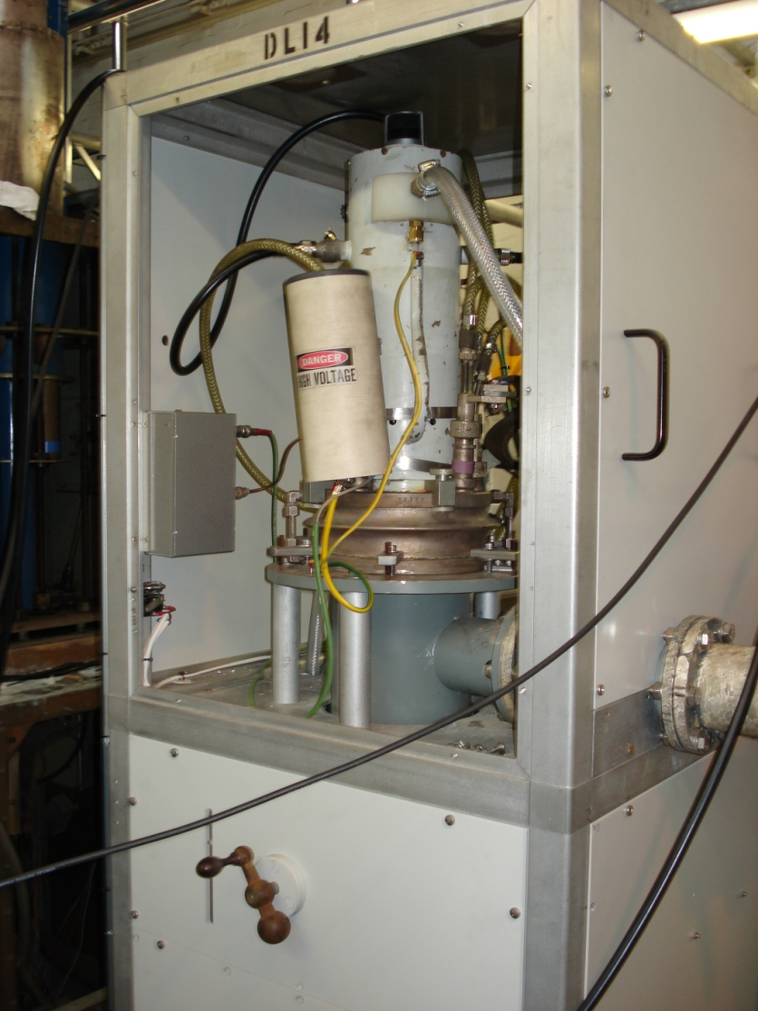
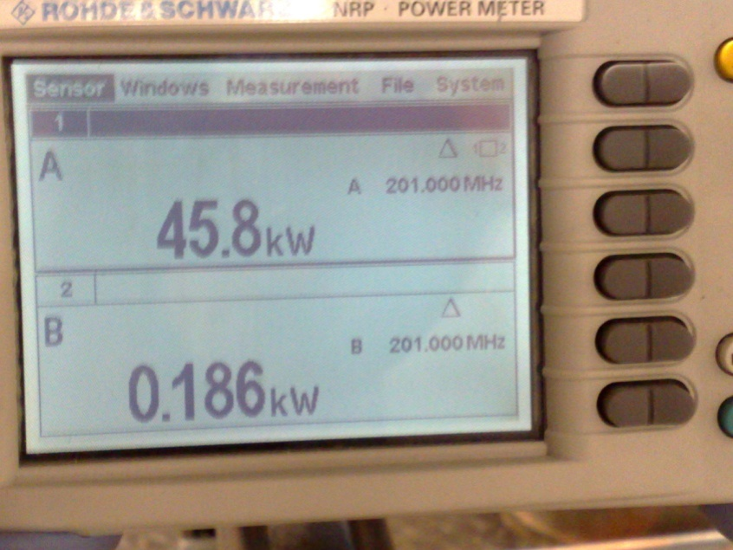
4616 medium power amplifier
4616 pre amplifier set up on matched test load
system has old LBNL tube installed, new ones in stock
System operated at 70kW into load, gives us a known starting point to run into the 2MW amplifier system

Slide 9
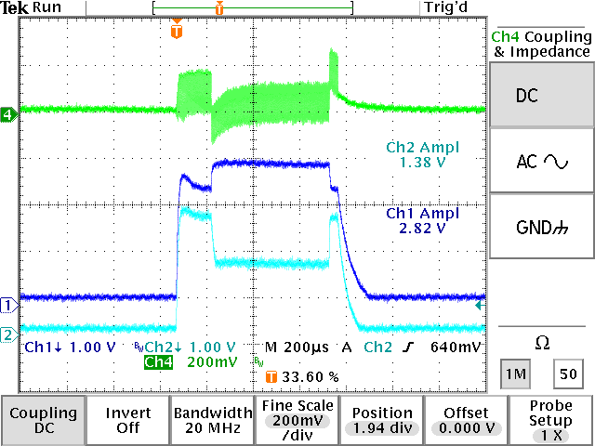
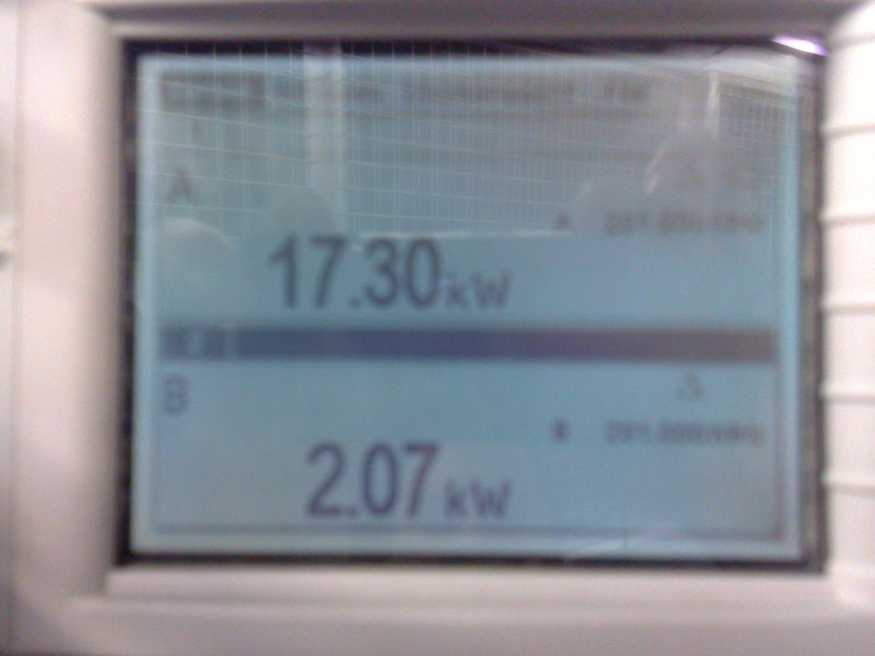
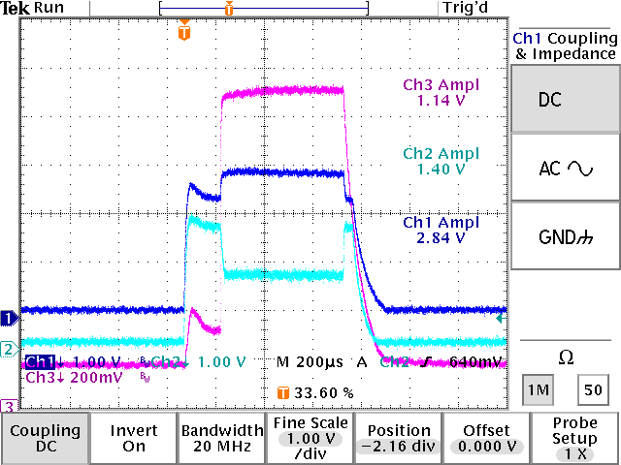
Initial testing
4616 connected into input of main 116 amplifier
High reflected power issues immediately, looked to be reflecting 50 % of power
However match of input changes with heating, RF drive level, HT applied and cathode modulator switching on, after playing with the system tuning match got much better (10th reflected power may still be a problem though)
RF diode traces a great diagnostic to see immediate changes in response (1Hz) operation as power meters slow to update at low rep rate
116 forward
4616 forward
reflected

Slide 10
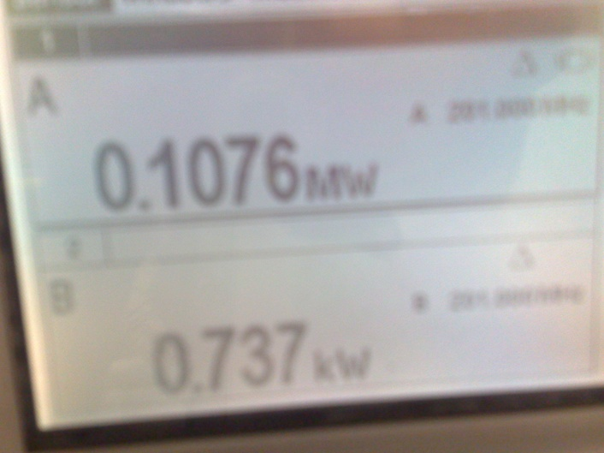
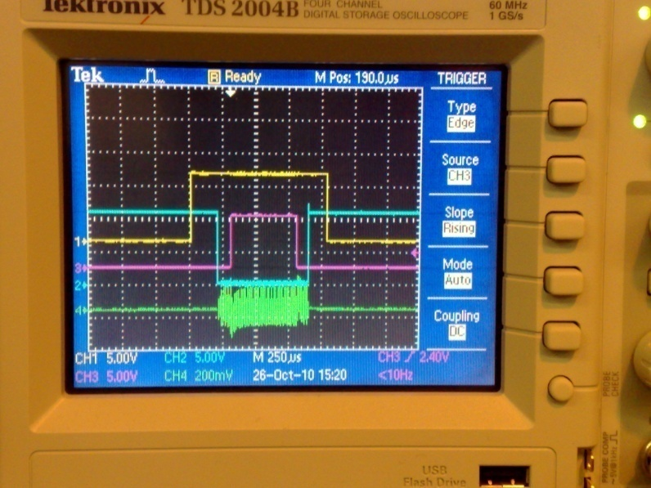
116 amplifier testing
So far testing has been relatively un dramatic and system very quickly up to 100kW output for 10kW input
Old ISIS tube installed while we learn how to operate the system
Sudden oscillation possible, can see diode traces change dramatically when this happens
lots of RF noise on all earth systems causing interlocks to fire at 160kW, gradually going around the power supply fixing these issues
Discussions with ISIS linac team have indicated that the amplifier looks to be working correctly, suggested a method for tuning up the system. HV bypass capacitors have been fitted on main cap bank to aid in noise reduction
Forward

Slide 11
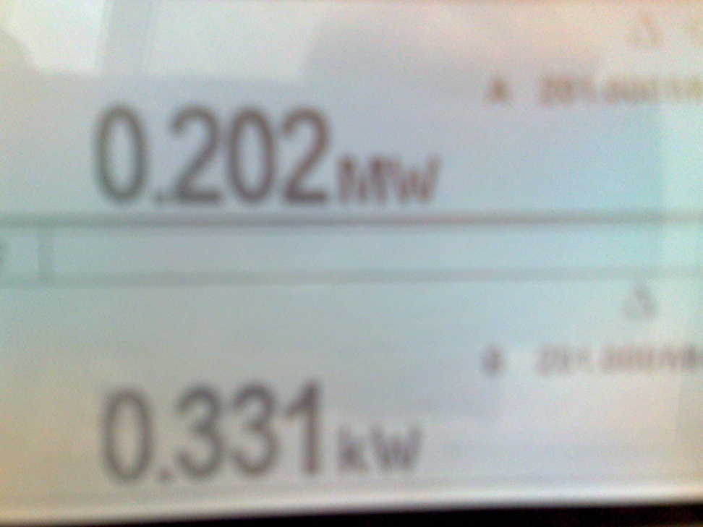
RF and power supply testing this week
System pushed to 200kW RF output by driving input very hard
Tests on crowbar circuit have revealed that at HV level of 23kV system starts to have breakdown issues inside power supply
Testing with a current limited (1mA) power supply to find cause of breakdown will commence
Forward power into load

Slide 12
Further 116 testing
HV issues are the are the major obstacle to reaching high power in this system at the moment, could also be some self oscillation in the circuit, lots more to understand
Old ISIS tube showing gain of 10 which is to be expected, should be useful up to 1MW
Will then swap to a new 4616 and new 116 to push system harder
So far the amplifier system seams very well behaved at up to 22kV and 200kW, however a long way to go yet !

Slide 13
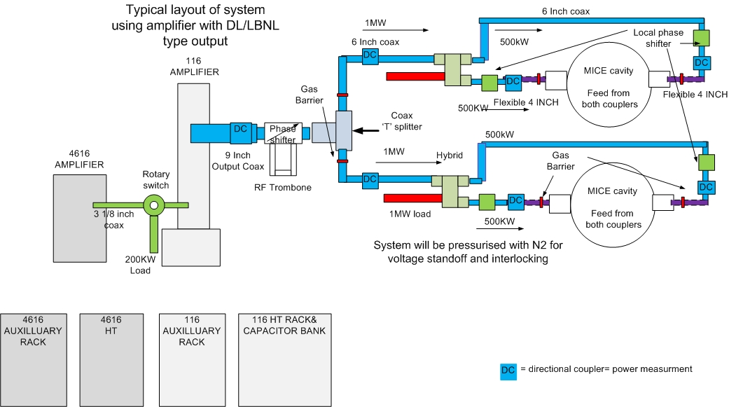
Predicted hall layout for RF components

Slide 14
Coax design
Coax system will use large phase shifter to make amplifier immune to reflected power issues
Hybrid power splitters to divide power before each cavity with a rejection load, this should provide a robust reliable system
Local phase shifters in each cavity coupler, small range available only, so need to plan coax system carefully to get phase lengths within range at the cavity input couplers
Power monitoring in each section of coax will be linked in to RF control system so that issues can be flagged before faults occur
Nitrogen gas pressure system with the coax for voltage stand off and interlock
Plan to have the ability to connect test loads in place of cavity to test amplifier/coax system in its complete configuration

Slide 15
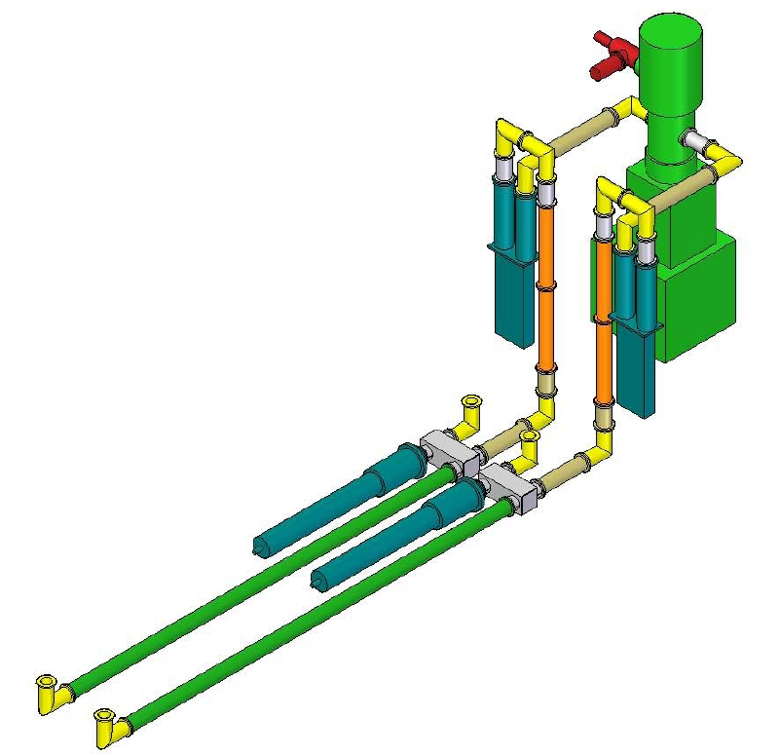
Tim Hayler, Alan Grant and Alan Muir
have been doing CAD layouts
CERN amplifier
Trombone phase shifter
Hybrid power splitter
RF load
Outputs to cavity

Slide 16
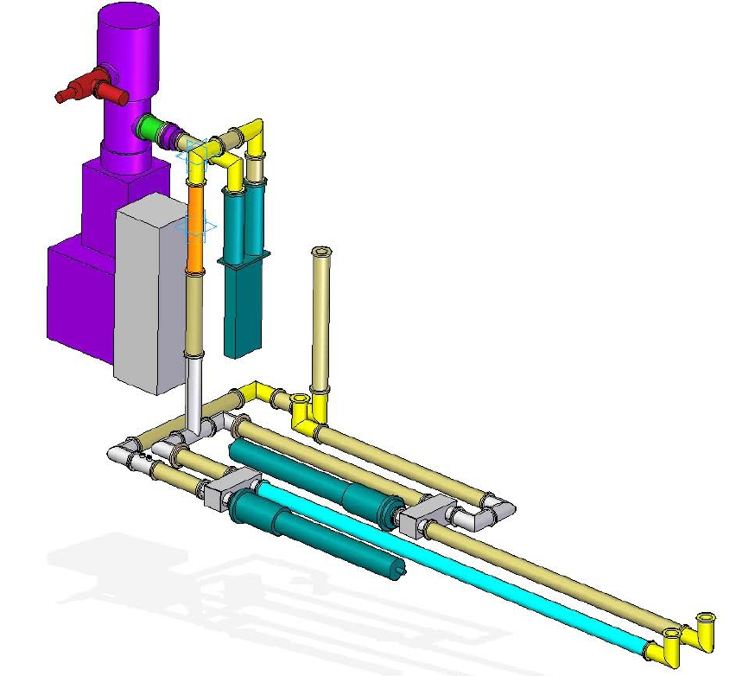
Berkeley amplifier
Trombone phase shifter
Hybrid power splitter
Outputs to cavity
RF load

Slide 17
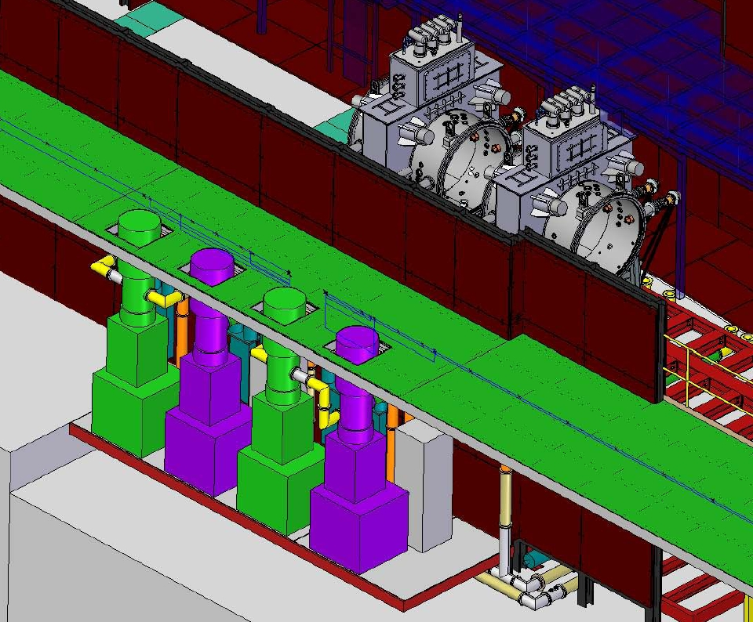

Slide 18
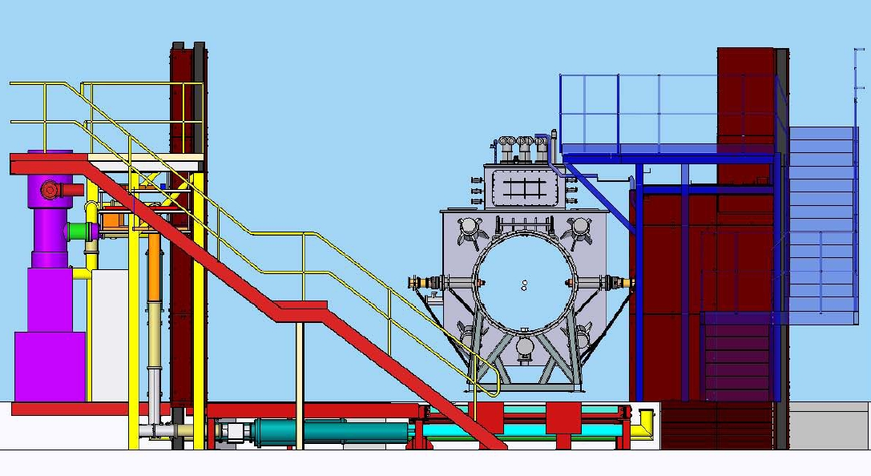

Slide 19
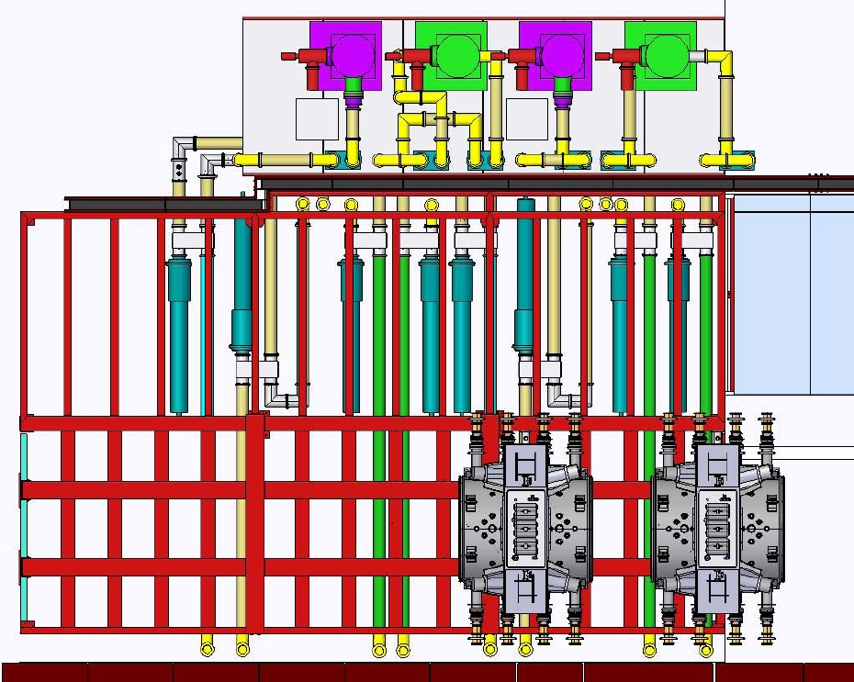

Slide 20
Layout optimisation
Try to get as much of the complex RF devices out from under the floor so that floor does not need to be lifted if there is a problem
Still need space around amplifiers to work on them
trombone phase shifters behind shield wall freed up a lot of space
move feeds to cavity couplers as close as possible to under the required port
‘flexible’s’ up from floor to cavity couplers will be able to be removed so RFCC can be moved
Tiara report on RF system layout and requirements due 6 months into project, Design and specification report at 12 months

Slide 21
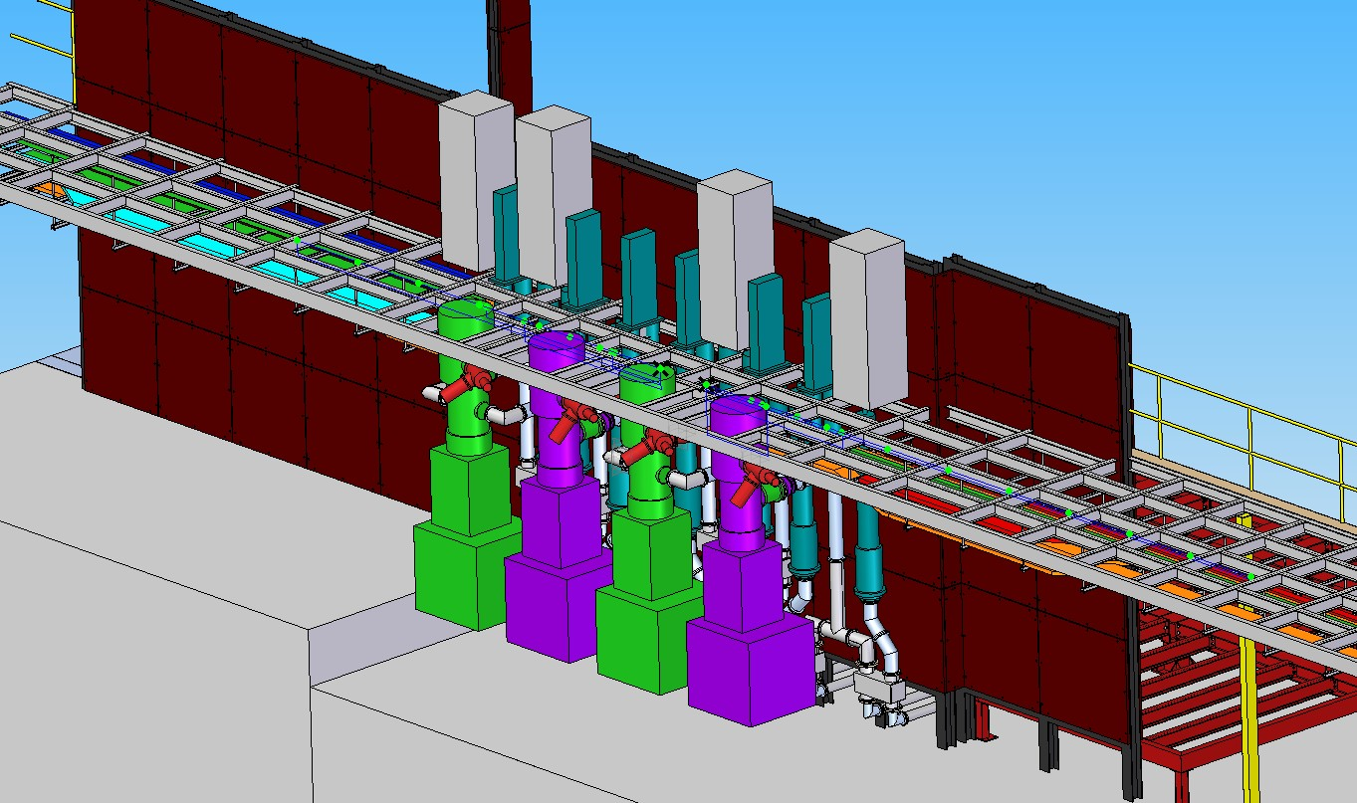
4616 amps

Slide 22
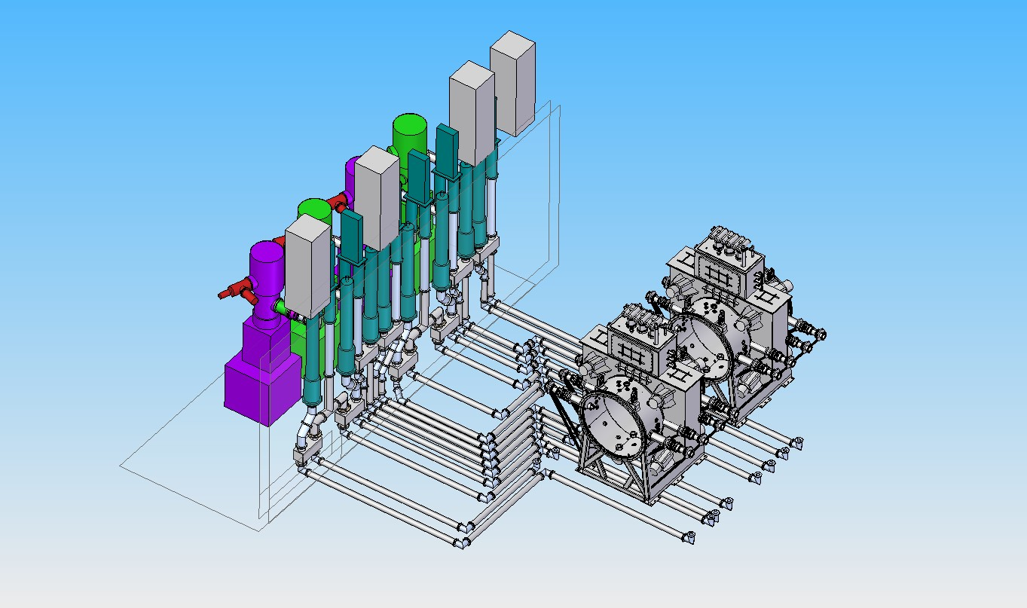
Hybrids and RF loads all behind shield wall
RF outputs below RFCC inputs

Slide 23
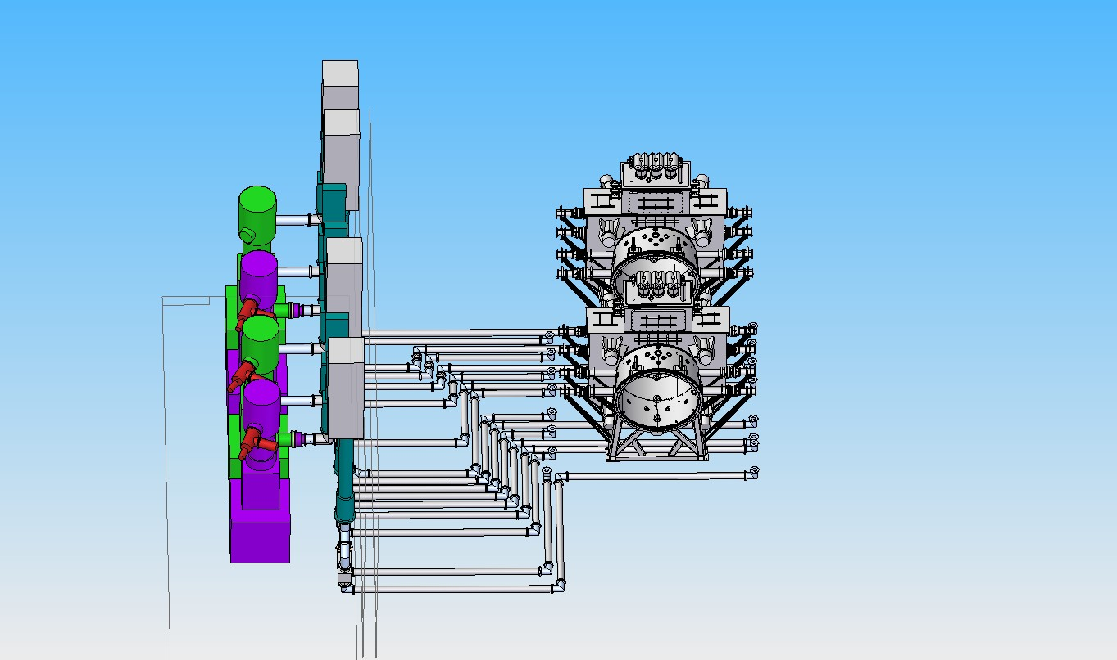

Slide 24
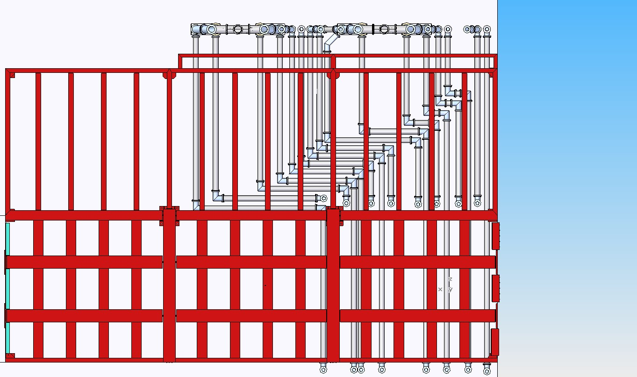

Slide 25
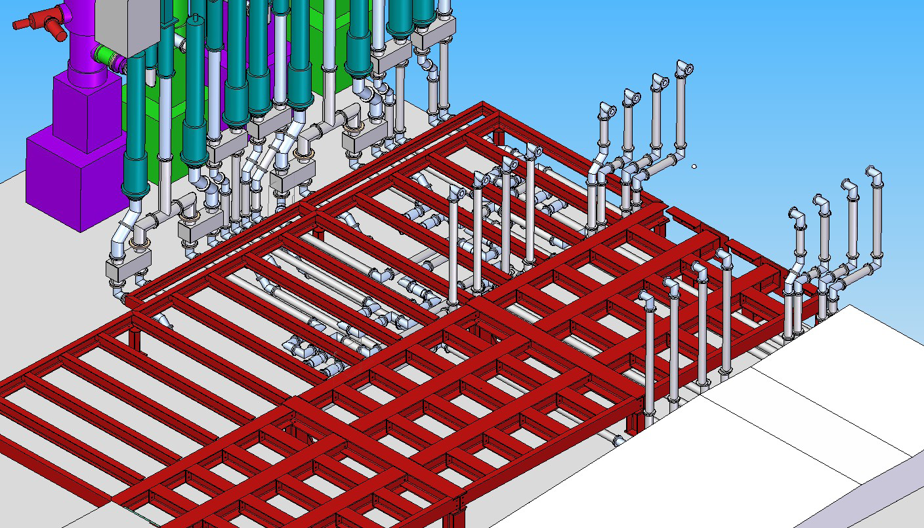

Slide 26
Layout further work
Need to match lengths of coax from hybrid splitters to cavity inputs for phase addition
These can be in 4 inch coax to save space
Smaller RF loads found, can be designed to our specification
Will add small phase shifters into these lines to take out small errors
N2 pressurisation to be discussed, cavity inputs may need this anyway for voltage standoff, interlock if something goes wrong in the couplers/coax
Write specification for coax system to purchase

Slide 27
Plan
Complete tests on current amplifier and then ship to MICE
Build up first CERN amplifier to working system and begin tests early 2011
Test digital LLRF on amplifier system
Build up next set of power supplies and transfer into test system, send current power supplies to be installed in MICE hall
Complete design of RF components from amplifier to cavities and procure

Slide 28
Thanks to
Tim Hayler, Alan Grant, Alan Muir for their work on the layout
Mark Keelan and Alan Letchford for help with the amplifier systems

