Slide 1
TIARA WP 7
Ionisation Cooling Test Facility (ICTF)
Task 7.2
Novel Pulsed RF Power Amplifier Design

Slide 2
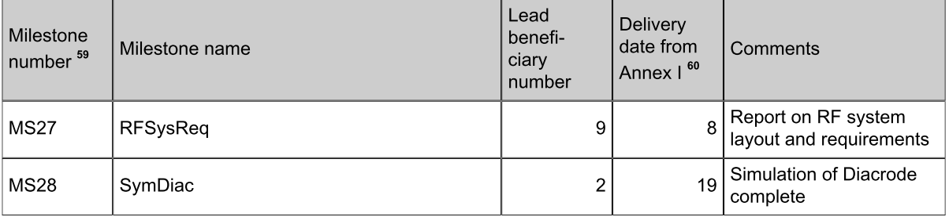
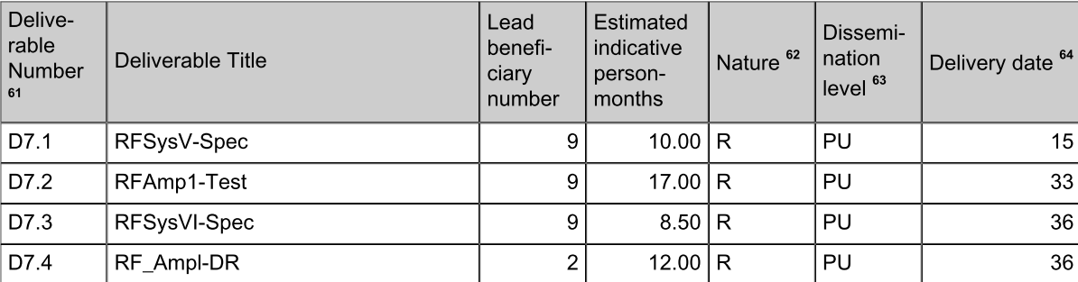
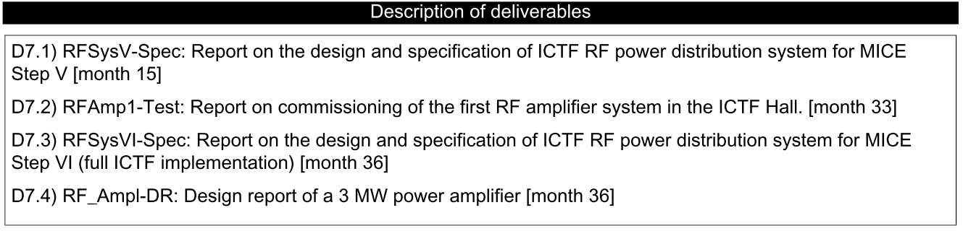
TIARA milestones and deliverables:

Slide 3
Alternative 201 MHz 3 MW pulsed power amplifier
Existing ICTF power amplifiers based on relatively old technology
Sufficient tubes procured, but will be discontinued
Future multi-megawatt RF power system will have to use more modern tubes
For ICTF to serve ionization cooling R&D program, it is essential to develop an alternative 201 MHz RF power source
Diacrodes are a possible solution
Objective of task 7.2 is a Design Study of a 3 MW pulsed power amplifier based on Diacrode tube
Fully exploit synergy since similar RF systems may be required at many other facilities (CERN’s SPS, RAL’s ISIS,…)

Slide 4
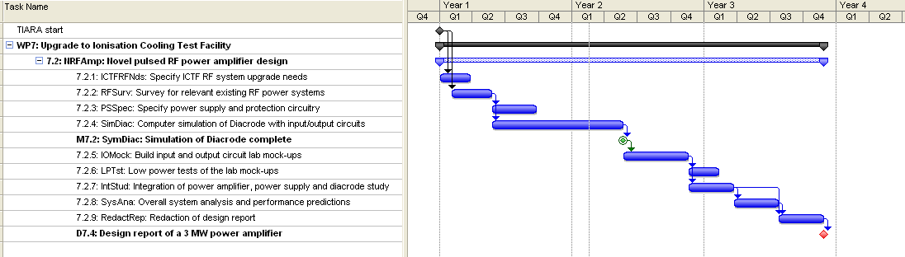
Summary tasks and milestones
6 months : Specification of the needs
18 months (M7.2) : Computer simulation of a Diacrode amplifier
25 months : Low power Mockups tests
36 Months (D7.4) : Design reports including
    Simulations and mockups tests results
    Integration study, HVPS and Amplifier
    Performance prediction

