Slide 1


Slide 2

TIARA WP7:
Ionisation Cooling Test Facility

Slide 3
Contents:
Muon accelerators for particle physics
Ionisation cooling
Muon Ionisation Cooling Experiment
Developing a facility
[the Ionisation Cooling Test Facility]
TIARA WP7

Slide 4
Muon Accelerators for Particle Physics
Ionisation Cooling Test Facility:

Slide 5
The Neutrino Factory:
Optimise discovery potential for CP and MH
  Requirements:
    Large ν_{e} (ν_{e}) flux
      Detailed study of
      sub-leading effects
All channels available
at the Neutrino Factory

Slide 6
The Neutrino Factory:
Optimise discovery potential for CP and MH
  Requirements:
    Large νe (νe) flux
      Detailed study of
      sub-leading effects
    (Large) high-energy
    ν_{e} (ν_{e}) flux
      Optimise event rate at
      fixed L/E

Slide 7
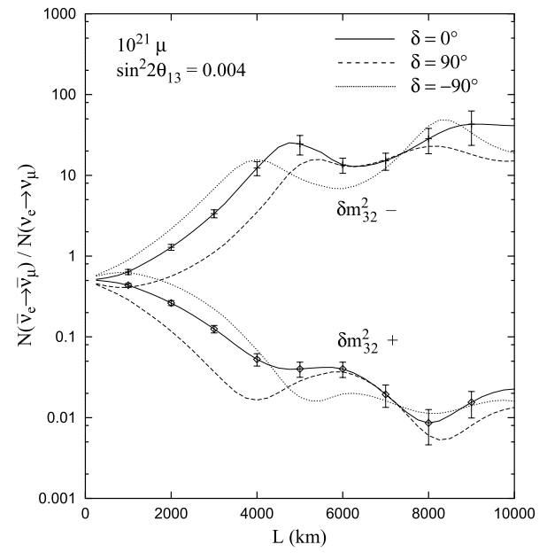
Risk avoidance: the Neutrino Factory:
Optimise discovery potential for CP and MH
  Requirements:
    Large νe (νe) flux
      Detailed study of
      sub-leading effects
    (Large) high-energy
    ν_{e} (ν_{e}) flux
      Optimise event rate at
      fixed L/E
      Optimise MH sensitivity
      Optimise CP sensitivity
CERN-2004-002

Slide 8
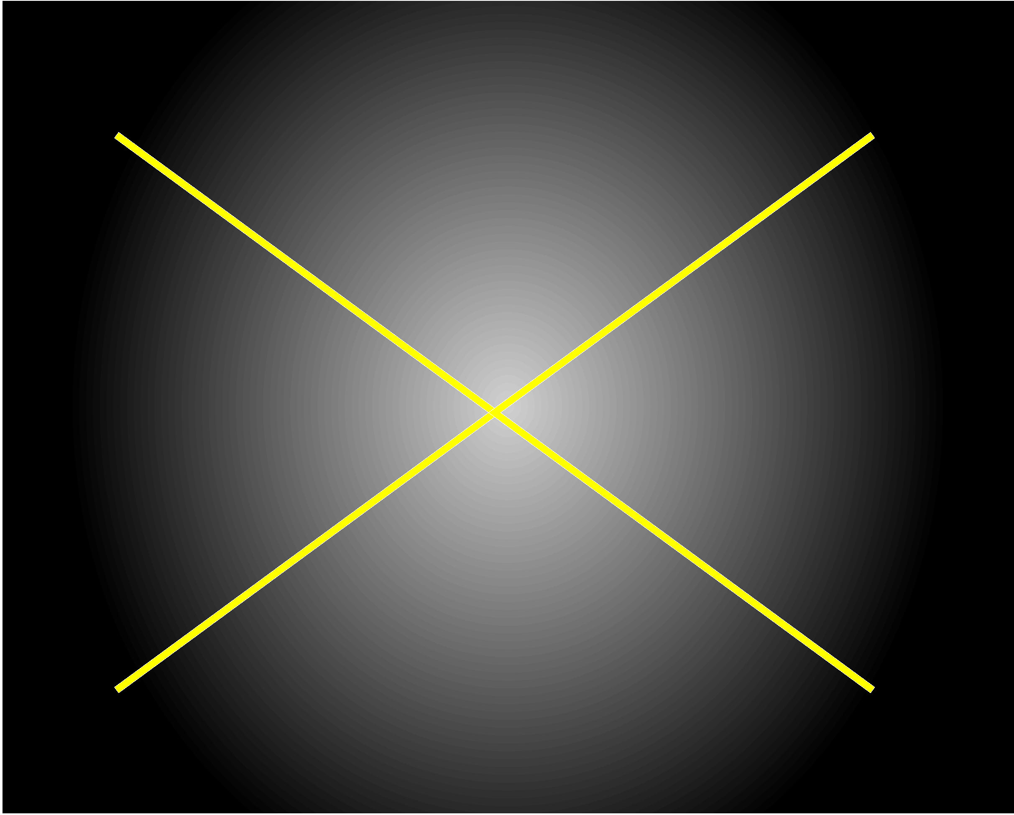
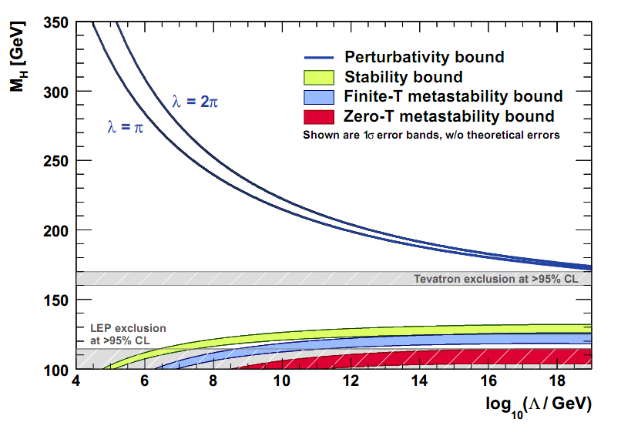
Standard Model issues: Theoretical:
Fits to precision measurements require the Higgs
  But it has not been seen … YET …
    … that is the exciting task of the LHC collaborations!
Standard Model Higgs mechanism:
  a description, not an explanation!
    … an explanation requires a deeper theory!
Higgs mass in SM ‘troublesome’
  Unless 130 < M_{H} < 170 GeV
  expect
  ‘new physics’
  at low energy
J. Ellis, J.R. Espinosa,
G.F. Giudice, A. Hoecker, and A. Riotto

Slide 9
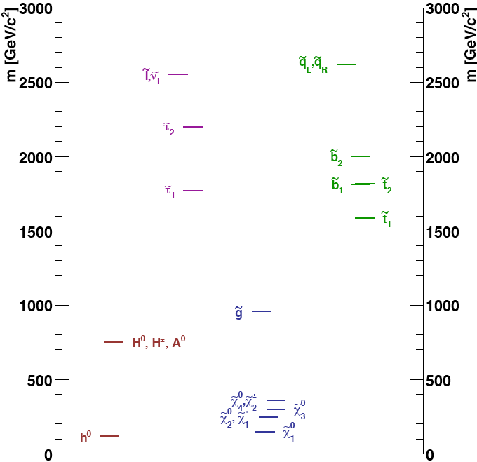
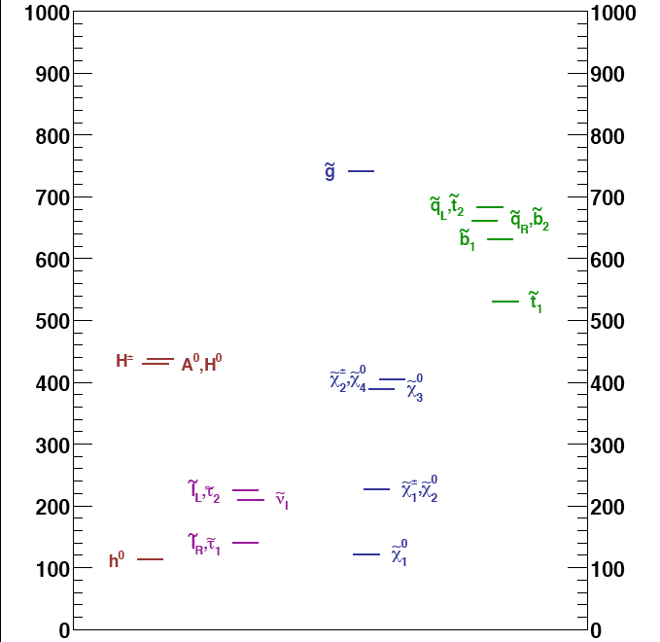
l⁺l– at high energy: the surgeon’s knive!
LHC discovers ‘tower of states’:
  Require l⁺l– collider to ilucidate details
High Mass SUSY
Low Mass SUSY
No idea of SUSY mass scale:
  Implies need option for multi-TeV l⁺l– collider

Slide 10
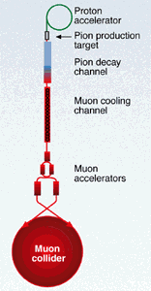
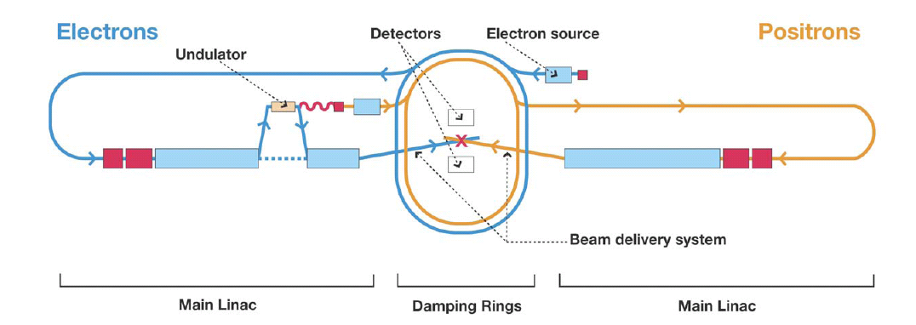
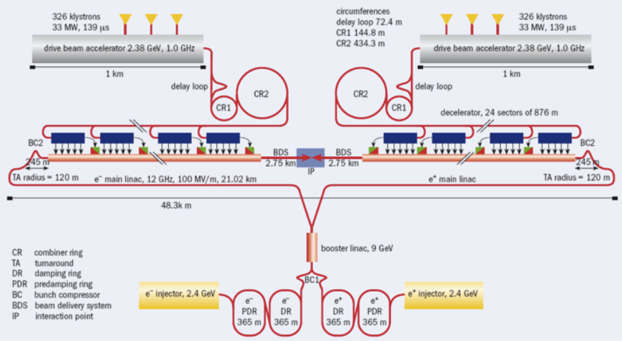
l⁺l– colliders: options:

Slide 11
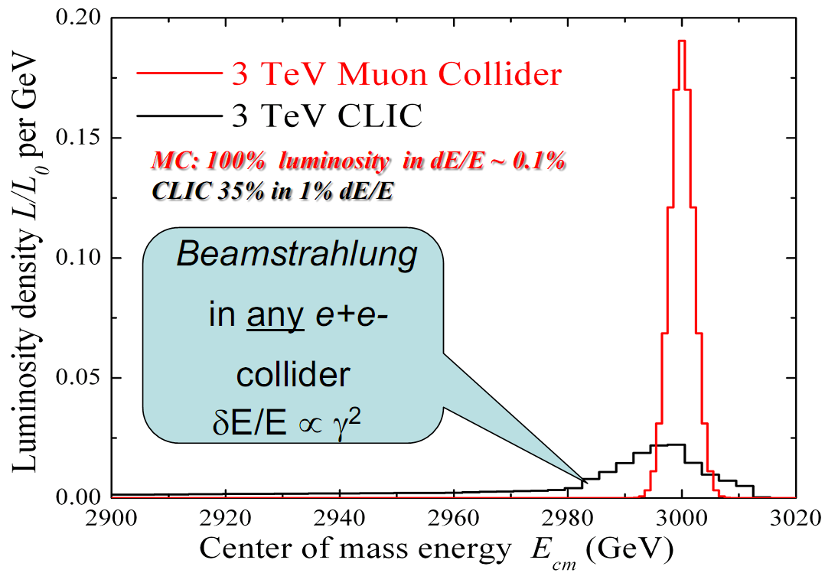
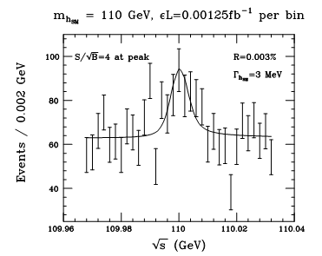
Muon Collider: basis of advantages:
Muon mass: 106 Mev/c² Electron mass: 0.511 MeV/c²
Consequences:
  Negligible synchrotron
  radiation at Muon Collider:
    Rate ∝ m⁴:
    ⇒ Muon Collider reduction
    factor: 5 × 10⁻¹⁰
    Compact, circular, accelerator
    Small energy spread
    Possible to preserve
    polarisation
    at ~30% level
      Yields possibility to determine
      beam energy precisely (0.003%)
      using (g – 2)
      precession
  Strong coupling to Higgs:
    Production rate ∝ m²:
    ⇒ Muon Collider enhancement
    factor: 5 × 10⁴
    Large data set allows branching
    ratios to be measured
100 pb⁻¹

Slide 12
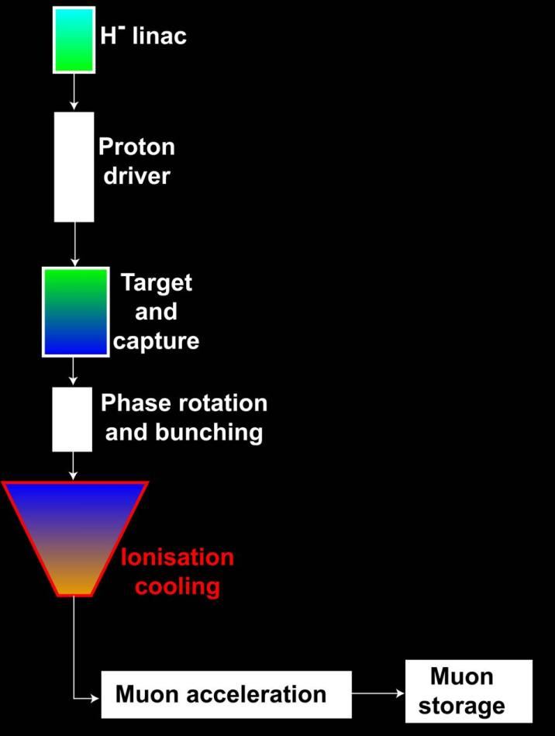
Muon accelerators for particle physics:
Muon Collider
Neutrino Factory
Muon
physics
Muon
physics

Slide 13
Ionisation cooling:
Ionisation Cooling Test Facility:

Slide 14
Ionisation cooling:
Muon beam after phase rotation and bunching:
  Wide — σ_{x} ~ 10(+) cm
  Divergent — σ_{θ} ~ 150(+) mr
  i.e. large normalised emittance:
Cooling required:
  To increase by a factor of 2—10 the number of muons in acceptance of subsequent accelerator
Ionisation cooling is the only practical solution:
  Muon lifetime is short (2 μs at rest)

Slide 15
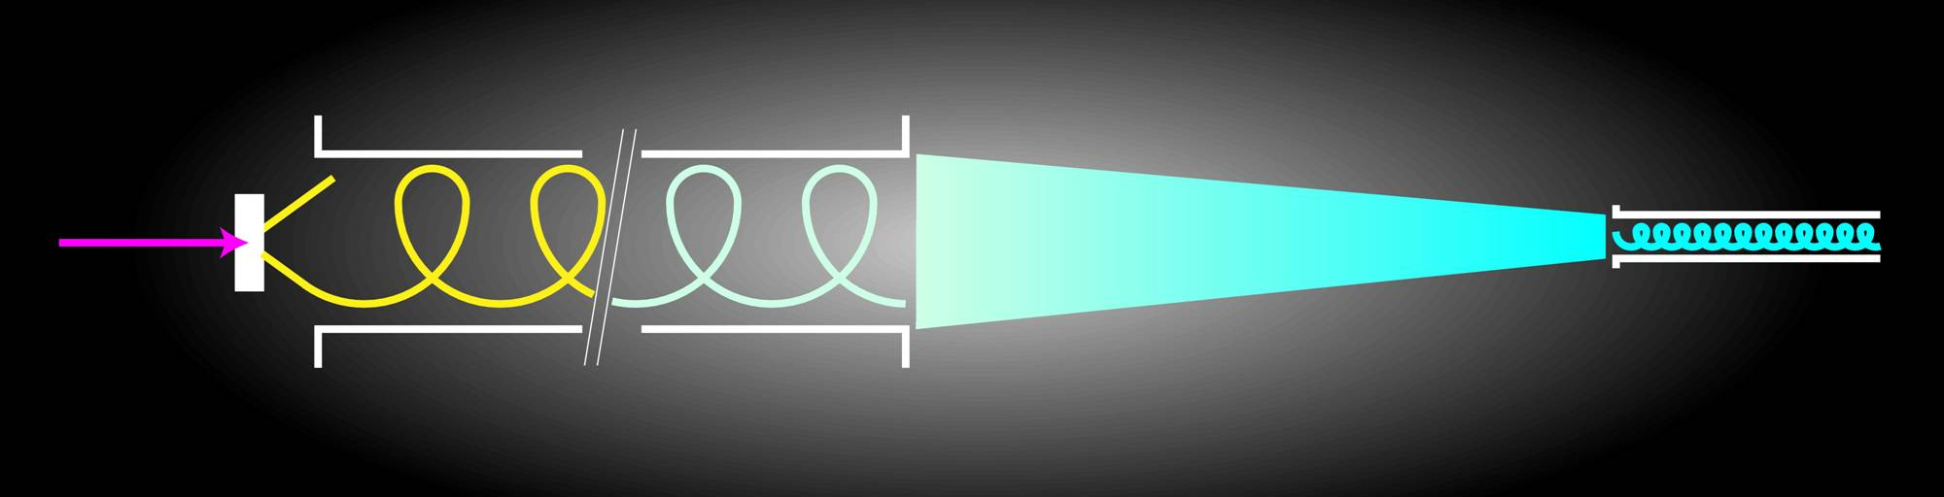
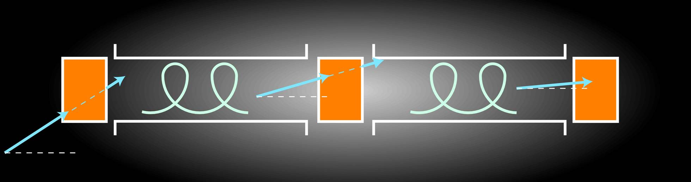
Ionisation cooling:
Proton
Cooling
Liquid hydrogen
absorber
Accelerate
Accelerate
Ionisation cooling

Slide 16
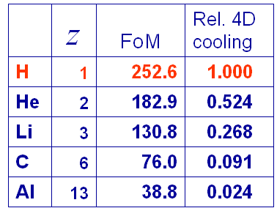
Ionisation cooling: principal:
Exponential decrease in normalised emittance:
Competition between:
  dE/dx [cooling] and MCS [heating]
Optimum:
  Low Z, large X₀
  Tight focus
  H₂ gives best
  performance

Slide 17
Muon Ionisation Cooling Experiment
Ionisation Cooling Test Facility:

Slide 18
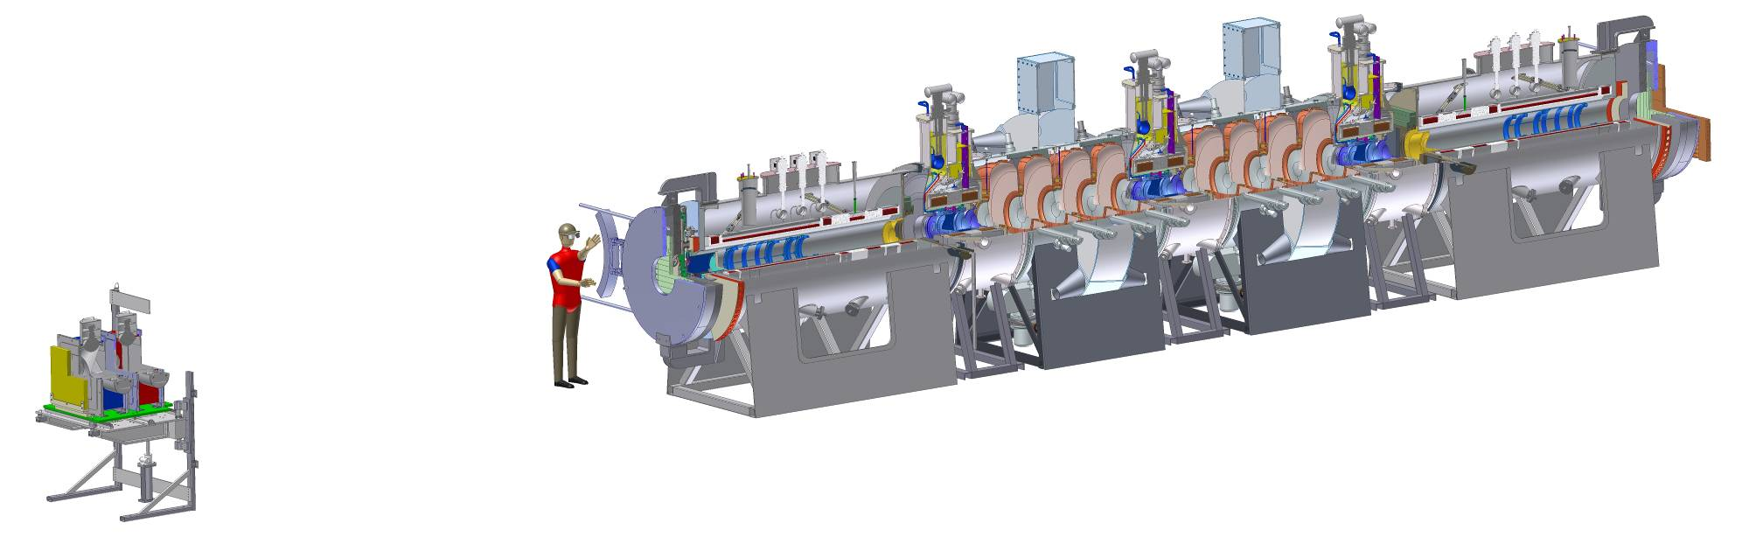
Muon ionisation cooling experiment
MICE:
  Design, build, commission and operate a realistic section of cooling channel
  Measure its performance in a variety of modes of operation and beam conditions …
  … i.e. results will allow Neutrino Factory complex
  to be optimised

Slide 19
Cooling performance:
15% cooling in MICE channel from 5% E loss per absorber

Slide 20
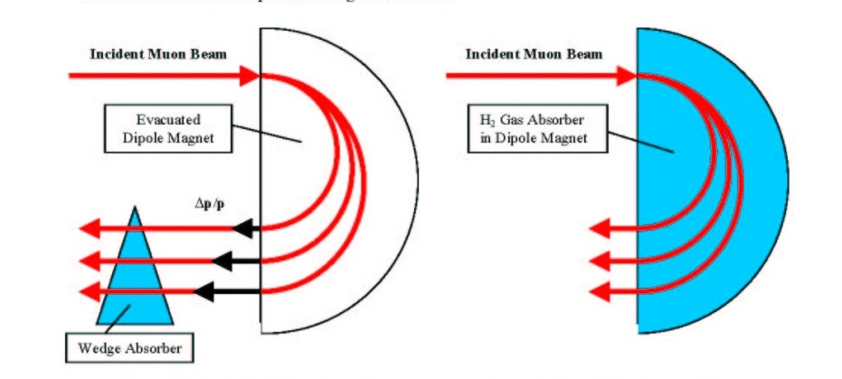
Ionistion cooling and the Muon Collider:
Muon Collider requires much more aggressive cooling:
  Must reduce emittance in all 6 phase-space dimensions
  Requires ‘emittance’ exchange
  The most challenging R&D programme for the Muon Collider

Slide 21
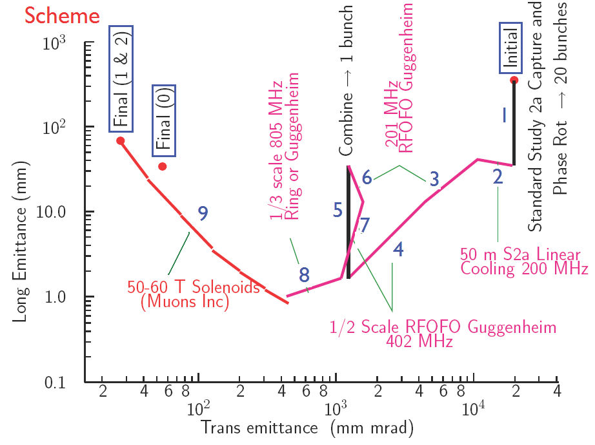
6D cooling scheme:
Initial cooling identical to Neutrino Factory

Slide 22
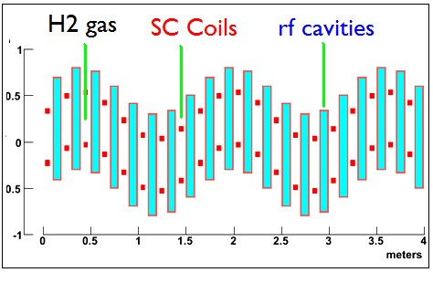
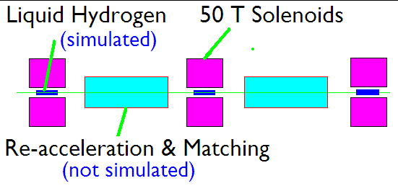
6D cooling scheme components:
Guggenheim
Helical cooling channel
6D ionisation cooling experiment under discussion:
  Possible use of MICE Muon Beam once MICE is complete
  Critical issue: high-gradient RF in magnetic field
Final cooling

Slide 23
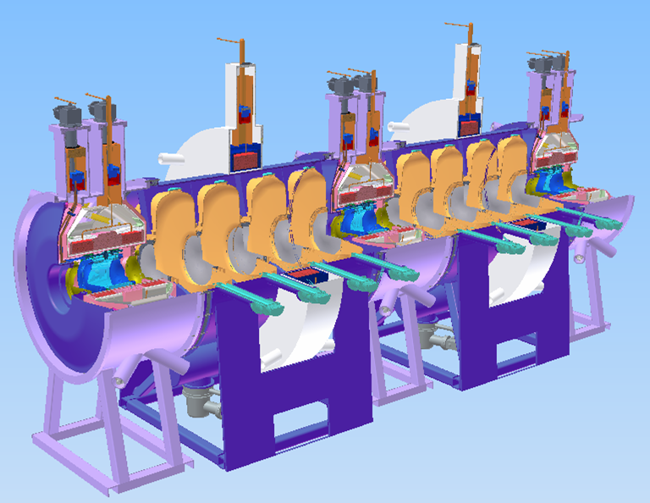
Cooling channel:

Slide 24
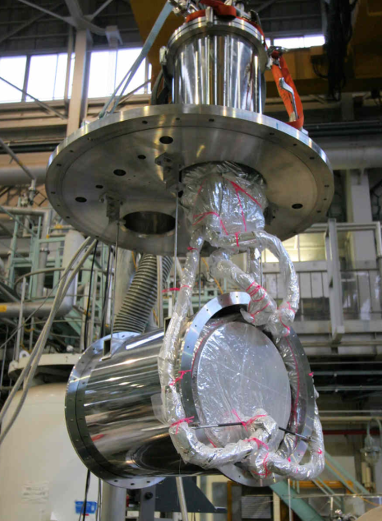
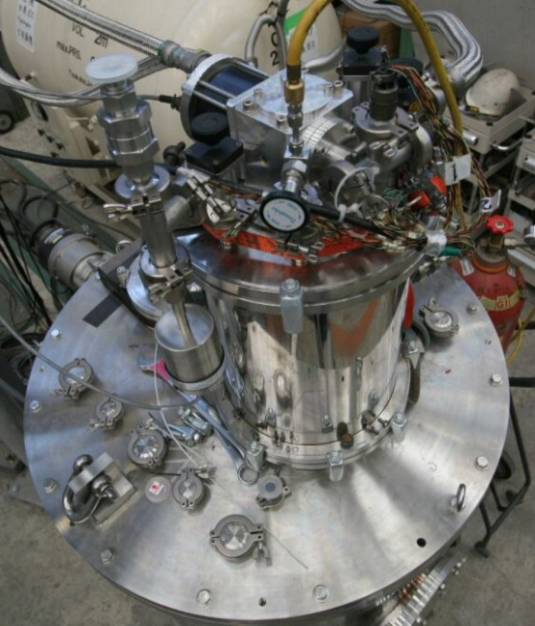
Absorber/focus-coil module:
Oxford, RAL,
KEK, Mississippi
Focus coil module:
  Under construction at TESLA
  Presently preparing for winding first set of coils
  First module, fall 2011
Absorber:
  Prototype tested at KEK
  Production underway:
    Will match (be ahead of!) focus-coil schedule
  Windows in production at Mississippi

Slide 25
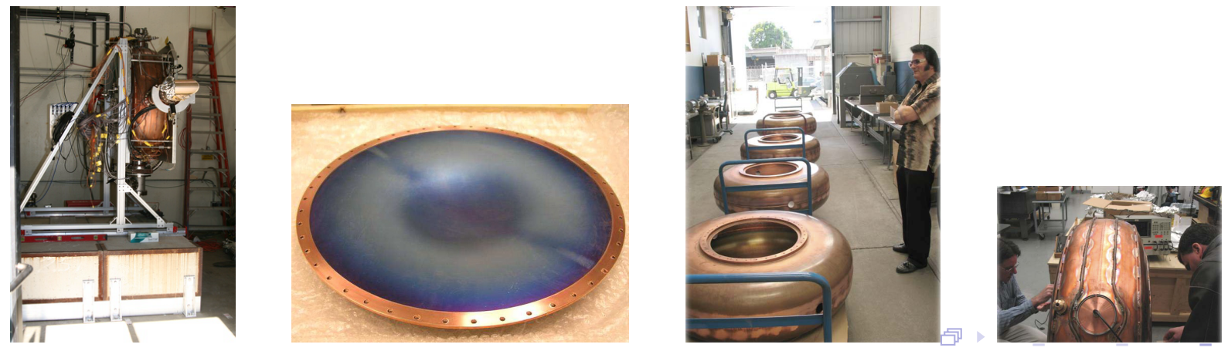
RFCC module: cavities:
LBNL
Design based on MuCool prototype:
Production presently ahead of schedule:
  Two sets of five cavities received:Suf
  Addition of ‘features’ underway
  Electropolishing in preparation

Slide 26
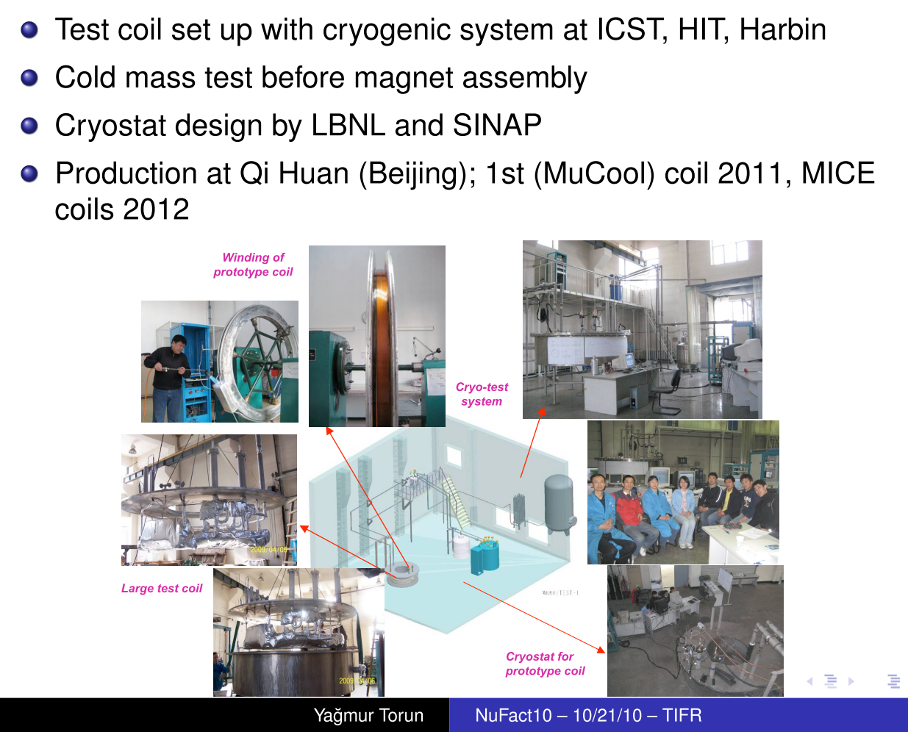
RFCC module: coupling coil:
LBNL, ICST

Slide 27
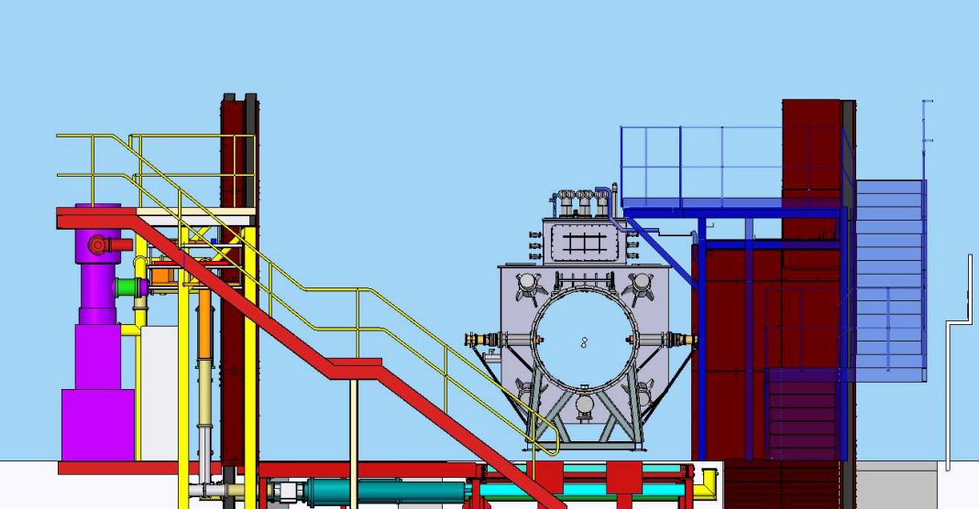
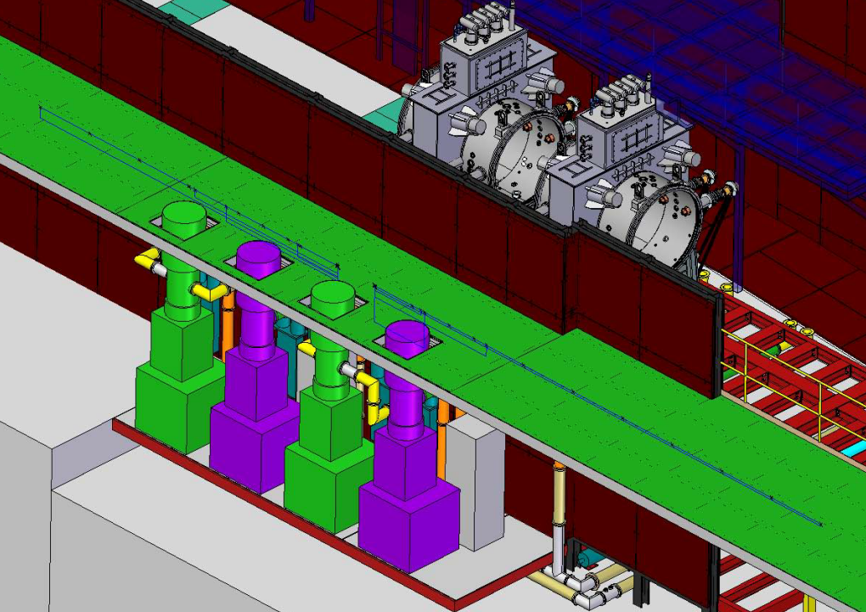
RF power infrastructure:
Layout of RF-power distribution:
  Development of RF power-distribution layout underway:

Slide 28
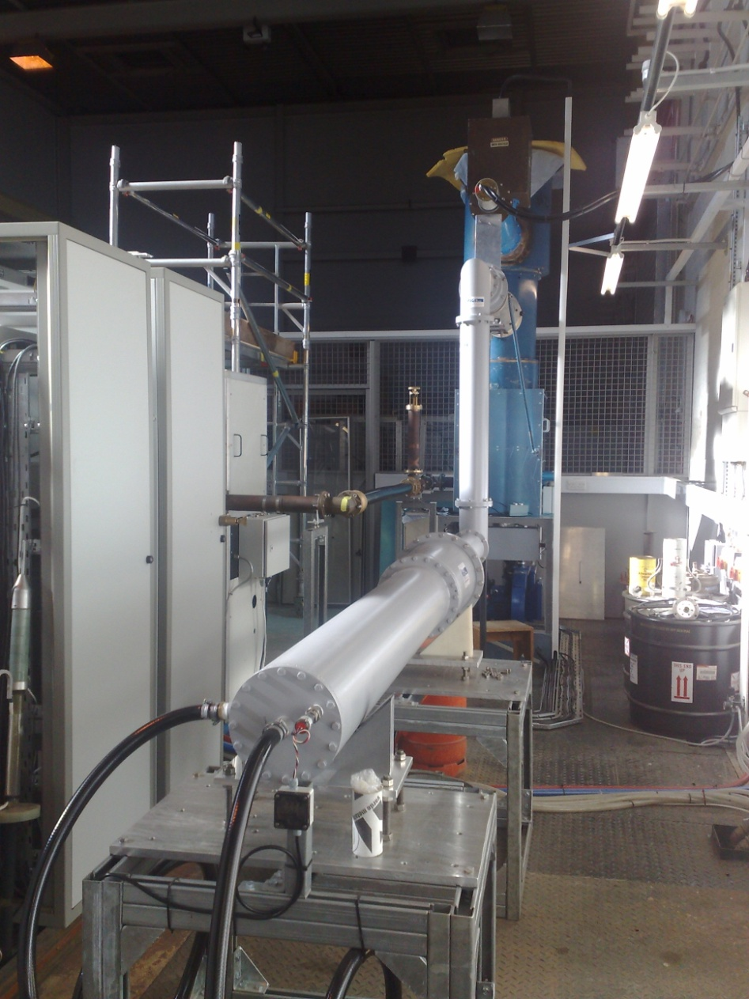
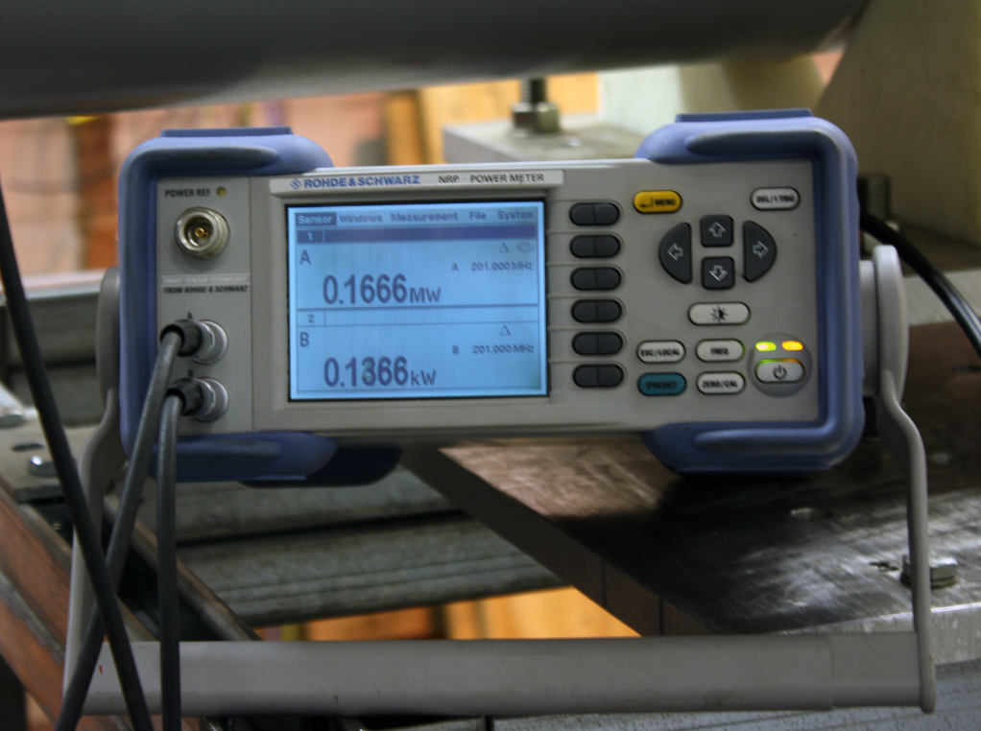
RF power infrastructure:
Commissioning of RF power amplifier:
  Steady progress in
  commissioning before
  Christmas, now picking
  up again

Slide 29
Developing a facility:
Ionisation Cooling Test Facility:

Slide 31
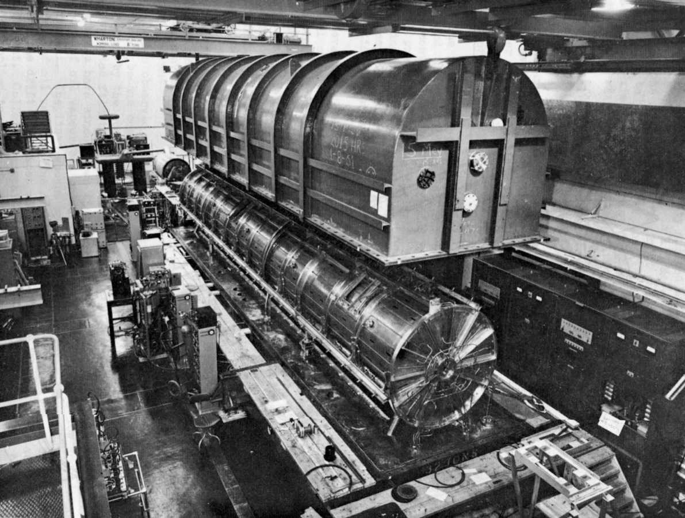

Slide 32
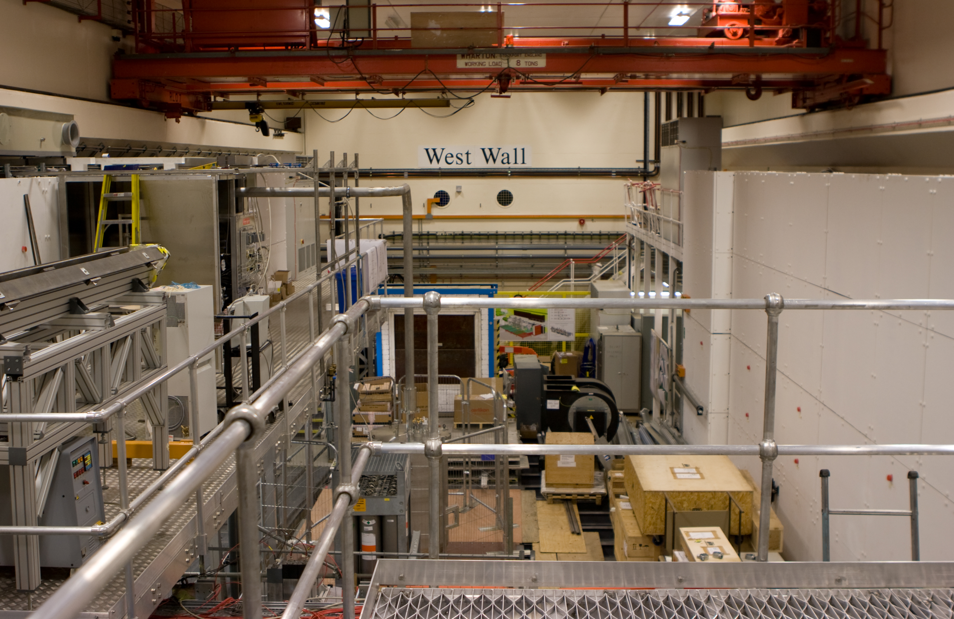

Slide 33
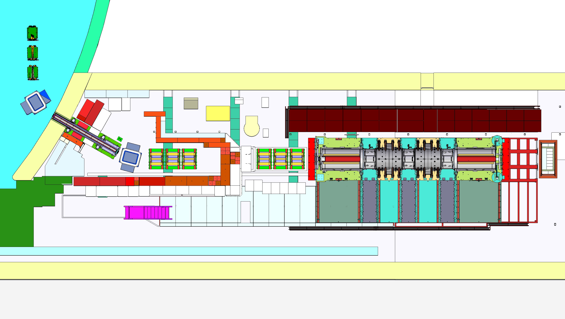

Slide 34

Status of MICE:
Decay solenoid
Linde refrigerator
MICE Local
Control Room:
in place
Target
Instrumentation in place:
Beam profile monitors
Trigger/rate scintillators
CKovA&B, TOF0,1&2, KL
Upstream
beam line
Downstream beam line

Slide 35
TIARA WP7:
Ionisation Cooling Test Facility:

Slide 36
TIARA WP7:
Contribute to developing the
Ionisation Cooling Test Facility!
Short term:
  RF power distribution system for MICE
Longer term:
  Novel RF power amplifier for 6D test facility

Slide 37
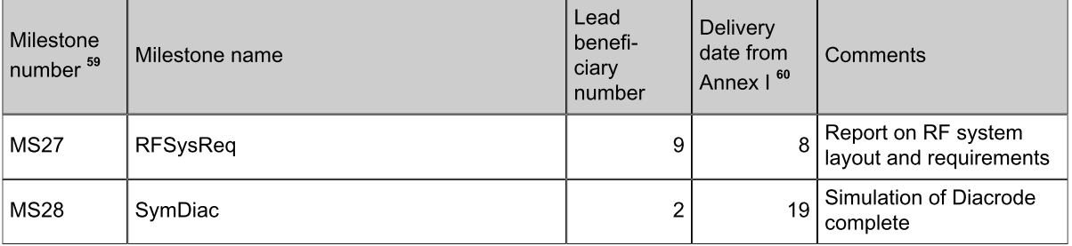
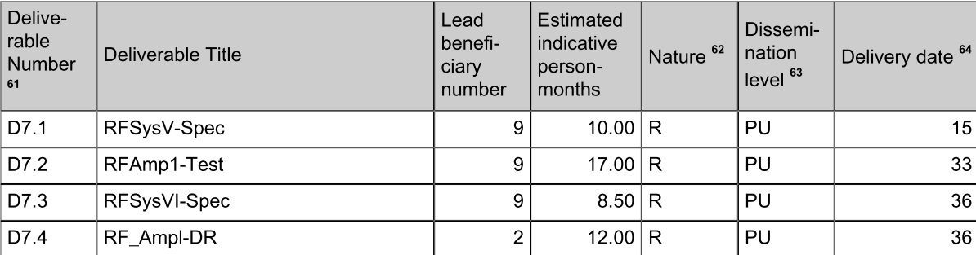
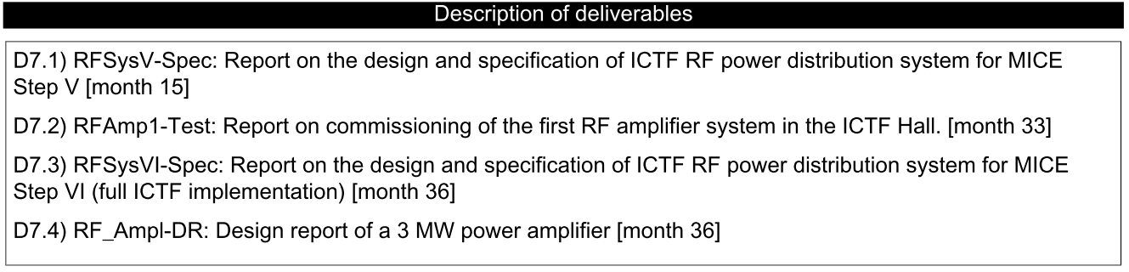
TIARA WP7: milestones and deliverables:

