Slide 1

TIARA
WP2 meeting
R. Aleksan
February 23. 2011
TIARA website: http://www.eu-tiara.eu
Welcome
to the first
Meeting objectives
Deliverables
Who does what
Organization matters
Conclusion
WP2 meeting

Slide 2
WP2 Meeting Objectives
Ensure that the work is effectively starting
  Work plan and deliverables
  Who does what
Review Organizational matters
  Next meetings
Discussion on next meetings

Slide 3
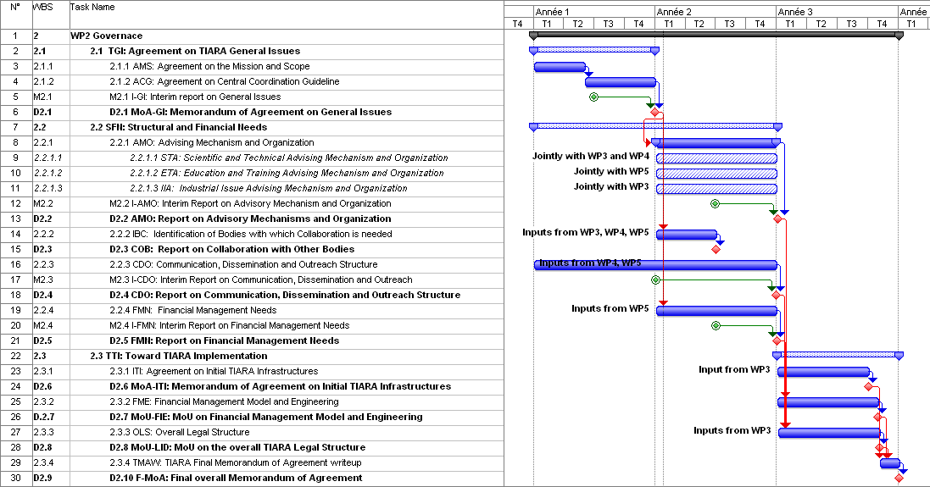
Work plan
2 activities should start on year 1
  Agreement on TIARA mission, scope and central coordination guidelines
  TIARA communication, dissemination and outreach structure

Slide 4
Deliverables/milestones
9 deliverables and 4 milestones
Num | Nat[1] | Short name | Description | month | Diss. level
D1.1 | O | MoA-GI | Memorandum of Agreement on General Issues | 12 | CO
D2.2 | R | AMO | Report on Advisory Mechanisms and Organization | 24 | CO
D2.3 | R | COB | Report on Collaboration with Other Bodies | 18 | CO
D2.4 | R | CDO | Report on Communication, Dissemination and Outreach Structure | 24 | CO
D2.5 | R | FMN | Report on Financial Management Needs | 24 | CO
D2.6 | O | MoA-ITI | Memorandum of Agreement on Initial TIARA Infrastructures | 33 | CO
D2.7 | R | MoU-FIE | MoU on Financial Model and Engineering | 34 | CO
D2.8 | R | MoU-LID | MoU on Legal Issues and Documents | 34 | CO
D2.9 | O | F-MoA | Final Memorandum of Agreement | 36 | CO
Num | Num Annex1 | Nat | Short name | Description | month | Diss. level
M2.1 | MS4 | R | I-GI | Interim Report on General Issues | 6 | CO
M2.2 | MS5 | R | I-AMO | Interim report of Advisory Mechanisms and Organization | 18 | CO
M2.3 | MS6 | R | I-CDO | Interim Report on Communication, Dissemination and Outreach | 12 | CO
M2.4 | MS7 | R | I-FMN | Interim Report on Financial Management Needs | 18 | CO

Slide 5
Organization matters
1 deliverable and 1 milestone on first year
Deliverable: Memorandum of Agreement on General Issues
Agreement on mission and scope (milestone on month 6)
  Term of reference: objective, field covered
  (research, clinical, industrial…), type of infrastructures,
  scope of R&D programme, « stakeholders »…
Agreement on central coordination guidelines
(deliverable on month 12)
  Governing body, Size of central team, profile of members,
  location, how to finance the central team…
How to proceed ?
Suggestions?

Slide 6
Organization matters
Another activity should start:
Definition of the TIARA communication, dissemination and outreach structure
Requires inputs from WP3, WP4 and WP5
Need to identify a coordinator to liaise with other WPs and
help reaching a consensus for a proposal
Who ?
Suggestions?
Practical application : development of a brochure on
impact of accelerators on society

Slide 7

Conclusions
The objectives of TIARA are very ambitious and challenging
TIARA-PP has started! It is our common task to make it a success and ensure the sustainability of accelerator R&D
TIARA will strengthen further
Accelerator science;
a powerful mean toward scientific, technical
and industrial breakthroughs…

