Slide 1

TIARA
GC meeting
R. Aleksan
February 23. 2011
TIARA website: http://www.eu-tiara.eu
Welcome
to the first
Meeting objectives
General Information
Final Budget
Consortium Agreement
Next meetings
Conclusion
Governing Council

Slide 2
GC Meeting Objectives
Ensure that the work is effectively starting
Review Organizational matters
Review Funding issues
Review status of CA
Discussion on next meetings

Slide 3
TIARA status
Since last TPB meeting
  May 18nd TPB meeting decision
Acceptation of the EC proposed contribution of 3.9 M€
Approval of the reorganisation of the project
Reduce costs of each technical WP by ~20% ,
keeping the main objectives
Reduce globally WP1-6 by ~20%
  with largest reduction coming from WP6
  preferably merge WP6 with WP3
Reduce significantly travel costs
(unit costs =625€ and less travels)
Agreement to keep the matching fund at about the same level as in proposal

Slide 4
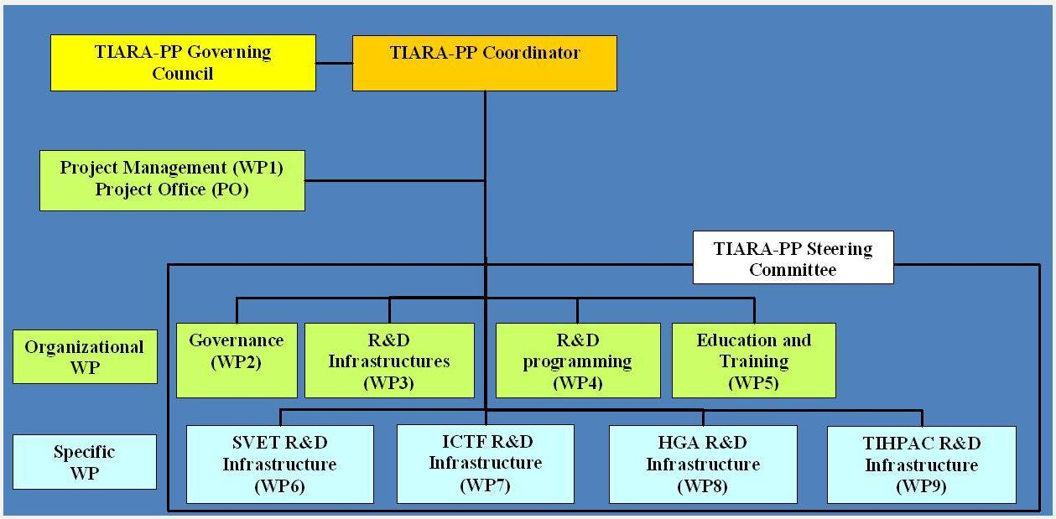
Revised TIARA project
R. A.
F. Kircher
C. Tanguy
R. A.
A. Unnervik
F. Cervelli
P. Burrows
E. Jensen
K. Long
M. Biagini
S. Bousson
New Total Cost: k€ 9 139
WP1-5: new total cost = k€ 5 758
WP6-9 : new total cost = k€ 3 381
WP leader change: A. Unnervik replaces O. Brunning for WP3

Slide 5
TIARA status (cont’d)
End June 2010: Approval of the new proposal by the EC
Long discussion with the EC for Third Parties
July 2010: Agreement with the EC to use subcontract instead of TP for Nordic consortium
Sept. 2010: Final DoW (annex 1) sent to the EC
New issue about IBBA with the EC
Nov 11, 2010: Approval of the DoW by the EC
Dec. 8, 2010: Grant Agreement signed by the EC
Dec. 21, 2010: First prepayment (2 925 k€) sent by the EC
January 1, 2011: Official start date of TIARA
January 25: Grant Agreement signed by all Beneficiaries
Hiring of Project Coordinator Assistant at CEA :
Celine Tanguy

Slide 6

First Period Deliverables
Num | Nat[1] | Short name | Description | month
D1.1 | O | OWSF | Overall Web Site Frame ready | 1 | PU
D1.2 | O | CAP | Consortium Agreement between participants ready | 1 | CO
D1.3 | O | CCE | Contract of the Consortium with the EC signed | 1 | CO
D1.4 | O | OKM | Organization of the Kickoff meeting | 1 | CO
D1.5 | O | IWSF | Internal Web Site Frame Ready | 2 | CO
D4.1 | R | KIR | General Report on Key Accelerator Research Areas and Key R&D Issues | 5 | PU
D6.1 | R | D_SLS_NOW | Report on existing hardware limitations and needed upgrades. | 9 | PU
D5.1 | R | ETR | Education and Training Survey Report | 10 | PU
D2.1 | O | MoA-GI | Memorandum of Agreement on General Issues | 12 | CO
D3.1 | R | ISR | Infrastructure Survey Report. | 12 | PU
D5.2 | O | ETD | Education and Training resources Database | 14 | PU
D7.1 | R | RFSysV-Spec | Report on the design and specification of ICTF RF power distribution system for MICE Step V | 15 | PU
D3.2 | O | IWD | Infrastructure Web-based Database. | 16 | PU
D1.6 | R | TTR | Midterm Report | 18 | CO
D2.3 | R | COB | Report on Collaboration with Other Bodies | 18 | CO
D6.2 | R | D_SPEC | Specifications ready | 18 | PU
D1.2: CA is written, final version awaiting approval from beneficiaries
D1.5: being done (see C. Tanguy talk at plenary)

Slide 7
Deliverables follow up
Documentation
TIARA documentation database for all types of TIARA documents
Publications, Reports, Notes, Conference papers, Thesis…
TIARA Progress indicator
Milestones/deliverables tables

Slide 8
Budget
 | Initial Proposal (k€) |  |  | TIARA final budget after negociation with EC (k€)
Participant | Total costs | EC | Match funds | Total costs | EC | Match funds
CEA | 1603 | 971 | 632 | 1325.8 | 630.5 | 695.3
CERN | 2192 | 931 | 1261 | 1878.5 | 713.8 | 1164.7
CNRS | 939 | 482 | 457 | 682.8 | 299.5 | 383.3
CIEMAT | 458 | 261 | 197 | 365.0 | 166.3 | 198.7
DESY | 611 | 367 | 244 | 284.0 | 138.0 | 146.0
GSI | 342 | 273 | 69 | 267.3 | 164.1 | 103.2
INFN | 1678 | 804 | 874 | 1350.5 | 540.7 | 809.8
PSI | 1610 | 765 | 845 | 1355.3 | 544.0 | 811.3
STFC | 1397 | 613 | 784 | 1090.6 | 414.4 | 676.2
UPPS. | 646 | 318 | 328 | 291.3 | 155.3 | 136.0
IPJ-PAN | 324 | 210 | 114 | 248.0 | 133.4 | 114.6
TOTAL | 11802 | 6000 | 5803 | 9139 | 3900 | 5239
TIARA final budget after negociation with EC (k€)
WP | Total costs | EC
WP1 | 854 | 401
WP2 | 1 326 | 663
WP3 | 1 674 | 841
WP4 | 986 | 504
WP5 | 918 | 458
WP6 | 1 063 | 348
WP7 | 704 | 179
WP8 | 1 106 | 349
WP9 | 508 | 158
Total | 9139 | 3900

Slide 9
First EC Money Transfer
First EC prepayment received: 2 925 000 €
 | TIARA final budget after negociation with EC (k€)
Participant | Total costs | EC | First transfer (done) | 2nd transfer (Beg. 2012)
CEA | 1325.8 | 630.5 | 236 437,50 | 236 437,50
CERN | 1878.5 | 713.8 | 267 675,00 | 267 675,00
CNRS | 682.8 | 299.5 | 112 297,50 | 112 297,50
CIEMAT | 365.0 | 166.3 | 62 347,50 | 62 347,50
DESY | 284.0 | 138.0 | 51 738,75 | 51 738,75
GSI | 267.3 | 164.1 | 61 552,50 | 61 552,50
INFN | 1350.5 | 540.7 | 202 773,75 | 202 773,75
PSI | 1355.3 | 544.0 | 203 985,00 | 203 985,00
STFC | 1090.6 | 414.4 | 155 418,75 | 155 418,75
UPPS. | 291.3 | 155.3 | 58 233,75 | 58 233,75
IPJ-PAN | 248.0 | 133.4 | 50 040,00 | 50 040,00
TOTAL | 9139 | 3900 | 1 462 500,00 | 1 462 500,00

Slide 10
Consortium Agreement
First iteration of GA written and circulated amongst beneficiaries
Received feedback from CNRS, CERN, CIEMAT, STFC,
INFN, PSI, Uppsala, IFJ-PAN
Second iteration of GA written by including most comments
(whenever there was no contradictions)
Being review by the CEA legal matters
We will be sent back soon to Beneficiaries
  We will accept last (minor) changes and modification of partners access rights with one week deadline (no answer meaning approval).
  We will then send the final version and ask you to return the signed page corresponding to your institute.

Slide 11
Organization matters
Most of the logistics aspects are (or close to being) in place
  Grant Agreement/Consortium Agreement
  Web site
  Documentation database
  EC Funding received and transferred to Beneficiaries
Communication actions should be (are) starting
  Articles (such as CERN courier, local courier…)
  Editing of brochure on impact of accelerators on society
  …
  Your help/suggestions will be needed

Slide 12
Organization matters
Reporting
TIARA internal reporting
Steering Committee meetings (at least 3 per year)
  Proposal: January/February, May/June, September/October
Biannual written reports
  Proposal: June and December
Individual phone discussions with WP leaders as needed
TIARA « official » reporting
Governing Council Meetings ( at least 1 per year)
  Proposal: February 2011, following ones tbd with GC
General TIARA meetings (in connection to 18 month report
  Proposal: May 2012 and November 2013
18 month written reports
  Proposal: June 2012 and December 2013
Mid-term review
  Tbd with the EC scientific officer

Slide 13
TIARA Kickoff meeting
Date: February 23-24, 2011
Website: http://indico.cern.ch/internalPage.py?pageId=0&confId=117195
Meeting format: It is essentially a work meeting
Feb. 23:
11:00-12:30 : Governing Board meeting
12:30: lunch in the glassbox
14:00-15:30 : Plenary session (general TIARA informations)
16:00-18:30 : Parallel sessions for the Work Packages activities
19:30: Dinner
Feb. 24:
8:30-10:00 : Parallel sessions for the Work Packages activities
10:30-12:30 : Plenary session (Reports from the Work Packages)
14:00-16:00 : Plenary session (Reports from the WP packages)

Slide 14
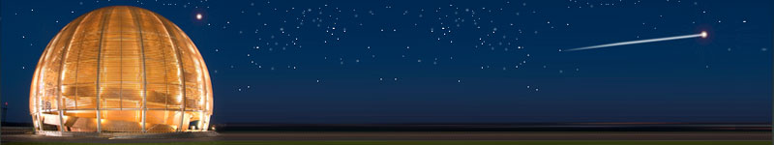
Conclusions
The objectives of TIARA are very ambitious and challenging
TIARA-PP has started! It is our common task to make it a success and ensure the sustainability of accelerator R&D
TIARA will strengthen further
Accelerator science;
a powerful mean toward scientific, technical
and industrial breakthroughs…

