Slide 1

WP6 (SVET)
SVET: “SLS Vertical Emittance Tuning”
  Russian “Свет” means “light”
Purpose:
  Convert the Swiss Light Source (SLS) to a R&D Infrastructure,
  demonstrate ultra-small emittances as required for future Linear Collider Damping Rings (5 nm normalized, 1 pm @ 2.86 GeV
  Enable to extend tests to lower energies (IBS dominated regime).

Slide 2
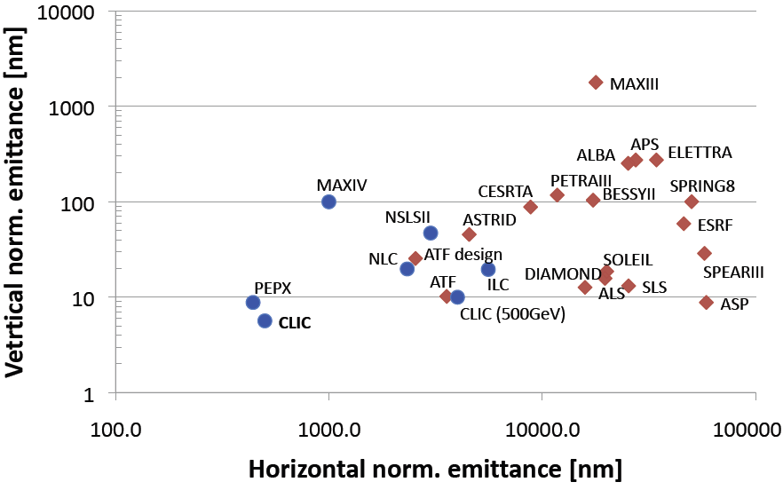
Small emittances

Slide 3
The players
PSI: Andreas Streun, ...
CERN: Yannis Papaphilippou, Fanouria Antoniou, ...
INFN/LNF: Marica Biagini, ...
Maxlab (via PSI): Åke Andersson, ...

Slide 4
What it takes: Step 1
Step 1: With the existing hardware:
Ensure optimum measurement accuracy (beam size, position, emittance, coupling, ...)
Minimize magnetic field errors
  alignment of girders/magnets
  alignment of BPM’s
minimize betatron coupling (using exisiting skew quads)
Result: What is possible, where are improvements needed.

Slide 5
What it takes: Step 2
Step 2: With those results:
Specify the necessary improvements of
  Beam position monitors
  Beam profile monitors
  emittance monitors
  emittance control knobs,
  magnet trimming coils and supplies
Result: Specification of upgrades

Slide 6
What it takes: Step 3
Step 3: Implementation of upgrade:
  Down-select most important hardware to be implemented (financial constraints), planned:
    improved BPM’s and/or alignment
    correction knobs and feedback algorithms (automated coupling control)
    improved resolution/sensitivity beam profile monitor (laser based?)
    knob allowing energy scaling
  Fabricate hardware,
  Install hardware in SLS
Result: An improved SLS, allowing to reach smaller vertical emittances at different energy levels.

Slide 7
What it takes: Step 4
Step 4: Commissioning:
  Commission improved BPM and/or alignment system
  Verification of the automated coupling control
  Commission new beam profile monitor
  (the commissioning at lower energy is not formally included due to financial/time constraints)

Slide 8
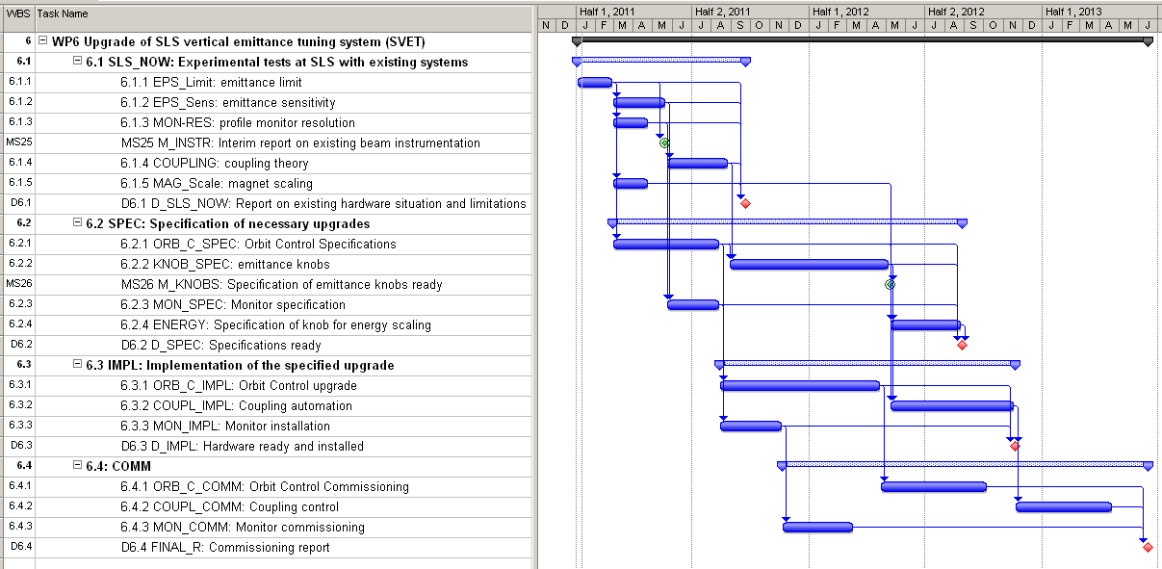
WP6 (SVET): Gantt chart

Slide 9
WP6 (SVET): Resources
Person-months:
Material:
Travel:
 | CERN | INFN | PSI | total | k€
pm | 16.5 | 11.5 | 45.5 | 73.5 | 556.83
 | CERN | INFN | PSI |  | total k€
k€ |  |  | 215 |  | 215
 | CERN | INFN | PSI | total | k€
units | 16 | 9 | 11 | 36 | 22.5

Slide 10
Ongoing before Kick-off:
PSI is in the process of opening a post-doc position.
We need a communication platform (collaboration web-space)
We need clear indication for the necessary form and dissemination procedure for different reports (TIARA reports?, templates?, ...)

