Slide 1

TIARA-WP2
SC meeting
R. Aleksan
February 11th. 2011
Objective
Deliverables
Organizational matters
Conclusion
http://www.eu-tiara.eu

Slide 2
WP2 Objective
  Main WP2 objective
Develop the TIARA governance structure enabling the creation,
the management, the operation and the evolution, in term of membership and infrastructures, of the proposed European distributed accelerator R&D facility, with particular attention towards the integration of the user needs for as many fields as possible, in a sustainable way.
Definition of the consortium structure,
Constitution of the statutes,
Development of required means and methods for its management including the related administrative, legal and financial aspects.
Development of the means and mechanisms enabling TIARA to promote the collaboration with other research infrastructures, to interact efficiently with the industrial sector and to develop the human knowledge and know-how as well as its dissemination.

Slide 3
Deliverables/Milestones
Num | Nat[1] | Short name | Description of Deliverables | month
D2.1 | O | MoA-GI | Memorandum of Agreement on General Issues | 12 | CO
D2.2 | R | AMO | Report on Advisory Mechanisms and Organization | 24 | CO
D2.3 | R | COB | Report on Collaboration with Other Bodies | 18 | CO
D2.4 | R | CDO | Report on Communication, Dissemination and Outreach Structure | 24 | CO
D2.5 | R | FMN | Report on Financial Management Needs | 24 | CO
D2.6 | O | MoA-ITI | Memorandum of Agreement on Initial TIARA Infrastructures | 33 | CO
D2.7 | R | MoU-FIE | MoU on Financial Model and Engineering | 34 | CO
D2.8 | R | MoU-LID | MoU on Legal Issues and Documents | 34 | CO
D2.9 | O | F-MoA | Final Memorandum of Agreement | 36 | CO
Num | Nat | Short name | Description of Milestones | month
M2.1 | R | I-GI | Interim Report on General Issues | 6 | CO
M2.2 | R | I-AMO | Interim report of Advisory Mechanisms and Organization | 18 | CO
M2.3 | R | I-CDO | Interim Report on Communication, Dissemination and Outreach | 12 | CO
M2.4 | R | I-FMN | Interim Report on Financial Management Needs | 18 | CO

Slide 4
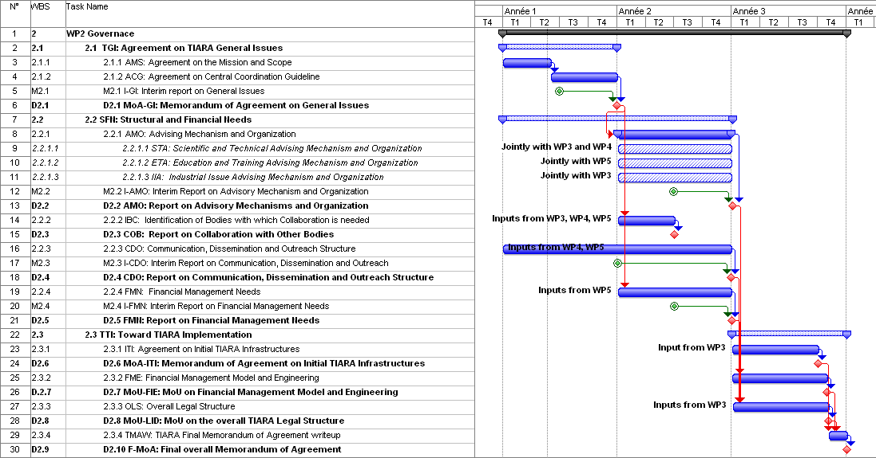
Work plan

Slide 5
Organizational matters
WP2 strongly relies on the inputs from the other WPs
Hence the effective work in most areas starts later than other WPs
Participating institutes and contacts
WP2 | Contacts
CEA | Roy.aleksan@cea.fr
CERN | Steve.myers@cern.ch
CNRS | mueller@ipno.in2P3.fr
CIEMAT | jm.perez@ciemat.es
DESY | karsten.wurr@desy.de
GSI | H.Eickhoff@gsi.de
INFN | vacchi@ts.infn.it
PSI | Leonid.rivkin@psi.ch
STFC | John.womersley@stfc.ac.uk
Uppsala | Tord.Ekelof@physics.uu.se
IFJ | wrochna@ipj.gov.pl

Slide 6
Organization matters (cont’d)
WP2 internal meeting
First phone meeting will be planned end-January
or beg.-February
  Review scope and discussion on task responsibilities
2nd Meeting during Kickoff meeting
  Distribute task responsibilities amonsgt participants

Slide 7

Conclusions
The objectives of WP are very ambitious, challenging
… and highly political!
It is our common task to convince the community and the funding agencies that it is a vital necessity to ensure the sustainability of accelerator R&D
TIARA will strengthen further
Accelerator science;
a powerful mean toward scientific, technical
and industrial breakthroughs…

