Slide 1

TIARA
SC meeting
R. Aleksan
February 11th. 2011
TIARA website: http://www.eu-tiara.eu
General Information
Final Budget
Meeting Objectives
Organizational matters
Kickoff meeting
Conclusion

Slide 2
TIARA status
Since last TPB meeting
  May 18nd TPB meeting decision
Acceptation of the EC proposed contribution of 3.9 M€
Approval of the reorganisation of the project
Reduce costs of each technical WP by ~20% ,
keeping the main objectives
Reduce globally WP1-6 by ~20%
  with largest reduction coming from WP6
  preferably merge WP6 with WP3
Reduce significantly travel costs
(unit costs =625€ and less travels)
Agreement to keep the matching fund at about the same level as in proposal

Slide 3
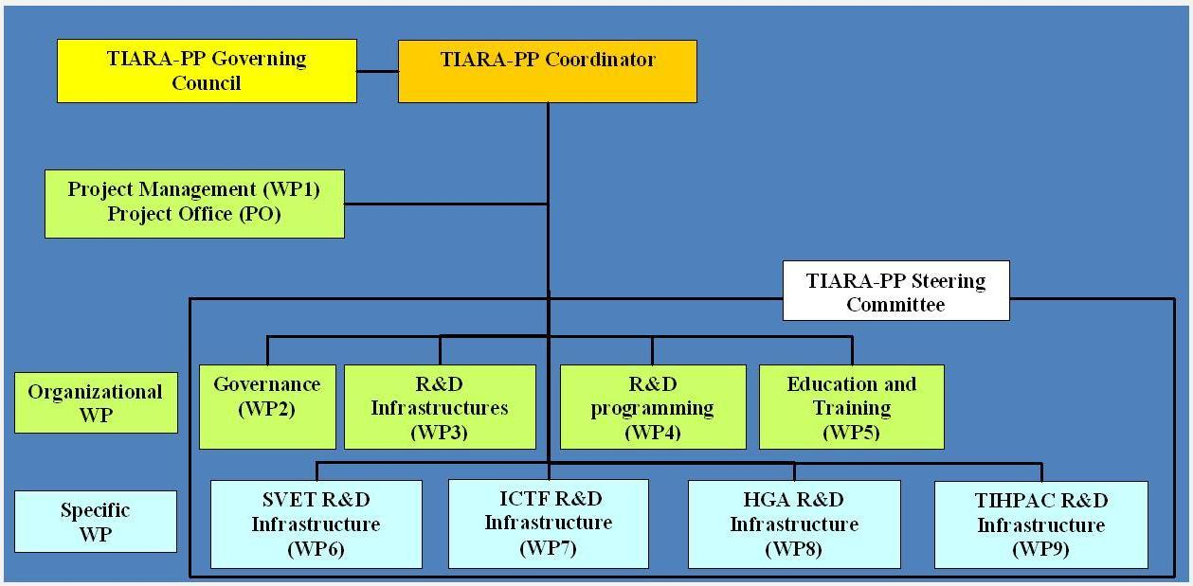
Revised TIARA project
New Total Cost: k€ 9 139
WP1-5: new total cost = k€ 5 758
WP6-9 : new total cost = k€ 3 381
WP leader change: A. Unnervik replaces O. Brunning for WP3

Slide 4
TIARA status (cont’d)
End June 2010: Approval of the new proposal by the EC
Long discussion with the EC for Third Parties
July 2010: Agreement with the EC to use subcontract instead of TP
Sept. 2010: Final DoW (annex 1) sent to the EC
New issue about IBBA with the EC
Nov 11, 2010: Approval of the DoW by the EC
Dec. 8, 2010: Grant Agreement signed by the EC
Dec. 21, 2010: First prepayment (2 925 k€) sent by the EC
January 1, 2011: Official start date of TIARA
Hiring of Project Coordinator Assistant at CEA
Candidate found: Celine Tanguy, awaiting contract signature

Slide 5
SC Meeting Objectives
Ensure that the work has effectively started in each WP
Review deliverables/milestones and difficulties if any
Get feedback of proposed first funding transfer to participants
Decide on TIARA organizational matters
Organize kickoff meeting

Slide 6
Revised Budget
 | Initial Proposal (k€) |  |  | TIARA final budget after negociation with EC (k€)
Participant | Total costs | EC | Match funds | Total costs | EC | Match funds
CEA | 1603 | 971 | 632 | 1325.8 | 630.5 | 695.3
CERN | 2192 | 931 | 1261 | 1878.5 | 713.8 | 1164.7
CNRS | 939 | 482 | 457 | 682.8 | 299.5 | 383.3
CIEMAT | 458 | 261 | 197 | 365.0 | 166.3 | 198.7
DESY | 611 | 367 | 244 | 284.0 | 138.0 | 146.0
GSI | 342 | 273 | 69 | 267.3 | 164.1 | 103.2
INFN | 1678 | 804 | 874 | 1350.5 | 540.7 | 809.8
PSI | 1610 | 765 | 845 | 1355.3 | 544.0 | 811.3
STFC | 1397 | 613 | 784 | 1090.6 | 414.4 | 676.2
UPPS. | 646 | 318 | 328 | 291.3 | 155.3 | 136.0
IPJ-PAN | 324 | 210 | 114 | 248.0 | 133.4 | 114.6
TOTAL | 11802 | 6000 | 5803 | 9139 | 3900 | 5239
TIARA final budget after negociation with EC (k€)
WP | Total costs | EC
WP1 | 854 | 401
WP2 | 1 326 | 663
WP3 | 1 674 | 841
WP4 | 986 | 504
WP5 | 918 | 458
WP6 | 1 063 | 348
WP7 | 704 | 179
WP8 | 1 106 | 349
WP9 | 508 | 158
Total | 9139 | 3900

Slide 7

First year Deliverables
Num | Nat[1] | Short name | Description | month
D1.1 | O | OWSF | Overall Web Site Frame ready | 1 | PU
D1.2 | O | CAP | Consortium Agreement between participants ready | 1 | CO
D1.3 | O | CCE | Contract of the Consortium with the EC signed | 1 | CO
D1.4 | O | OKM | Organization of the Kickoff meeting | 1 | CO
D1.5 | O | IWSF | Internal Web Site Frame Ready | 2 | CO
D4.1 | R | KIR | General Report on Key Accelerator Research Areas and Key R&D Issues | 5 | PU
D6.1 | R | D_SLS_NOW | Report on existing hardware limitations and needed upgrades. | 9 | PU
D5.1 | R | ETR | Education and Training Survey Report | 10 | PU
D2.1 | O | MoA-GI | Memorandum of Agreement on General Issues | 12 | CO
D3.1 | R | ISR | Infrastructure Survey Report. | 12 | PU
D1.1: already exists
D1.2: Is written, awaiting approval from CEA legal service prior to sending
to beneficiaries
D1.3: Contract (GA) signed by CEA and EU, awaiting last 3 beneficiary signatures
D1.4: date fixed to 23-24:2/2011 at CERN, organization on going

Slide 8

First year Milestones
Num | Nat | Short name | Description | month
M3.1 | O | NWPC | Nomination of WPC for each ARA. | 1 | CO
M4.1 | O | FSG | Formation of Study Group for Identification of Key Issues | 1 | CO
M1.1 | O | MTR | Monitoring tool and documentation repository | 4 | CO
M4.2 | O | FWG | Formation of Working Groups | 5 | CO
M6.1 | R | M_INSTR | Interim report on existing beam instrumentation | 5 | PU
M2.1 | R | I-GI | Interim Report on General Issues | 6 | CO
M5.1 | O | METR | Meeting to plan ETR report | 7 | CO
M3.2 | R | ISR | Interim Infrastructure Survey Report | 8 | CO
M7.1 | R | RFSysReq | Report on RF system layout and requirements | 8 | PU
M8.1 | O | HARDW-A | Purchase of crucial hardware components | 9 | PU
M5.2 | O | METD | Meeting to plan ETD database | 11 | CO
M2.3 | R | I-CDO | Interim Report on Communication, Dissemination and Outreach | 12 | CO
M9.1 | R | DSIF | Definition and Specifications of the Irradiation test Facilities | 12 | PU

Slide 9
Revised detailed budget
 | TIARA final budget after negociation with EC (k€)
Participant | Total costs | EC | First transfer
CEA | 1325.8 | 630.5 | 236 437,50
CERN | 1878.5 | 713.8 | 267 675,00
CNRS | 682.8 | 299.5 | 112 297,50
CIEMAT | 365.0 | 166.3 | 62 347,50
DESY | 284.0 | 138.0 | 51 738,75
GSI | 267.3 | 164.1 | 61 552,50
INFN | 1350.5 | 540.7 | 202 773,75
PSI | 1355.3 | 544.0 | 203 985,00
STFC | 1090.6 | 414.4 | 155 418,75
UPPS. | 291.3 | 155.3 | 58 233,75
IPJ-PAN | 248.0 | 133.4 | 50 040,00
TOTAL | 9139 | 3900 | 1 462 500,00

Slide 10
Organization matters
Reporting
TIARA internal reporting
Steering Committee meetings (at least 3 per year)
  Proposal: January/February, May/June, September/October
Biannual written reports
  Proposal: June and December
Individual phone discussions with WP leaders as needed
TIARA « official » reporting
Governing Council Meetings ( at least 1 per year)
  Proposal: February 2011, following ones tbd with GC
General TIARA meetings (in connection to 18 month report
  Proposal: May 2012 and November 2013
18 month written reports
  Proposal: June 2012 and December 2013
Mid-term review
  Tbd with the EC scientific officer

Slide 11
Organization matters (cont’d)
Documentation
TIARA documentation database for all types of TIARA documents
Publications, Reports, Notes, Conference papers, Thesis…
(see CARE model)
TIARA Progress indicator
Milestones/deliverables tables (see CARE model)

Slide 12
TIARA Kickoff meeting
Date: February 23-24, 2011
Meeting format: It is essentially a work meeting
Feb. 23:
11:00-12:30 : Governing Board meeting
14:00-15:30 : Plenary session (general TIARA informations)
16:00-18:30 : Parallel sessions for the Work Packages activities
Feb. 24:
8:30-10:30 : Parallel sessions for the Work Packages activities
11:00-12:30 : Plenary session (Reports from the Work Packages)
14:00-17:00 : Plenary session (Reports from the WP packages)
Meeting Room reservations
8 rooms have been reserved for parallel sessions
Rooms: 4/3-021, 60/2-023, 61/1-017, 61/1-007, 14/4-002, 72/1-020, 72/R-036, 5/5-008 (tbc)
Any special wish from WP leaders?

Slide 13
TIARA Kickoff meeting (cont’d)
Hostel room reservations
60 CERN hostel rooms prereserved with deadline on 20/01/2011
TIARA Dinner
We are planning to organize a TIARA dinner on evening 23/2/2011
Web site
Beeing done, should be ready this week
Local responsible persons for the meeting
Anders Unnervik and Nathalie Gouriou (secretary)

Slide 14

Conclusions
The objectives of TIARA are very ambitious and challenging
TIARA-PP has started! It is our common task to make it a success and ensure the sustainability of accelerator R&D
TIARA will strengthen further
Accelerator science;
a powerful mean toward scientific, technical
and industrial breakthroughs…

