Slide 1

TIARA
TPB meeting
R. Aleksan
May 18th. 2010
TIARA website: http://www.eu-tiara.eu
General Information
Meeting Objectives
Revised proposal &Budget
Conclusion

Slide 2
April 22 TPB
meeting outcome
  April 22nd agreed guidelines
All partners wish to partcipate to TIARA
Keep all Technical Work packages
Allow matching funds at the same level as in proposal
Reduce costs of each technical WP by ~20% ,
keeping the main objectives
Reduce globally WP1-6 by ~20%
  with largest reduction coming from WP6
  DESY cannot lead WP6
  preferably merge WP6 with WP3
Reduce significantly travel costs
(unit costs =625€ and less travels)

Slide 3
Meeting Objectives
Agree upon the revised proposal and subsequent budget
In particular
Agree on the final list of Work Packages to be kept
Agree on the activities that are suppressed and the final WP activities, which will be carried out
Agree on the final TIARA budget

Slide 4
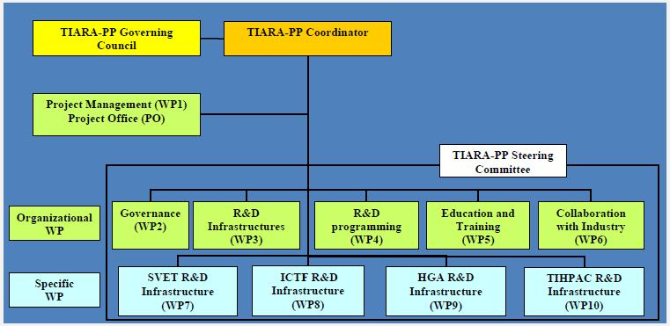
Main modifications
proposed
Proposal Total Costs: k€ 11 802
New Total Costs: k€ 9 234
WP1-6 : total cost = k€ 7 535
WP7-10 : total cost = k€ 4 267
WP1-5: new total cost = k€ 5 793
WP6-9 : new total cost = k€ 3 441
- ~20%
- ~20%
- ~20%
- ~20%
- ~20%

Slide 5
Revised proposal
 | Initial Proposal |  | Revised proposal
WP number | Direct costs | Total costs | Direct costs | Total costs
WP1 | 690 | 1008 | 565 | 854
WP2 | 1030 | 1582 | 855 | 1323
WP3 | 854 | 1310 | 1091 | 1686
WP4 | 803 | 1235 | 644 | 993
WP5 | 725 | 1149 | 582 | 936
WP6 | 803 | 1252 | 0 | 0
WP7 | 1000 | 1337 | 794 | 1078
WP8 | 541 | 896 | 393 | 704
WP9 | 904 | 1343 | 771 | 1106
WP10 | 432 | 690 | 346 | 554
TOTAL | 7780 | 11802 | 6043 | 9235

Slide 6
Report of the initial negotiation
discussion with the EC
  Second (phone) meeting with the EC on May 10, 2010
    EC reiterate its thrust in our community. appreciates TIARA and gives priority for concluding negotiations before June 11
    EC agrees with our strategic choices, proposed reorganization and redefinition of the work plan
    In particular, EC understands the removal of WP6 due to budget cuts, but it wishes that some of the related activities are kept and well identified
    EC believes that travels costs could be reduced
    The EC would like to receive a draft of the new proposal by May 31
    The EC would like to receive the signed GPF on June 10 at the latest

Slide 7
Revised proposal
 | Initial Proposal |  |  | Revised proposal
Participant | Total costs | EC | Match funds | Total costs | EC | Match funds
CEA | 1603 | 971 | 632 | 1325.8 | 651.6 | 674.2
CERN | 2192 | 931 | 1261 | 1878.5 | 676.3 | 1202.2
CNRS | 939 | 482 | 457 | 682.8 | 303.5 | 379.3
CIEMAT | 458 | 261 | 197 | 365.0 | 171.6 | 193.4
DESY | 611 | 367 | 244 | 284.0 | 143.0 | 141.0
GSI | 342 | 273 | 69 | 267.3 | 175.6 | 91.7
INFN | 1678 | 804 | 874 | 1350.5 | 542.5 | 808.0
PSI | 1610 | 765 | 845 | 1241.6 | 493.9 | 747.7
STFC | 1397 | 613 | 784 | 1090.6 | 392.6 | 698.0
UPPS. | 646 | 318 | 328 | 500.6 | 208.0 | 292.6
IPJ-PAN | 324 | 210 | 114 | 248.0 | 141.4 | 106.6
TOTAL | 11802 | 6000 | 5803 | 9234.8 | 3900 | 5334.8

Slide 8
Initial proposal budget
as submitted on Dec.3
Detailed contributions in submitted proposal (k€)
Participant | WP1-6 direct | WP7-10 direct | Total Direct | Indir. costs | Total costs | EC | EC/Total | EC/Direct | Match funds
CEA | 1099 | 0 | 1099 | 504 | 1603 | 971 | 0.606 | 0.884 | 632
CERN | 852 | 518 | 1370 | 822 | 2192 | 931 | 0.425 | 0.680 | 1261
CNRS | 400 | 187 | 587 | 352 | 939 | 482 | 0.513 | 0.821 | 457
CIEMAT | 255 | 0 | 255 | 203 | 458 | 261 | 0.571 | 1.028 | 197
DESY | 382 | 0 | 382 | 229 | 611 | 367 | 0.601 | 0.962 | 244
GSI | 297 | 0 | 297 | 45 | 342 | 273 | 0.799 | 0.922 | 69
INFN | 387 | 673 | 1060 | 618 | 1678 | 804 | 0.479 | 0.758 | 874
PSI | 351 | 990 | 1341 | 268 | 1610 | 765 | 0.475 | 0.570 | 845
STFC | 435 | 378 | 813 | 584 | 1397 | 613 | 0.439 | 0.755 | 784
UPPS. | 244 | 160 | 404 | 242 | 646 | 318 | 0.493 | 0.789 | 328
IPJ-PAN | 203 | 0 | 203 | 121 | 324 | 210 | 0.649 | 1.038 | 114
TOTAL | 4904 | 2906 | 7810 | 3992 | 11802 | 6000 | 0.50 | 0.768 | 5803

Slide 9
Revised detailed budget
Detailed revised proposal (k€), (there are rounding mismatchs)
Participant | WP1-6 direct | WP7-10 direct | Total Direct | Indir. costs | Total costs | EC | EC/Total | EC/Direct | Match funds
CEA | 884.8 | 0.0 | 884.8 | 441.0 | 1325.8 | 651.6 | 0.492 | 0.737 | 674.1
CERN | 725.1 | 448.9 | 1174.0 | 704.4 | 1878.5 | 676.3 | 0.360 | 0.576 | 1202.2
CNRS | 282.4 | 144.4 | 426.8 | 256.1 | 682.8 | 303.5 | 0.444 | 0.711 | 379.3
CIEMAT | 197.1 | 0.0 | 197.1 | 167.9 | 365.0 | 171.6 | 0.470 | 0.871 | 193.4
DESY | 177.5 | 0.0 | 177.5 | 106.5 | 284.0 | 143.0 | 0.504 | 0.806 | 141.0
GSI | 230.3 | 0.0 | 230.3 | 37.1 | 267.3 | 175.6 | 0.657 | 0.763 | 91.7
INFN | 293.5 | 561.8 | 855.3 | 495.2 | 1350.5 | 542.5 | 0.402 | 0.634 | 808.0
PSI | 276.2 | 758.5 | 1034.6 | 206.9 | 1241.6 | 493.9 | 0.398 | 0.477 | 747.7
STFC | 327.5 | 266.8 | 594.3 | 496.3 | 1090.6 | 392.6 | 0.360 | 0.661 | 698.0
UPPS. | 188.8 | 124.0 | 312.9 | 187.7 | 500.6 | 208.0 | 0.415 | 0.665 | 292.6
IPJ-PAN | 155.0 | 0.0 | 155.0 | 93.0 | 248.0 | 141.4 | 0.570 | 0.912 | 106.6
TOTAL | 3738.1 | 2304.4 | 6042.5 | 3192.1 | 9234.8 | 3900 | 0.422 | 0.645 | 5334.8

Slide 10
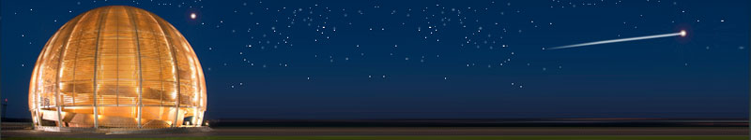
Conclusions
WP leaders have converged to establish a revised proposal within the TPB guidelines and the new EC contribution
This revised proposal is submitted for approval to the TPB. To meet the negotiation deadline set by the EC, this revised proposal has to be agreed by TPB urgently.
TIARA will strengthen further
Accelerator science; a powerful mean
toward scientific, technical
and industrial breakthroughs…

