Slide 1

WP7 (SVET): Modifications:
In the process of reducing the TIARA-pp proposal by about 20%, WP7 was essentially reduced by
  the 2nd monitor and
  the additional coils for the low energy run and their commissioning.
Subtasks:
  7.2.4 changed name to “energy knob”.
  7.2.5, 7.3.4, 7.3.5, 7.4.4, 7.4.5 were suppressed.
Milestones and deliverables:
  D7.2 advanced from M20 to M18
  D7.3 advanced from M36 to M30
  M7.3 was suppressed.
  Total duration reduced to 30 months.
The new budget of SVET is 80.6 % of the original.

Slide 2
WP7 (SVET): Impact of changes
The overall goal of the work package could be kept.
Suppression of 2nd monitor: It was planned to use a complementary method of measurement. (e.g. long baseline X-ray pinhole, X-ray zone plate, compound refractive X-ray lenses). Dropping the 2nd monitor consequently implies a loss of complementarity. Furthermore, reduced redundancy may lead to limitations of determination of local and global coupling. Nevertheless, based on the first monitor alone, in addition to the existing one, a very fruitful R&D on low emittance tuning will be possible.
Dropping the additional magnet coils will not significantly restrict the proposed operation at low energies, since recent experience with SLS indicates that low energy tuning is feasible without magnet modifications. On the other hand, the importance of alignment improvements has risen, so funds foreseen for magnet improvements were partially kept and assigned to alignments.

Slide 3
WP7 (SVET): Resources
Person-months:
Material:
Travel:
Overall (new/old): (1,077.57 k€ / 1,336.9 k€) = 80.6 %
* UU representing U-Lund (Maxlab)
pm | CERN | INFN | PSI | UU* | total | k€ | %
original | 17 | 12 | 36 | 14 | 79 | 596.76
reduced | 16.5 | 11.5 | 33.5 | 12 | 73.5 | 556.83 | 93 %
k€ | CERN | INFN | PSI | UU* |  | total k€ | %
original |  |  | 370 |  |  | 370
reduced |  |  | 215 |  |  | 215 | 58.1 %
units | CERN | INFN | PSI | UU* | total | k€ | %
original | 16 | 10 | 6 | 10 | 42 | 33.6
reduced | 16 | 9 | 6 | 5 | 36 | 22.5 | 62.5 %

Slide 4
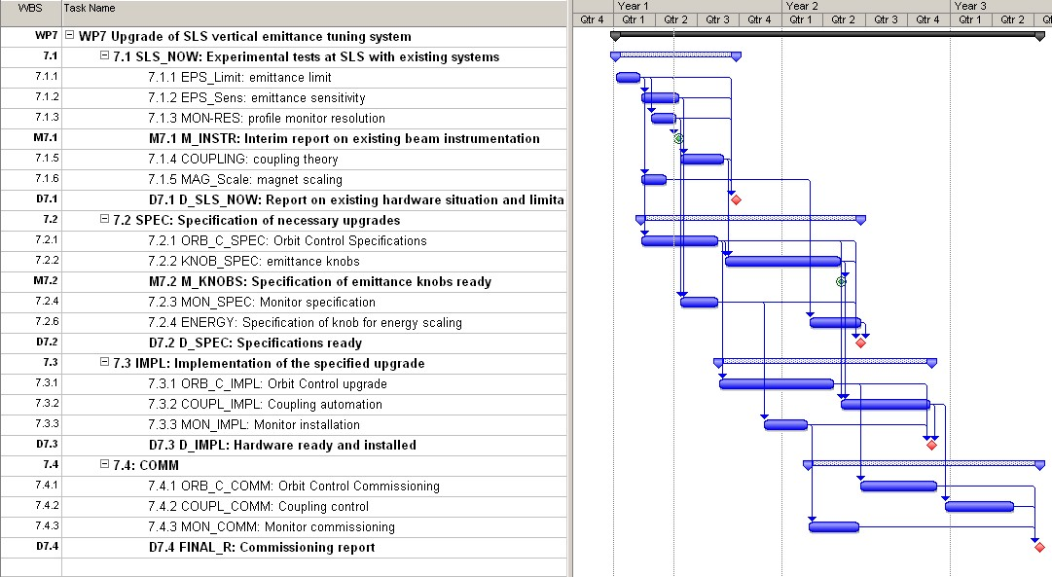
WP7 (SVET): new Gantt chart

