Slide 1

Structuring further Accelerator R&D
In Europe
TPB meeting
R. Aleksan
September 2nd, 2009
Introduction
General Context
Building TIARA
Conclusion

Slide 2

Unraveling the fundamental mysteries of the universe requires
to “recreate” the initial conditions of the “Big Bang”,
to search for rare events,
State of the art accelerators
“Energy Frontier” able to reach higher energy
“Intensity/Power Frontier” able to produce higher luminosity
“Probes Frontier” able to accelerate different probes
State of the art accelerator technology, instrumentation and
test facilities
These infrastructures and technology can be useful (vital)
to many research fields, as well as for industrial developments

Slide 3
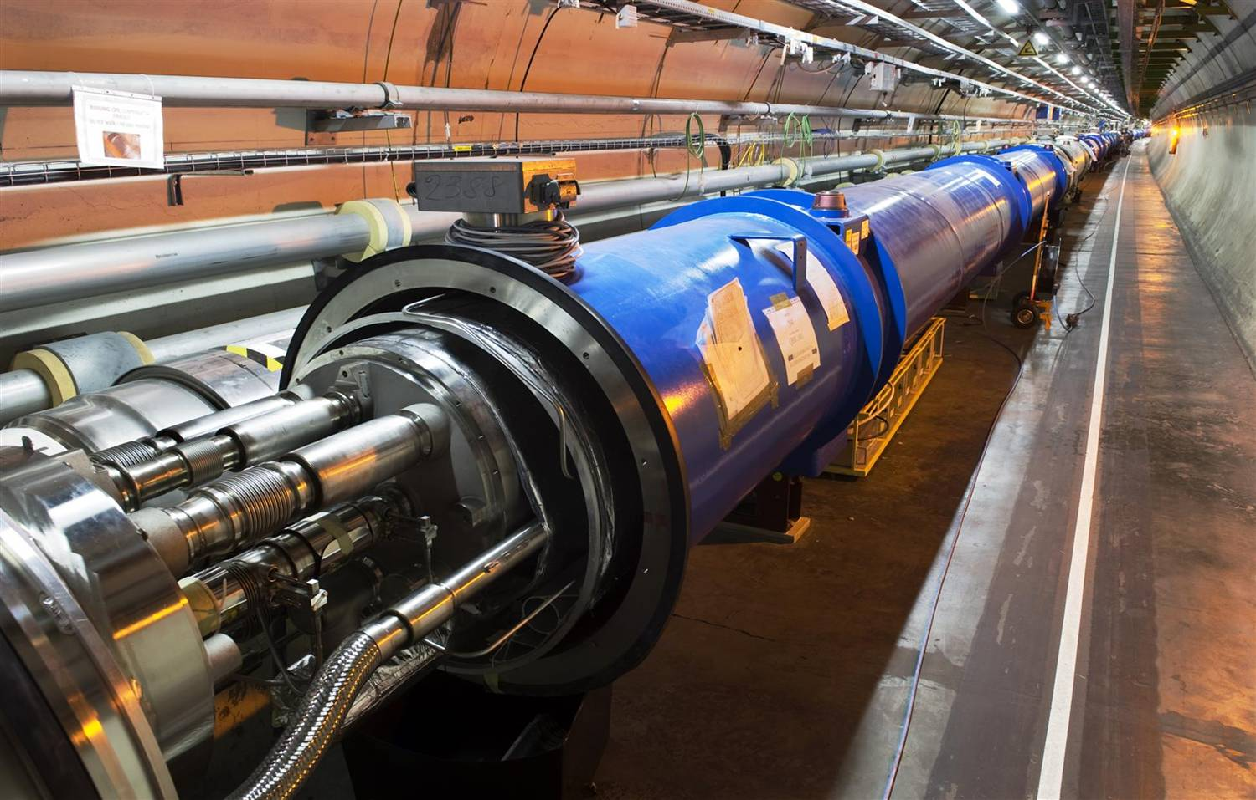
The LHC is the most recent illustration of
a state of the art accelerator

Slide 4
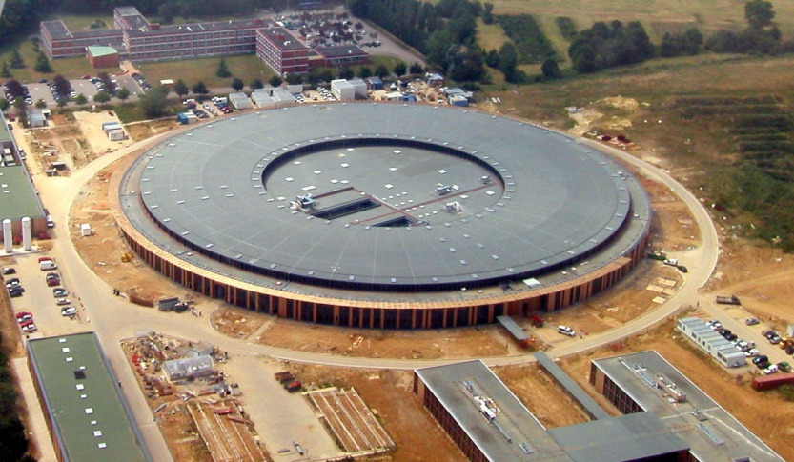
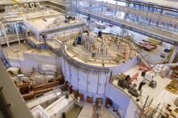
The use of Accelerators
The development of state of the art accelerators is essential for many many fields of science (fundamental, applied or industrial)
Research accelerators
Particle Physics
Nuclear Physics
Research fields using light source (condensed matter, biology, geophysics, human sciences…)
Research fields using spallation neutron sources (material sciences... )
Study of material for fusion
Study of transmutation
SOLEIL
ISIS
FLASH

Slide 5
The use of Accelerators
Examples
projects | Science field | Beam type | Estimated cost
LHC | Particle Physics | proton | 3700M€
FAIR | Nuclear Physics | Proton /ion | 1200M€
XFEL | multi fields | electron aphoton | 1050M€
ESS | multi fields | Proton aneutron | 1300M$
IFMIF | Fusion | Deuton aneutron | 1000M€
MYRRHA | Transmutation | Proton aneutron | 700M€
In past 50 years, about 1/3 of Physics Nobel Prizes are rewarding
work based on or carried out with accelerators
This « market » represents ~15 000 M€ for the next 15 years, i.e.
~1 000M€/year

Slide 6
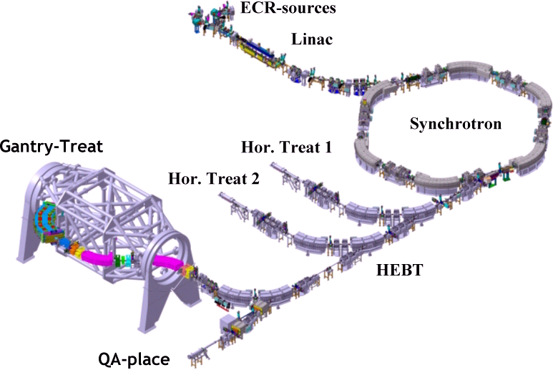
Clinical accelerators
Varian
radiotherapy
electron therapy
hadron (proton/ion)therapy
Radiotherapy linac
Gantry PSI
HIT (Heidelberg)

Slide 7
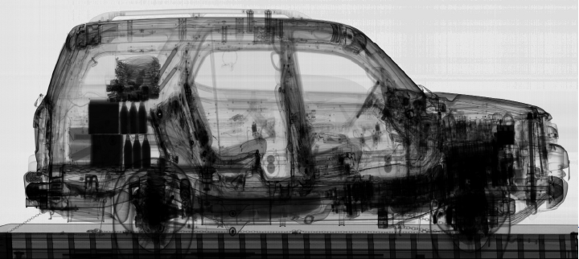
Industrial accelerators
ion implanters
electron cutting&welding
electron beam and X-ray irradiators
radioisotope production
…
Ion Implatation
accelerators
Energy (KeV)
Atoms/cm²
Security and inspection
X-ray accelerators

Slide 8
Industrial market for accelerators
Application | Total systems (2007) approx. | System sold/yr | Sales/yr ($M) | System price ($M)
Cancer Therapy | 9100 | 500 | 1800 | 2.0 - 5.0
Ion Implantation | 9500 | 500 | 1400 | 1.5 - 2.5
Electron cutting and welding | 4500 | 100 | 150 | 0.5 - 2.5
Electron beam and X-ray irradiators | 2000 | 75 | 130 | 0.2 - 8.0
Radioisotope production (incl. PET) | 550 | 50 | 70 | 1.0 - 30
Non-destructive testing (incl. security) | 650 | 100 | 70 | 0.3 - 2.0
Ion beam analysis (incl. AMS) | 200 | 25 | 30 | 0.4 - 1.5
Neutron generators (incl. sealed tubes) | 1000 | 50 | 30 | 0.1 - 3.0
Total | 27500 | 1400 | 3680
Total accelerators sales increasing more than 10% per year

Slide 9
To be able to build such accelerators, a strong
sustainable R&D program is indispensible
Exploratory R&D
Assessment of the validity of the principles
Demonstration of conceptual feasibility of new and innovative idea
Targeted R&D
Demonstration of the Technical feasibility of all critical components
Demonstration of fully engineered system feasibility
Industrialization R&D
Transfer of technology
Large scale feasibility and cost optimization
Diversification of Applications
It includes 3 levels of R&D

Slide 10
Carrying the needed R&D requires
Strong expertise and skilled personnel
Large variety of infrastructures
Training of young accelerator scientists
Large/Medium
Size labs
University
Industry
The potential
partners
Coordinated R&D Program
Hard to find all this to cover all aspects of accelerator R&D
in a single location or even a single country
We have to think at the European level, at least

Slide 11

Accelerator R&D in Europe (History and today’s Organization)
1) ECFA 2001 Report “The Future of Accelerator-based Particle Physics in Europe”
“an improved educational programme in the field of accelerator physics
and increased support for accelerator R&D activity in European universities, national facilities and CERN”
2) Absence of HEP in the FP of the EU
in 2002
R. Aleksan (Chair), M. Cerrada (CIEMAT),
R. Edgecock (CCLRC), E. Elsen (DESY) ,
S. Guiducci (LNF), J.-P. Koutchouk (CERN),
F. Richard (IN2P3/Orsay), L. Rivkin (PSI)
http://esgard.lal.in2p3.fr
The ESGARD should develop a proposal to optimize and enhance the outcome of the Research and Technical Development in the field of accelerator physics in Europe by
q promoting mutual coordination and facilitating the pooling of European resources
q promoting a coherent and coordinated utilization and development of infrastructures
q promoting inter-disciplinary collaboration including industry
This proposal is aimed at preparing and conducting a coherent set of bids to apply for EU funding in the 6th Framework Programme.

Slide 12

FP6
FP7
 | 2003 |  | 2004 | 2005 | 2006 | 2007 | 2008 |  | 2009 |  | 2010 | 2011 |  | 2012 |  | 2013 | 2014 | 2105
Accelerator R&D
CARE |  | 3 Networks (e, ν, p) |  |  |  |  |  |  | EuCARD
CARE |  | SRF |  |  |  |  |  |  | EuCARD (SRF)
CARE |  | PHIN |  |  |  |  |  |  | EuCARD (SRF, ANAC)
CARE |  |  |  | HIPPI |  |  |  |  | EuCARD (SRF, ColMat)
CARE |  |  |  | NED |  |  |  |  | EuCARD (HFM)
SLHC |  |  |  |  |  |  | SLHC-PP
EUROTEV |  |  |  | DS: ILC+CLIC |  |  | ILC-HiGrade
EURISOL |  |  |  | DS: Neutrino β-beam
DS νFact |  |  |  | Scoping study |  |  |  | DS-EuroNu
EUROLEAP |  |  |  |  | e in plasma
B-Factory |  |  |  |  |  |  | DS-EuroCrab???
EuCARD (ANAC)
EuCARD (ANAC)
Altogether EC has partially financed projects in FP6 and FP7
with a total budget of 160 M€ (59.6 M€ from EC)

Slide 13




Summary of Accelerator R&D projects co-financed by the EC
in FP6
Project | Type | Beam Type | Start date | Duration Years | Total Cost | EU contribution
CARE | I3 | All | 1/1/04 | 5 | 55 M€ | 15.2 M€
EUROTEV | DS | e⁺,e⁻ (LC) | 1/1/05 | 4 | 29 M€ | 9 M€
EURISOL | DS | Ion, p (ν β−beam) | 1/2/05 | 4.5 | 33 M€ (3.3 M€) | 9.2 M€ (1 M€)
EUROLEAP | NEST | e Plasma acceleration | 1/9/06 | 3 | 4.1 M€ | 2 M€
Total |  |  |  |  | >121 M€ (90) | 35.4 M€ (27.2)
Total cost of approved accelerator R&D projects: >121 M€ (~90 M€)
Total EC contribution: 35.4 M€ (~27.2M€ excluding Nuclear Phys.)

Slide 14

 | 2002 | 2003 |  | 2004 | 2005 | 2006 |  | 2007 | 2008 | 2009 |  | 2010 | 2011 | 2012
Accelerator R&D
CARE |  |  | 3 Networks (e, ν, p)
CARE |  |  | SRF
CARE |  |  | PHIN
CARE |  |  |  |  | HIPPI
CARE |  |  |  |  | NED
EUROTEV |  |  |  |  | DS: ILC+CLIC
EURISOL |  |  |  |  | DS: Neutrino β-beam
DS νFact |  |  |  |  | Scoping study
EUROLEAP |  |  |  |  |  |  | e in plasma
Exploratory R&D (plasma acceleration…)
Targeted R&D (i.e. toward specific projects such as SLHC, ILC/CLIC…)
Industrialization R&D (New conductor for high field magnets…)
These projects are well structured, with clear objectives, deliverables and milestones. They represent a fantastic asset and strength for the
HEP European community in order to play a leadership role
  In the improvement of present accelerators
  In the development of new accelerators

Slide 15
Summary of Accelerator R&D projects proposed in FP7 (call 1-3)
Project | Type | Beam Type | Start date | Duration Years | Total Cost | EC contribution
SLHC Preparatory | CNI | proton | 1/4/08 | 3 | 15.6 M€ | 5.2 M€
ILC-HiGrade Preparatory | CNI | e⁺,e⁻ (LC) | 1/2/08 | 4 | 9.8 M€ | 5.0 M€
EuroNu | DS | neutrino | 1/9/08 | 4 | 13.4 M€ | 4.0 M€
EuCARD | IA | All | 1/4/09 | 4 | 31.2 M€ | 10 M€
Total |  |  |  |  | 70.0 M€ | 24.2 M€
All EC financed projects pioneered by CARE have a continuation
in FP7 with a total budget of 70.0 M€ (24.2 M€ from EC)

Slide 16
In the meantime
CERN Council, as the HEP European Strategy Body, had included
accelerator R&D as a high priority item in its Strategy Document.
The LHC will be the energy frontier machine for the foreseeable future, maintaining
European leadership in the field; the highest priority is to fully exploit the physics
potential of the LHC, resources for completion of the initial programme have to be
secured such that machine and experiments can operate optimally at their design
performance. A subsequent major luminosity upgrade (SLHC), motivated by
physics results and operation experience, will be enabled by focussed R&D; to this
end, R&D for machine and detectors has to be vigorously pursued now and centrally
organized towards a luminosity upgrade by around 2015.
In order to be in the position to push the energy and luminosity frontier even further
it is vital to strengthen the advanced accelerator R&D programme; a coordinated
programme should be intensified, to develop the CLIC technology and highperformance
magnets for future accelerators, and to play a significant role in the study
and development of a high-intensity neutrino facility.
FP7 calls were used to strengthen further the strategy

Slide 17
We have to think beyond
ESGARD is already carrying out a coordination leading to development
of well organized European wide integrated R&D project for Particle Physics
(see the high success rate of FP proposals).
Building on this experience, we can and need to go further
A structure and mechanism that ensures the sustainability of accelerator R&D useful for many fields, which includes
The integration of R&D infrastructures and offered services
within a general framework
The development of a joint R&D program and the launching
of a set of consistent integrated accelerator R&D projects
The promotion of the education and training for accelerator sciences
A model for financing all of the above

Slide 18
Put all the ingredients presented in previous slides
i.e. Fields, Infrastructures, Partners
in a single coordinated structure

Slide 19
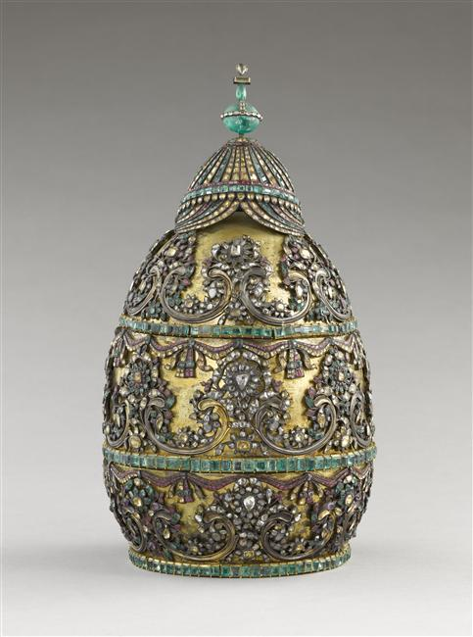

TIARA
Test Infrastructure and Accelerator Research Area
The Jewels of the Crown
A multi-field, coordinated pan-European distributed infrastructure
or

Slide 20
The Virtuous Triangle
R&D projects
Test Infrastructures
Education and Training
Coordination and Funding Mechanism

Slide 21
Joint Strategic programming
Elaborating a common European strategy toward the development
of accelerators , i.e.
Carrying a shared strategic analysis of the accelerator needs and perspectives
Developing a common strategy toward the development of accelerators
Developing a common accelerator R&D strategy based on a
continuous survey and evaluation of the European R&D needs

Slide 22
Joint R&D programming and the launching of a set of
consistent integrated accelerator R&D projects
Initiating and coordinating the launching of collaborative accelerator R&D projects by providing partial funding
Overseeing the progress of the accelerator R&D projects
Monitoring and promoting the exchange of information and personnel within and across fields
Establishing a partnership with the European industry to share
mature technology driven R&D and hand over production of industrialized components

Slide 23
Promotion of the education and
training for accelerator science
After a survey of the education and training for accelerator science in Europe, encouraging the development of support programs to strengthen further this area, such as, for example facilitating
the organization of summer school,
internship for master students,
promotion of European accelerator masters,
training on accelerator operation,
exchange of scientists…
Integration of accelerator science lecture halls and accelerator R&D complex should be investigated

Slide 24
Strengthening the collaboration with the industry
Understanding the industry needs for accelerators and related accelerator R&D infrastructures and Programs
Investigating how to industrialize recent technologies
Establishing a Technology Roadmap for industrial development of future accelerator components.

Slide 25
Needed Infrastructures
Test accelerators
for carrying accelerator R&D
10-100M€
TIER1
Specific large scale equipments
1-10M€
TIER2
Laboratory equipments
0.1-1M€
TIER3
A rough estimate of all these infrastructure is 500-1000 M€
These infrastructures need to be upgraded and/or new infrastructures are necessary
Creation of a pan-European Multi-Purpose
Distributed Test Infrastructure

Slide 26
Coordination of a panEuropean multi-purpose
Distributed Test Infrastructure
Monitoring and coordinating the use and the development of the
European test infrastructures for accelerator R&D
Monitoring accesses, including industry involvement
Identifying weaknesses and needed upgrades/investments and
assessing their costs
Make recommendations for upgrading and/or constructing new
Infrastructures as well as their corresponding R&D programs

Slide 27
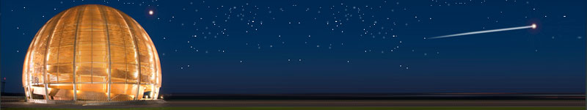
Conclusions
ESGARD has promoted and coordinated the elaboration
of a collaborative Accelerator R&D program in Europe
mainly for Particle Physics
Accelerator R&D is now fully part of the Particle Physics
program in Europe
We have now to go beyond and develop a mechanism
ensuring the sustainability of accelerator R&D
with a more comprehensive scope
With TIARA
Accelerator science could be a powerful mean
toward scientific, technical
and industrial breakthroughs…

