Slide 1

TIARA: Structuring further
Accelerator R&D in Europe
R. Aleksan
February 14th, 2011
Introduction
General Context
Building TIARA
Conclusion

Slide 2
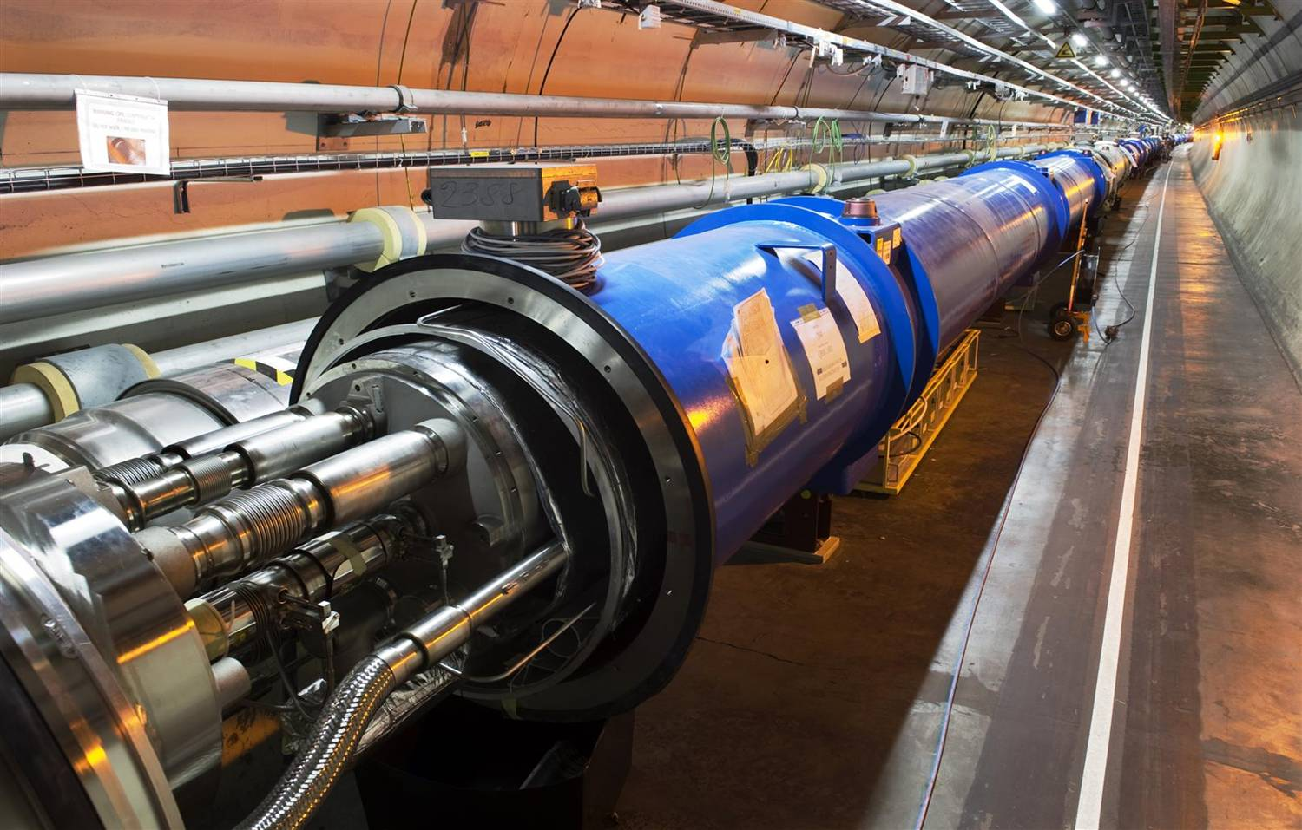
The use of Accelerators
The development of state of the art accelerators is essential for many many fields of science (fundamental, applied or industrial)
Research accelerators
Particle Physics, Nuclear Physics, Research fields using light source, Research fields using spallation neutron sources, Study of material for fusion, Study of transmutation…
In past 50 years, about 1/3 of Physics Nobel Prizes are rewarding work based on or carried out with accelerators
This « market » represents ~15 000 M€ for the next 15 years, i.e. ~1 000M€/year
Clinical accelerators
radiotherapy, electron therapy,
hadron (proton/ion)therapy…
Industrial accelerators
ion implanters, electron beam and X-ray irradiators, radioisotope production…
This market represents ~3 000M€/year and is increasing at a rate of ~10% /year

Slide 3

Unraveling the fundamental mysteries of the universe requires
to “recreate” the initial conditions of the “Big Bang”,
to search for rare events,
State of the art accelerators
“Energy Frontier” able to reach higher energy
“Intensity/Power Frontier” able to produce higher luminosity
“Probes Frontier” able to accelerate different probes
State of the art accelerator technology, instrumentation and
test facilities
These infrastructures and technology can be useful (vital)
to many research fields, as well as for industrial developments

Slide 4
The LHC is the most recent illustration of
a state of the art accelerator

Slide 5
The use of Accelerators
Examples
projects | Science field | Beam type | Estimated cost
LHC | Particle Physics | proton | 3700M€
FAIR | Nuclear Physics | Proton /ion | 1200M€
XFEL | multi fields | electron aphoton | 1050M€
ESS | multi fields | Proton aneutron | 1450M$
IFMIF | Fusion | Deuton aneutron | 1000M€
MYRRHA | Transmutation | Proton aneutron | 700M€
In past 50 years, about 1/3 of Physics Nobel Prizes are rewarding
work based on or carried out with accelerators
This « market » represents ~15 000 M€ for the next 15 years, i.e.
~1 000M€/year

Slide 6
Clinical accelerators
Industrial accelerators
radiotherapy
electron therapy
hadron (proton/ion)therapy
ion implanters
electron cutting&welding
electron beam and X-ray irradiators
radioisotope production
…
Application | Total systems (2007) approx. | System sold/yr | Sales/yr ($M) | System price ($M)
Cancer Therapy | 9100 | 500 | 1800 | 2.0 - 5.0
Ion Implantation | 9500 | 500 | 1400 | 1.5 - 2.5
Electron cutting and welding | 4500 | 100 | 150 | 0.5 - 2.5
Electron beam and X-ray irradiators | 2000 | 75 | 130 | 0.2 - 8.0
Radioisotope production (incl. PET) | 550 | 50 | 70 | 1.0 - 30
Non-destructive testing (incl. security) | 650 | 100 | 70 | 0.3 - 2.0
Ion beam analysis (incl. AMS) | 200 | 25 | 30 | 0.4 - 1.5
Neutron generators (incl. sealed tubes) | 1000 | 50 | 30 | 0.1 - 3.0
Total | 27500 | 1400 | 3680
Courtesy: R. Hamm
Total accelerators sales increasing more than 10% per year

Slide 7
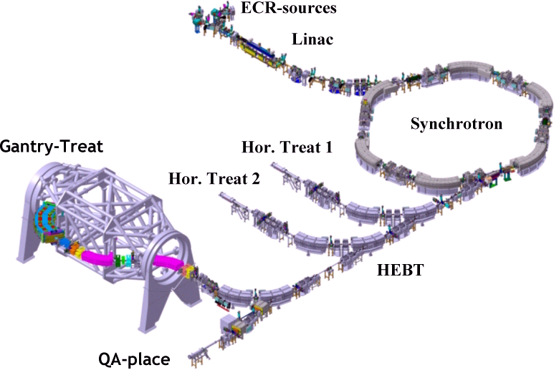
Clinical accelerators
Varian
radiotherapy
electron therapy
hadron (proton/ion)therapy
Radiotherapy linac
Gantry PSI
HIT (Heidelberg)

Slide 8
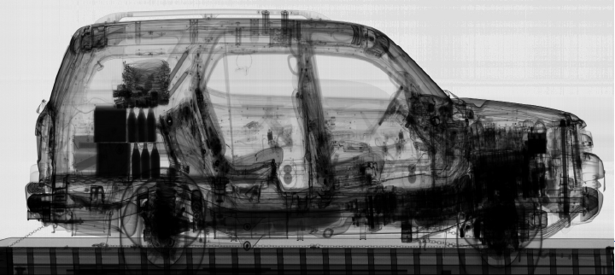
Industrial accelerators
ion implanters
electron cutting&welding
electron beam and X-ray irradiators
radioisotope production
…
Ion Implatation
accelerators
Energy (KeV)
Atoms/cm²
Security and inspection
X-ray accelerators

Slide 9

Accelerator R&D in Europe (History and today’s Organization)
1) ECFA 2001 Report “The Future of Accelerator-based Particle Physics in Europe”
“an improved educational programme in the field of accelerator physics
and increased support for accelerator R&D activity in European universities, national facilities and CERN”
in 2002
R. Aleksan (Chair), M. Cerrada (CIEMAT),
R. Edgecock (CCLRC), E. Elsen (DESY) ,
S. Guiducci (LNF), J.-P. Koutchouk (CERN),
F. Richard (IN2P3/Orsay), L. Rivkin (PSI)
http://www.esgard.org
ESGARD mandate develop and implement a Strategy to optimize and enhance the outcome of the Research and Technical Development in the field of accelerator physics in Europe
2) Absence of HEP in the FP of the EU
This strategy led to the preparation and implementation of a coherent set of collaborative projects using the incentive funding of the 6th and 7th Framework Programme.

Slide 10

ESGARD developed and implemented a strategy to promote Accelerator R&D
with the incentive of the EC Framework Programme within ERA
 | 2003 |  | 2004 | 2005 | 2006 | 2007 | 2008 |  | 2009 |  | 2010 | 2011 |  | 2012 |  | 2013 | 2014 | 2105
Accelerator R&D
CARE |  | 3 Networks (e, ν, p) |  |  |  |  |  |  | EuCARD
CARE |  | SRF |  |  |  |  |  |  | EuCARD (SRF)
CARE |  | PHIN |  |  |  |  |  |  | EuCARD (SRF, ANAC)
CARE |  |  |  | HIPPI |  |  |  |  | EuCARD (SRF, ColMat)
CARE |  |  |  | NED |  |  |  |  | EuCARD (HFM)
SLHC |  |  |  |  |  |  | SLHC-PP |  |  |  |  |  | HiLumi
EUROTEV |  |  |  | DS: ILC+CLIC |  |  | ILC-HiGrade (PP)
EURISOL |  |  |  | DS: Neutrino β-beam
DS νFact |  |  |  | Scoping study |  |  |  | DS-EuroNu
EUROLEAP |  |  |  |  | e in plasma
SuperB
TIARA |  |  |  |  |  |  |  |  |  |  |  | R&D-RI & program
FP6
FP7
EuCARD (ANAC)
EuCARD (ANAC)
Altogether EC has partially financed projects in FP6 and FP7
with a total budget of ~197 M€ (60 M€ from EC)

Slide 11
FP7-Planning of calls
and indicative budget
Total operational budget 1665 M€ | Call 1 2007 | Call 2 2007 | Call 3 2008 | Call 4 2008 | Call 5 2009 | Call 6 2010 | Call 7 2011
Integrating activities |  |  | 277 |  | 162 | 104 | <100
e-Infrastructures | 42 | 50 |  | 113 | x |  | x
Design studies | 31 |  |  |  |  | 20
Construction – Support to the Preparatory Phase | 147 |  |  |  | 45
Construction – Support to the Implementation Phase | RSFF (200 M€) + 130 M€ |  |  |  |  | 30
Policy Development and Programme Implementation | 8 | 14 | 5 |  | 9.94 | 9.5 | x
Total per call (M€) | 228 | 64 | 282 | 113 | 216.9 | 163.5
EuCARD
AIDA
(detector)
IA-accel. R&D
EuroNu
HiLumi
SLHC
HiGrad
TIARA
CRISP

Slide 12




Summary of Accelerator R&D projects co-financed by the EC
in FP6
Project | Type | Beam Type | Start date | Duration Years | Total Cost | EU contribution
CARE | I3 | All | 1/1/04 | 5 | 55 M€ | 15.2 M€
EUROTEV | DS | e⁺,e⁻ (LC) | 1/1/05 | 4 | 29 M€ | 9 M€
EURISOL | DS | Ion, p (ν β−beam) | 1/2/05 | 4.5 | 33 M€ (3.3 M€) | 9.2 M€ (1 M€)
EUROLEAP | NEST | e Plasma acceleration | 1/9/06 | 3 | 4.1 M€ | 2 M€
Total |  |  |  |  | >121 M€ (90) | 35.4 M€ (27.2)
Total cost of approved accelerator R&D projects: >121 M€ (~90 M€)
Total EC contribution: 35.4 M€ (~27.2M€ excluding Nuclear Phys.)

Slide 13

 | 2002 | 2003 |  | 2004 | 2005 | 2006 |  | 2007 | 2008 | 2009 |  | 2010 | 2011 | 2012
Accelerator R&D
CARE |  |  | 3 Networks (e, ν, p)
CARE |  |  | SRF
CARE |  |  | PHIN
CARE |  |  |  |  | HIPPI
CARE |  |  |  |  | NED
EUROTEV |  |  |  |  | DS: ILC+CLIC
EURISOL |  |  |  |  | DS: Neutrino β-beam
DS νFact |  |  |  |  | Scoping study
EUROLEAP |  |  |  |  |  |  | e in plasma
Exploratory R&D (plasma acceleration…)
Targeted R&D (i.e. toward specific projects such as SLHC, ILC/CLIC…)
Industrialization R&D (New conductor for high field magnets…)
These projects are well structured, with clear objectives, deliverables and milestones. They represent a fantastic asset and strength for the
HEP European community in order to play a leadership role
  In the improvement of present accelerators
  In the development of new accelerators

Slide 14




Summary of Accelerator R&D projects proposed in FP7 (call 1-3)
Project | Type | Beam Type | Start date | Duration Years | Total Cost | EC contribution
SLHC Preparatory | CNI-PP | proton | 1/4/08 | 3 | 15.6 M€ | 5.2 M€
ILC-HiGrade Preparatory | CNI-PP | e⁺,e⁻ (LC) | 1/2/08 | 4 | 9.8 M€ | 5.0 M€
EuroNu | DS | neutrino | 1/9/08 | 4 | 13.4 M€ | 4.0 M€
EuCARD | IA | All | 1/4/09 | 4 | 31.2 M€ | 10 M€
TIARA | CNI-PP | All | 1/1/11 | 3 | 9.2 M€ | 3.9 M€
HL-LHC | DS | All | 1/1/12? | 4 | 27.3 M€ | 5.0 M€
Total |  |  |  |  | 106.5 M€ | 33.1 M€
All EC financed projects pioneered by CARE have a continuation
in FP7 with a total budget of 106.5 M€ (33.1 M€ from EC)

Slide 15
But the trend seems that the EC funding is diminishing steadily
For FP8, the EC wishes to support of the implemetation and operation of RI
TC=90M€
EC=27.2 M€
TC=106.5M€
EC=33.1 M€
AIDA(detector)
FP6
FP7

Slide 16
To be able to build future accelerators, a strong
sustainable R&D program is indispensible
Exploratory R&D
Assessment of new ideas
Demonstration of conceptual feasibility of new and innovative principles
Targeted R&D
Demonstration of the Technical feasibility of all critical components
Demonstration of the feasibility of fully engineered system
Industrialization R&D
Transfer of technology
Large scale production and cost optimization
Diversification of Applications
It includes 3 levels of R&D
It requires large and costly infrastructures
We have to think at the European level, at least

Slide 17
Carrying the needed R&D requires
Strong expertise and skilled personnel
Large variety of infrastructures
Training of young accelerator scientists
Large/Medium
Size labs
University
Industry
The potential
partners
Coordinated R&D Program
Hard to find all this to cover all aspects of accelerator R&D
in a single location or even a single country
We have to think at the European level, at least

Slide 18
Since then, the importance of accelerator R&D has been further emphasized
In 2006
CERN Council, as the HEP European Strategy Body, had endorsed
the needs to develop strongly accelerator R&D and included it
as a high priority item in its Strategy Document.
More recently
CERN Council has included “Advanced Accelerator R&D” in the
Roadmap for Research Infrastructures (ESFRI 2008 Roadmap)
as the second item in list for particle physics, just after LHC
“It is vital to strengthen the advanced accelerator R&D
programme in Europe, providing a strong technological basis
for future projects in particle physics.”

Slide 19
First item in the Strategy Document
The LHC will be the energy frontier machine for the foreseeable future, maintaining
European leadership in the field; the highest priority is to fully exploit the physics
potential of the LHC, resources for completion of the initial programme have to be
secured such that machine and experiments can operate optimally at their design
performance. A subsequent major luminosity upgrade (SLHC), motivated by
physics results and operation experience, will be enabled by focussed R&D; to this
end, R&D for machine and detectors has to be vigorously pursued now and centrally
organized towards a luminosity upgrade by around 2015.
Second item in the Strategy Document
In order to be in the position to push the energy and luminosity frontier even further
it is vital to strengthen the advanced accelerator R&D programme; a coordinated
programme should be intensified, to develop the CLIC technology and highperformance
magnets for future accelerators, and to play a significant role in the study
and development of a high-intensity neutrino facility.

Slide 20
We have to think beyond
ESGARD is already carrying out a coordination leading to development
of well organized European wide integrated R&D project for Particle Physics
(see the high success rate of FP proposals).
Building on this experience, we can and need to go further
A structure and mechanism that ensures the sustainability of accelerator R&D useful for many fields, which includes
The integration of R&D infrastructures and offered services
within a general framework (including industry)
The development of a joint R&D program and the launching
of a set of consistent integrated accelerator R&D projects
The promotion of the education and training for accelerator science and technology
A model for financing all of the above

Slide 21

Test Infrastructure and Accelerator Research Area
TIARA website: http://www.eu-tiara.eu
Accelerating Knowledge and Innovation
A multi-field, coordinated pan-European distributed infrastructure
Joint particle accelerator R&D programming in Europe and the integration of the required infrastructures

Slide 22
The Virtuous Triangle
R&D projects
Test Infrastructures
Education and Training
Innovations for
Cultural, Medical,
Industrial…
applications
Innovations for
Fundamental
Research
Infrastructures
Coordination and Funding Mechanism

Slide 23


Creation of a coordinated panEuropean multi-purpose distributed Test Infrastructure
Joint Strategic Analysis of the accelerator needs
and perspective for the development of R&D RI
Joint R&D programming and launching of a set
of consistent integrated accelerator R&D projects
Promotion of the education and training for accelerator science
Strengthening the collaboration with the industry

Slide 24
Needed Infrastructures
Test accelerators
for carrying accelerator R&D
10-100M€
TIER1
Specific large scale equipments
1-10M€
TIER2
Laboratory equipments
0.1-1M€
TIER3
A rough estimate of all these infrastructure is 500-1000 M€
These infrastructures need to be upgraded and/or new infrastructures are necessary

Slide 25
Creation of a coordinated panEuropean
multi-purpose distributed Test Infrastructure
Monitoring and coordinating the use and the development of the
European test infrastructures for accelerator R&D
Facilitating accesses to R&D RIs, including industry involvement
Identifying weaknesses and needed upgrades/investments and
assessing their costs
Making recommendations and contributing to upgrade
and/or construction of new R&D Infrastructures as well as
their corresponding R&D programs

Slide 26
Joint Strategic Analysis
Elaborating a common European strategy toward the development
of accelerators , i.e.
Carrying a shared strategic analysis of the accelerator needs and perspectives
Developing a common strategy toward the development of accelerators
Developing a common accelerator R&D strategy based on a
continuous survey and evaluation of the European R&D needs

Slide 27
Joint R&D programming and the launching of a set of
consistent integrated accelerator R&D projects
Defining procedures for launching of collaborative accelerator R&D projects and providing partial funding
Overseeing the progress of the accelerator R&D projects
Monitoring and promoting the exchange of information and personnel within and across fields
Establishing a partnership with the European industry to share
mature technology driven R&D and hand over production of industrialized components

Slide 28
Promotion of the education and
training for accelerator science
After a survey of the education and training for accelerator science in Europe, encouraging the development of support programs to strengthen further this area, such as,
for example promoting and facilitating
the organization of summer school,
internship for master students,
the creation of European accelerator masters,
training on accelerator operation,
exchange of scientists…
Integration of accelerator science lecture halls and accelerator R&D complex should also be investigated

Slide 29
Strengthening the collaboration with the industry
Understanding the industry needs for accelerators and related accelerator R&D infrastructures and Programs
Encouraging the industrialization of recent technologies
Establishing a Technology Roadmap for industrial development of future accelerator components.

Slide 30
11 participants (8 countries + 1 int. organisation)
Number | Organization Name | Country
1(coordinator) | CEA | France
2 | CERN | International
3 | CNRS | France
4 | CIEMAT | Spain
5 | DESY | Germany
6 | GSI | Germany
7 | INFN | Italy
8 | PSI | Switzerland
9 | STFC | UK
10 | Uppsala University (rep. Nordic Consortium) | Sweden
11 | IPJ-PAN | Poland

Slide 31
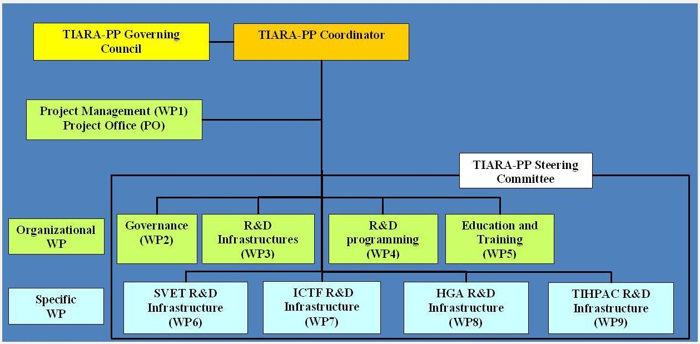
http://www.eu-tiara.eu
2009, Sept. 18th : TIARA has been presented and approved by the
CERN Council at the European session of the Council
FP7-PP call in Dec. 2009, accepted in 2010 and started in 2011
Duration:
3 years
R. A.
F. Kircher
C. Tanguy
R. A.
A. Unnervik
P. Pierini
P. Burrows
Y. Papaphilippou
K. Long
M. Biagini
S. Bousson
Total Cost: € 9 139 196 EC contribution: € 3 900 000

Slide 32
Organization (cont’d)
1. Management of TIARA-PP
WP1: Management of the consortium (MGT)
Objective: Organization of the Preparatory Phase work,
Dissemination and outreach
2. General Coordination and Support Work Packages
WP2: Governance of TIARA (SUPP)
Objective: Developing governance allowing one to involve as many fields as possible
WP3: Accelerator R&D Infrastructures in Europe (COORD)
Objective: Integrating and optimizing European Infrastructures for accelerator R&D
WP4: Joint R&D programming (COORD)
Objective: Defining a Joint R&D Programme in the field of accelerator science
WP5: Education and Training for accelerator sciences (SUPP)
Objective: Promoting education and training for accelerator research in Europe

Slide 33
WP2 - Governance
WP2: Governance of TIARA (SUPP)
Objective: Developing governance allowing one to involve as many fields as possible
2.1 Agreement on TIARA General Issues
2.2 Structural and Financial Needs
  2.2.1 Advising Mechanisms and Organization
  2.2.2 Identification of the Bodies with which Collaboration is needed
  2.2.3 Enabling efficient communication, dissemination and outreach
  2.2.4 Financial Management Needs
2.3 Toward the TIARA Implementation
  2.3.1 Agreement on Initial TIARA Infrastructures
  2.3.2 Financial Management Model and Engineering
  2.3.3 Overall Legal Structure
In 2012
In 2013

Slide 34
WP3: R&D Infrastructures
WP3: Accelerator R&D Infrastructures in Europe (COORD)
Objective: Integrating and optimizing European Infrastructures for accelerator R&D
3.1 Survey of accelerator R&D infrastructures and Establishing Communication with Industry
3.2 Assessing the current, medium- and long-term needs for accelerator R&D infrastructures
3.3 Sharing R&D Infrastructures and Developing Joint R&D Infrastructures
3.4 Definition of a Technology Roadmap for the Development of Future Accelerator Components in Industry
3.5 Definition of the appropriate Structure for ensuring the Sustainability of the evaluation and recommendations procedures within TIARA and determination of common Costing methods for the upgrade and
construction of individual large infrastructures.
3.6 Ensuring Access to the TIARA accelerator R&D Infrastructures.
3.7 Joining the TIARA distributed accelerator R&D Infrastructure
In 2012
In 2013

Slide 35
WP4: R&D Programme
WP4: Joint R&D programming (COORD)
Objective: Defining a Joint R&D Programme in the field of accelerator science
4.1 Identification of Key Accelerator research Areas and Key technical Issues for a coherent joint R&D programme.
4.2 Procedure for initiating and methodology for costing and implementing collaborative R&D Projects
4.3 Definition of the coherent collaborative Accelerator R&D Program (this is an input to WP3) and identification of the necessary infrastructures. 3.2.
In 2012
In 2013

Slide 36
WP5: Education & Training
WP5: Education and Training for accelerator sciences (SUPP)
Objective: Promoting education and training for accelerator research in Europe
5.1 Performing a Survey of the numbers of students, courses, and teaching resources in Europe in the field of Accelerator Science and establishing a common resources database
5.2 Evaluating and developing the “market” for trained Accelerator Scientists (physicists, engineers and technicians) for research, healthcare, and public service.
5.3 Determining a plan of action for promoting Accelerator Science and Technology within schools, universities and research organizations, and society, and estimation of required resources for the proposed actions
In 2012
In 2013

Slide 37
Industry
One of the goals of TIARA is to strengthen relations with industry.
Several aspects of TIARA concern industry
WP2:
How should we associate the industrial sector in TIARA Governance
WP3:
Study options for sharing R&D infrastructures and developing joint R&D Infrastructures with the industry
Define technology roadmap for the development of future accelerator components in industry.
WP4:
Develop an accelerator R&D programme in Europe
WP5:
Survey of the numbers of students, courses, and teaching resources
Evaluation and Study of the development of the market for Accelerator Sciences
Establish a plan of action for promoting Accelerator Science and Technology

Slide 38
Organization (cont’d)
3. Specific RTD Work Packages
WP6: SLS Emittance Tuning System Infrastructure (SVET)
Objective: Upgrade of SLS at PSI for very low emittance studies
Main interested projects: CLIC, Light Sources, SuperB
WP7: Ionisation Cooling Test Facility (ICTF)
Objective: Upgrade of Test Infrastructure at RAL for ionisation cooling studies
Main interested projects: Neutrino Factory
WP8: High Gradiant Acceleration Infrastrcuture (HGA)
Objective: Construction at LNF of SC C-Band High Gradiant Test Infrastructure
Main interested projects: SuperB, FEL
WP9: Test Infrastructure for High Power Accelerator Components (TIHPAC)
Objective: Design of infrastructures for multi MW target complex tests and of test cryostat for SC low beta SC cavity tests
Main interested projects: EURISOL, ESS, MYRRHA

Slide 39
WP6 - SVET
SVET: “SLS Vertical Emittance Tuning”
Objectives:
  Allow the Swiss Light Source (SLS) to be used as an R&D Infrastructure
  Demonstrate ultra-small vertical emittances as required for future Linear Collider Damping Rings (e.g. 5 nm normalized, <1 pm @ 2.86 GeV for CLIC)
  Enable to extend tests to lower energies (IBS dominated regime).

Slide 40
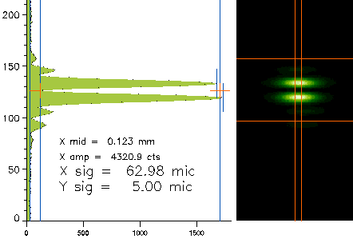
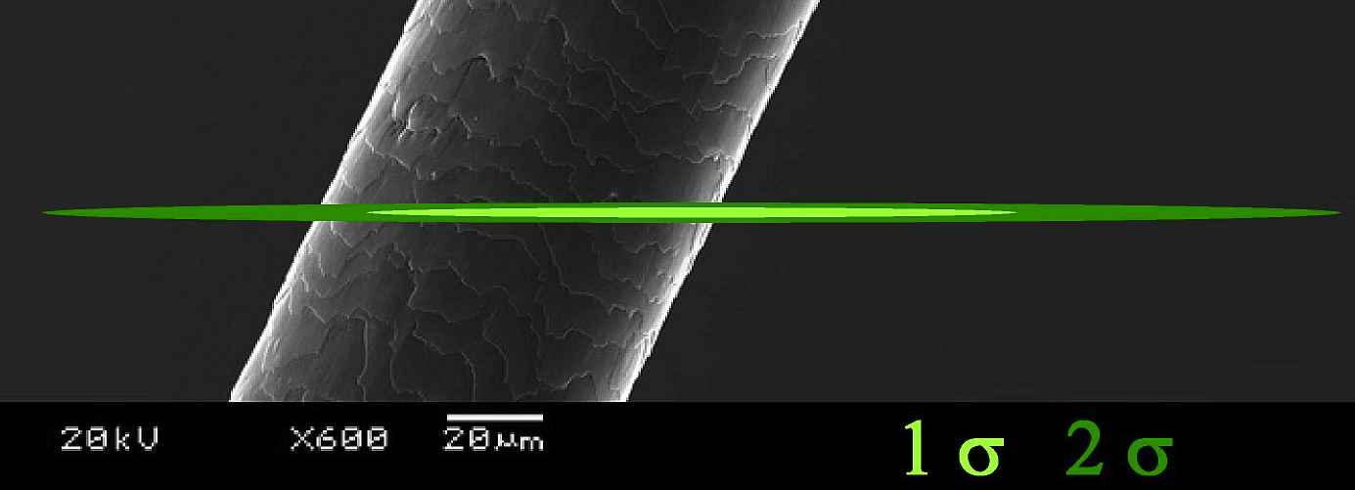
WP6 - SVET
Emittance achievements
Best result up to March 16, 2011
Beam height 5 ± 0.5 μm RMS
ε_{y} = 1.9 ± 0.4 pm
Vertical emittance WORLD RECORD
End 2012:
ε_{y} = 0.9 ± 0.4 pm
with beam of 400 mA

Slide 41
WP6 - SVET
Vertical emittance WORLD RECORD
After re-alignment campaign of last autumn, series of MD shifts scheduled (end of 2011)
Beam of 400 mA stored in top up mode
Different methods of coupling suppression using 36 skew quadrupoles (combination of response matrix based correction and random walk optimisation)
Performance of existing emittance monitor had to be further stretched to get beam profile data at a size of around 3-4μm
Vertical emittance reduced to a minimum value of 0.9±0.4pm (CLIC damping rings target vertical emittance) which is a new world record
Work in progress for reproducibility of this result and understanding of systematic model errors
Even at this early stage of analysis, this achievement is remarkable, demonstrating the potential of the applied methods and measurement techniques at the SLS storage ring

Slide 42
WP7 - ICTF
ICTF: “Ionization Cooling Test Facility” @ RAL
for testing the cooling of muon beam with the aim of developing neutrino factory
Objective within TIARA:
  Upgrade of the RF system of the experimental Hall for High power operation
7.1 ICTF RF power infrastructure
Including
  Specification and Design of RF power distribution system for MICE stepVI
  Assembly, test and commissioning of RF High Power Amplifiers
7.2 Novel pulsed RF power amplifier design
Including
  Development and test of Diacrode based High power amplifier
In 2013
In 2013

Slide 43
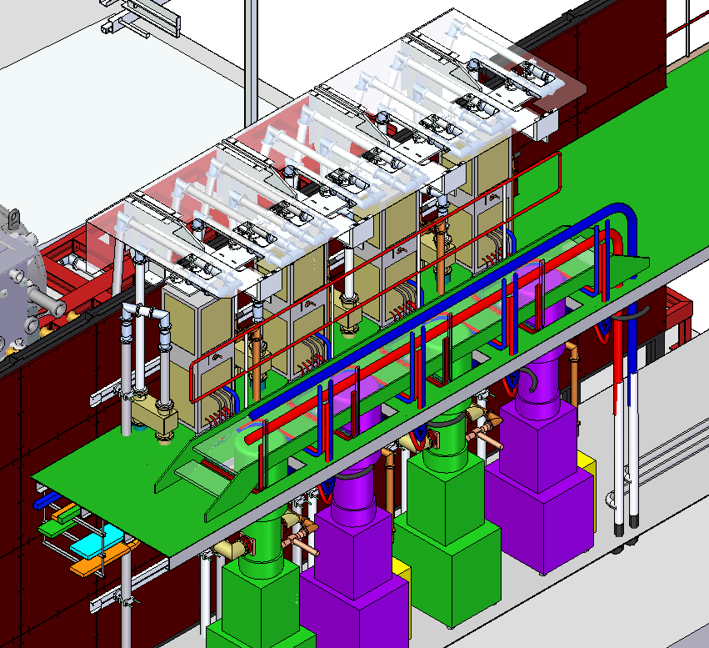
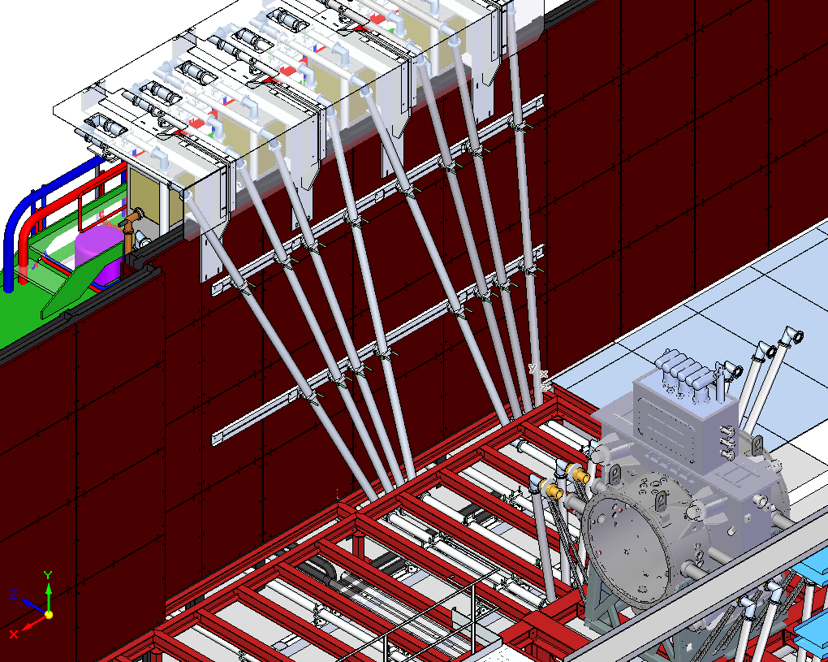
WP7 - ICTF
  Specification and Design of RF power distribution system for MICE stepVI
Amplifier to cavity
distribution
Coax distribution

Slide 44
WP8 - HGA
Goal: energy upgrade of the Frascati SPARC test-facility linac for studying SASE-FEL based X-ray source
  by designing, constructing and commissioning 2 C-band (f=5712 MHz) TW high-gradient accelerating structures
Work Breakdown:
  WP8.1 : Study of SPARC upgrade in Energy (INFN)
  WP8.2 : RF Low level Electronics for SPARC (PSI)
  WP8.3 : Construction and test of 2 C-band sections (INFN)
In 2013

Slide 45
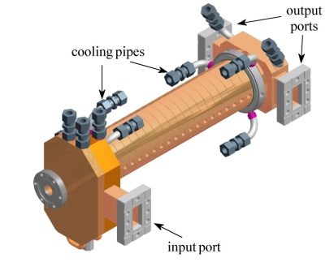
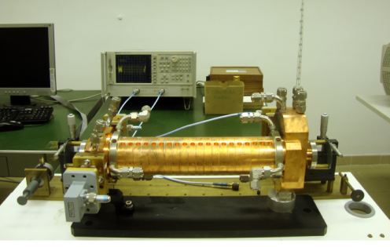
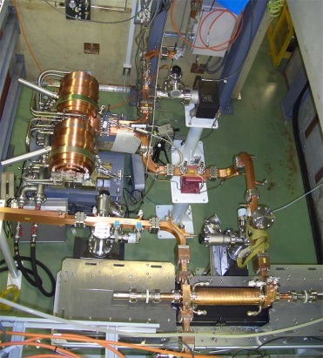
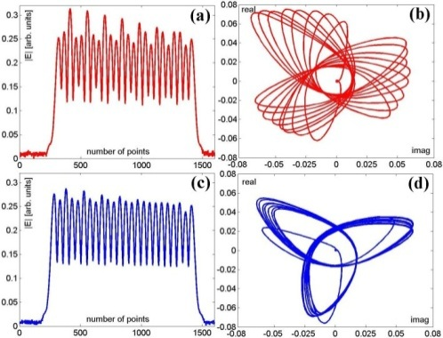
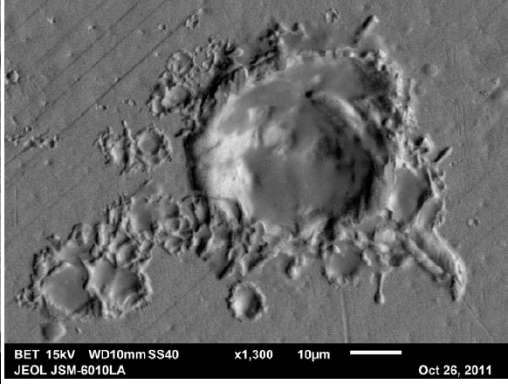
WP8 - HGA
Status of C-band (5712 MHz) TW accelerating sections
Design of TW structures for SPARC
Realization of a prototype with a reduced number of cells
Test at high power @ KEK of the prototype
Tuning of the prototype
Inspection of the cells and coupler status after
high power RF tests

Slide 46
WP8 - HGA
Status of C-band (5712 MHz) TW accelerating sections
(in progress)
First accelerating structure :
  The cells have been fabricated and are beeing brazed
  The input/output couplers have been fabricated and the brazing is in progress
Second accelerating structure :
  The cells are under fabrication
  The input/output couplers are under fabrication

Slide 47
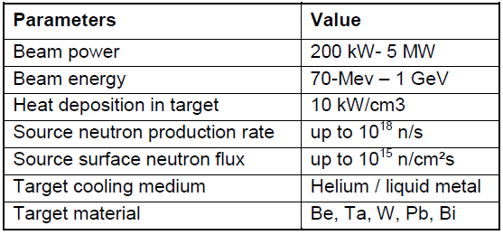
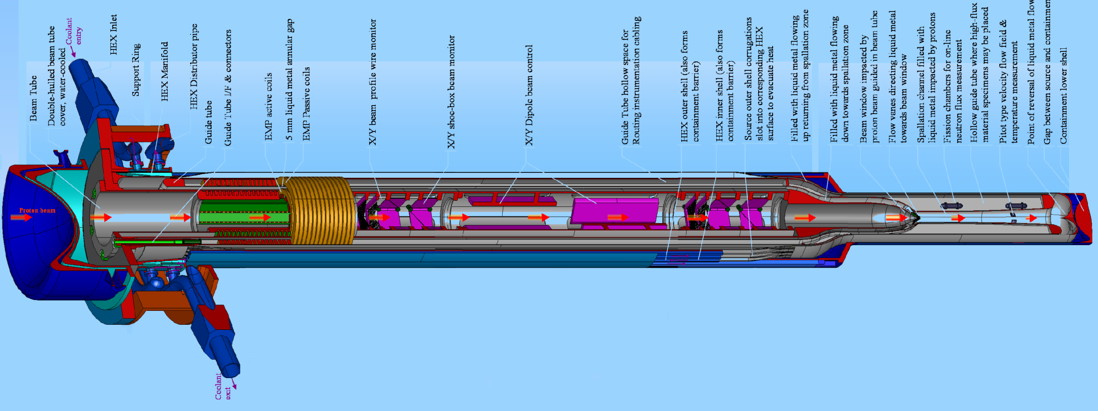
WP9 - TIHPAC
TIHPAC: Test Infrastructure for High Power Accelerator Components
9.1 Design Multi MW Irradiation Facility for complex target testing
Preliminary liquid concept Engineering detail

Slide 48
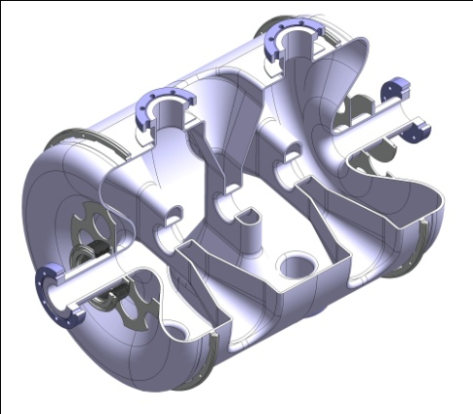
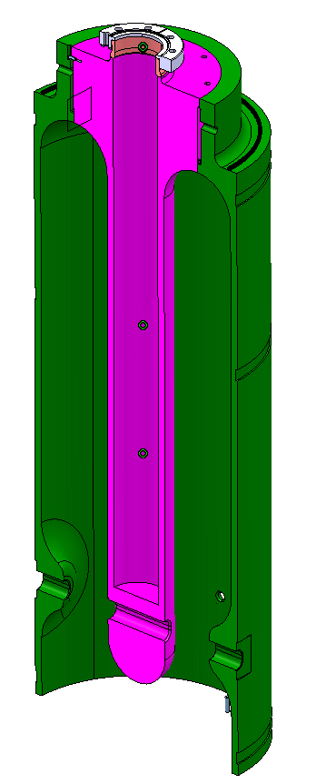
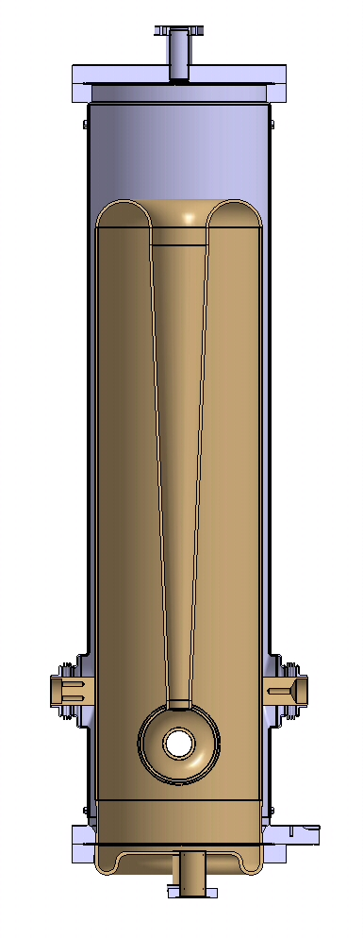
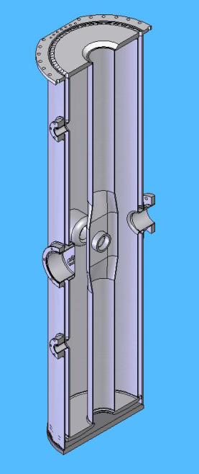
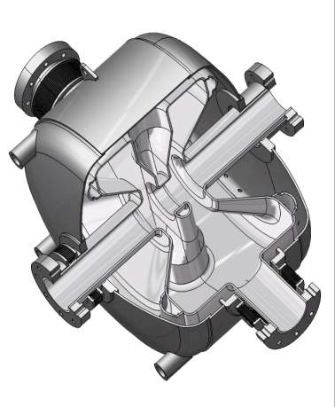
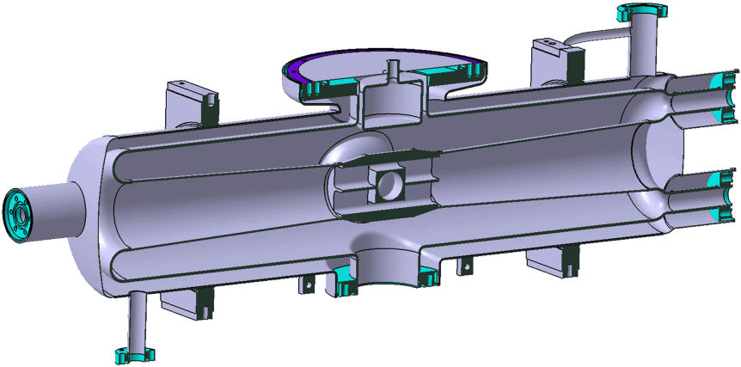
WP9 - TIHPAC
9.2 Design of a fully equipped low beta Cavities Test Cryostat
Challenge is to develop a versatile test facility allowing one to test different types of cavities
QWR
Triple spoke
QWR
HWR
Single spoke
HWR

Slide 49
Status
  Official start 1/1/2011
  February 23-24, 2011:
  TIARA-PP Kickoff at CERN
  November 8-9, 2011:
  Governing Council in Uppsala
Next large event

Slide 50
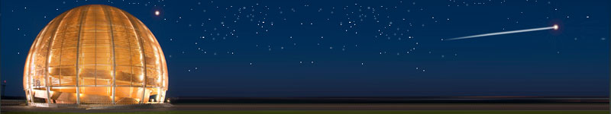
Conclusions
After having established an accelerator R&D strategy,
implemented through several projects in FP6 & FP7,
ESGARD proposed to go one step further with the TIARA
Concept.
The EC has approved TIARA as a Preparatory Phase project
with an EC funding of 3.9 M€.
The project has started on 1/1/2011 and is on track.
TIARA will hopefully establish the groundbase for supporting
sustainably Accelerator R&D and infrastructures in Europe through “program funding” in FP8
Accelerator science is a powerful mean
toward scientific, technical and
industrial breakthroughs and innovations…
TIARA will strengthen significantly this potential

