Slide 1

The EU R&D for Accelerators
HiLumi Kickoff
R. Aleksan
November 18th, 2011
Introduction
HiLumi in General Context
Building TIARA
Conclusion

Slide 2
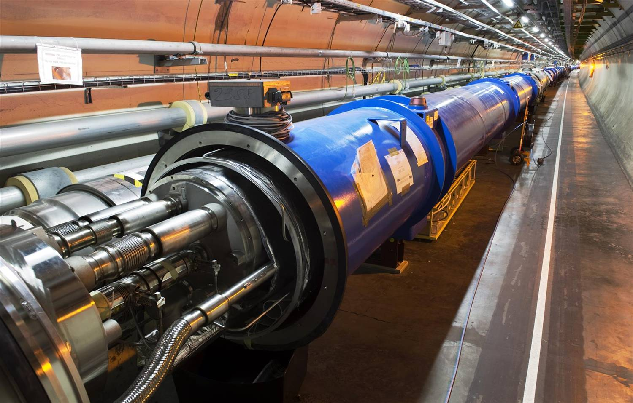
The use of Accelerators
The development of state of the art accelerators is essential for many many fields of science (fundamental, applied or industrial)
Research accelerators
Particle Physics, Nuclear Physics, Research fields using light source, Research fields using spallation neutron sources, Study of material for fusion, Study of transmutation…
In past 50 years, about 1/3 of Physics Nobel Prizes are rewarding work based on or carried out with accelerators
This « market » represents ~15 000 M€ for the next 15 years, i.e. ~1 000M€/year
Clinical accelerators
radiotherapy, electron therapy,
hadron (proton/ion)therapy…
Industrial accelerators
ion implanters, electron beam and X-ray irradiators, radioisotope production…
This market represents ~3 000M€/year and is increasing at a rate of ~10% /year

Slide 3

Unraveling the fundamental mysteries of the universe requires
to “recreate” the initial conditions of the “Big Bang”,
to search for rare events,
State of the art accelerators
“Energy Frontier” able to reach higher energy
“Intensity/Power Frontier” able to produce higher luminosity
“Probes Diversity” able to accelerate different probes
State of the art accelerator technology, instrumentation and
test facilities
These infrastructures and technology can be useful (vital)
to many research fields, as well as for industrial developments

Slide 4
The use of Accelerators
Examples
projects | Science field | Beam type | Estimated cost
LHC | Particle Physics | proton | 3700M€
FAIR | Nuclear Physics | Proton /ion | 1200M€
XFEL | multi fields | electron aphoton | 1100M€
ESS | multi fields | Proton aneutron | 1450M$
IFMIF | Fusion | Deuton aneutron | 1000M€
MYRRHA | Transmutation | Proton aneutron | 700M€
In past 50 years, about 1/3 of Physics Nobel Prizes are rewarding
work based on or carried out with accelerators
This « market » represents ~15 000 M€ for the next 15 years, i.e.
~1 000M€/year

Slide 5
Clinical accelerators
Industrial accelerators
radiotherapy
electron therapy
hadron (proton/ion)therapy
ion implanters
electron cutting&welding
electron beam and X-ray irradiators
radioisotope production
…
Application | Total systems (2007) approx. | System sold/yr | Sales/yr ($M) | System price ($M)
Cancer Therapy | 9100 | 500 | 1800 | 2.0 - 5.0
Ion Implantation | 9500 | 500 | 1400 | 1.5 - 2.5
Electron cutting and welding | 4500 | 100 | 150 | 0.5 - 2.5
Electron beam and X-ray irradiators | 2000 | 75 | 130 | 0.2 - 8.0
Radioisotope production (incl. PET) | 550 | 50 | 70 | 1.0 - 30
Non-destructive testing (incl. security) | 650 | 100 | 70 | 0.3 - 2.0
Ion beam analysis (incl. AMS) | 200 | 25 | 30 | 0.4 - 1.5
Neutron generators (incl. sealed tubes) | 1000 | 50 | 30 | 0.1 - 3.0
Total | 27500 | 1400 | 3680
Courtesy: R. Hamm
Total accelerators sales increasing more than 10% per year

Slide 6
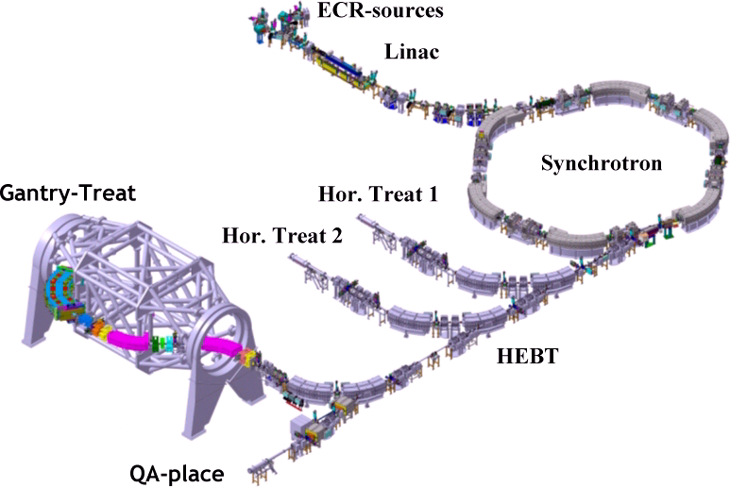
Clinical accelerators
Varian
radiotherapy
electron therapy
hadron (proton/ion)therapy
Radiotherapy linac
Gantry PSI
HIT (Heidelberg)

Slide 7
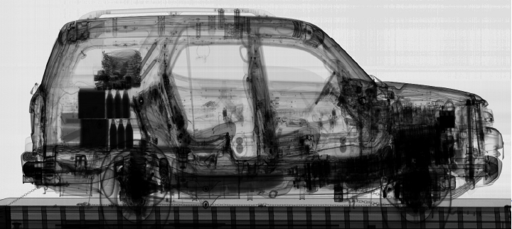
Industrial accelerators
ion implanters
electron cutting&welding
electron beam and X-ray irradiators
radioisotope production
…
Ion Implatation
accelerators
Energy (KeV)
Atoms/cm²
Security and inspection
X-ray accelerators

Slide 8

Accelerator R&D in Europe (History and today’s Organization)
1) ECFA 2001 Report “The Future of Accelerator-based Particle Physics in Europe”
“an improved educational programme in the field of accelerator physics
and increased support for accelerator R&D activity in European universities, national facilities and CERN”
in 2002
R. Aleksan (Chair), M. Cerrada (CIEMAT),
R. Edgecock (CCLRC), E. Elsen (DESY) ,
S. Guiducci (LNF), J.-P. Koutchouk (CERN),
F. Richard (IN2P3/Orsay), L. Rivkin (PSI)
http://www.esgard.org
ESGARD mandate develop and implement a Strategy to optimize and enhance the outcome of the Research and Technical Development in the field of accelerator physics in Europe
In 2006, CERN Council, as the HEP European Strategy Body, had
stressed further the needs to strengthen further accelerator R&D and
included it as a high priority item in its Strategy Document.

Slide 9
The ESGARD Strategy
Use the incentive of the European Commission Framework Programmes (FP6, 7…) to implement a coherent set of accelerator R&D collaborative projects
Including
Multipurpose R&D Projects (Integrating Activities: Incubators)
Targeted Design Studies (DS) and R&D for specific Accelerator
Projects
Preparation Phase (PP) and final R&D projects for launching
construction
With the quantitative objective to augment significantly the
EC contribution
For each euros from the EC,
Get ~2 more euros from the partners
(i.e. organizations/labs/universities/industries…)

Slide 10

ESGARD developed and implemented a strategy to promote Accelerator R&D
with the incentive of the EC Framework Programme within ERA
 | 2003 |  | 2004 | 2005 | 2006 | 2007 | 2008 |  | 2009 |  | 2010 | 2011 |  | 2012 |  | 2013 | 2014 | 2105
Accelerator R&D
CARE |  | 3 Networks (e, ν, p) |  |  |  |  |  |  | EuCARD
CARE |  | SRF |  |  |  |  |  |  | EuCARD (SRF)
CARE |  | PHIN |  |  |  |  |  |  | EuCARD (SRF, ANAC)
CARE |  |  |  | HIPPI |  |  |  |  | EuCARD (SRF, ColMat)
CARE |  |  |  | NED |  |  |  |  | EuCARD (HFM)
SLHC |  |  |  |  |  |  | SLHC-PP |  |  |  |  |  | HiLumi
EUROTEV |  |  |  | DS: ILC+CLIC |  |  | ILC-HiGrade (PP)
EURISOL |  |  |  | DS: Neutrino β-beam
DS νFact |  |  |  | Scoping study |  |  |  | DS-EuroNu
EUROLEAP |  |  |  |  | e in plasma
SuperB
TIARA |  |  |  |  |  |  |  |  |  |  |  | R&D-RI & program
FP6
FP7
EuCARD (ANAC)
EuCARD (ANAC)
Altogether EC has partially financed projects in FP6 and FP7
with a total budget of ~197 M€ (60 M€ from EC)

Slide 11
FP7-Planning of calls
and indicative budget
Total operational budget 1665 M€ | Call 1 2007 | Call 2 2007 | Call 3 2008 | Call 4 2008 | Call 5 2009 | Call 6 2010 | Call 7 2011
Integrating activities |  |  | 277 |  | 162 | 104 | <100
e-Infrastructures | 42 | 50 |  | 113 | x |  | x
Design studies | 31 |  |  |  |  | 20
Construction – Support to the Preparatory Phase | 147 |  |  |  | 45
Construction – Support to the Implementation Phase | RSFF (200 M€) + 130 M€ |  |  |  |  | 30
Policy Development and Programme Implementation | 8 | 14 | 5 |  | 9.94 | 9.5 | x
Total per call (M€) | 228 | 64 | 282 | 113 | 216.9 | 163.5
EuCARD
AIDA
(detector)
IA-accel. R&D
EuroNu
HiLumi
SLHC
HiGrad
TIARA
CRISP

Slide 12




Summary of Accelerator R&D projects co-financed by the EC
in FP6
Project | Type | Beam Type | Start date | Duration Years | Total Cost | EU contribution
CARE | I3 | All | 1/1/04 | 5 | 55 M€ | 15.2 M€
EUROTEV | DS | e⁺,e⁻ (LC) | 1/1/05 | 4 | 29 M€ | 9 M€
EURISOL | DS | Ion, p (ν β−beam) | 1/2/05 | 4.5 | 33 M€ (3.3 M€) | 9.2 M€ (1 M€)
EUROLEAP | NEST | e Plasma acceleration | 1/9/06 | 3 | 4.1 M€ | 2 M€
Total |  |  |  |  | >121 M€ (90) | 35.4 M€ (27.2)
Total cost of approved accelerator R&D projects: >121 M€ (~90 M€)
Total EC contribution: 35.4 M€ (~27.2M€ excluding Nuclear Phys.)

Slide 13

 | 2002 | 2003 |  | 2004 | 2005 | 2006 |  | 2007 | 2008 | 2009 |  | 2010 | 2011 | 2012
Accelerator R&D
CARE |  |  | 3 Networks (e, ν, p)
CARE |  |  | SRF
CARE |  |  | PHIN
CARE |  |  |  |  | HIPPI
CARE |  |  |  |  | NED
EUROTEV |  |  |  |  | DS: ILC+CLIC
EURISOL |  |  |  |  | DS: Neutrino β-beam
DS νFact |  |  |  |  | Scoping study
EUROLEAP |  |  |  |  |  |  | e in plasma
Exploratory R&D (plasma acceleration…)
Targeted R&D (i.e. toward specific projects such as SLHC, ILC/CLIC…)
Industrialization R&D (New conductor for high field magnets…)
These projects are well structured, with clear objectives, deliverables and milestones. They represent a fantastic asset and strength for the
HEP European community in order to play a leadership role
  In the improvement of present accelerators
  In the development of new accelerators

Slide 14




Summary of Accelerator R&D projects proposed in FP7 (call 1-3)
Project | Type | Beam Type | Start date | Duration Years | Total Cost | EC contribution
SLHC Preparatory | CNI-PP | proton | 1/4/08 | 3 | 15.6 M€ | 5.2 M€
ILC-HiGrade Preparatory | CNI-PP | e⁺,e⁻ (LC) | 1/2/08 | 4 | 9.8 M€ | 5.0 M€
EuroNu | DS | neutrino | 1/9/08 | 4 | 13.4 M€ | 4.0 M€
EuCARD | IA | All | 1/4/09 | 4 | 31.2 M€ | 10 M€
TIARA | CNI-PP | All | 1/1/11 | 3 | 9.2 M€ | 3.9 M€
HL-LHC | DS | All | 1/1/12? | 4 | 27.3 M€ | 5.0 M€
Total |  |  |  |  | 106.5 M€ | 33.1 M€
All EC financed projects pioneered by CARE have a continuation
in FP7 with a total budget of 106.5 M€ (33.1 M€ from EC)

Slide 15
R&D toward Energy and Intensity Frontier
with p-colliders: a key driver in this strategy
Time
IA
PP
DS
EuCARD2
In preparation
toward HE-LHC
X-beams network
Future Magnet (20T)
Collimation
CARE
HHH p-Acc. Science
HIPPI (injectors)
NED (Nb₃Sn magnet)
EuCARD
AccNet: Acc. Science
HFM (Nb₃Sn magnet)
ColMat: Collimation
sLHC
~200fb⁻¹
/10-12 years
HiLumi
~3000fb⁻¹
/10-12 years
LHC: the most recent
state-of-the-art p-accelerator

Slide 16
R&D toward Energy and Intensity Frontier
with p-colliders: a key driver in this strategy
Started in CARE with:
  HHH network to study
      Advancements in Accelerator Magnet Technologies
      Novel Methods for Accelerator Beam Instrumentation
      Accelerator Physics and synchrotron Design
  HIPPI : High intensity injector R&D with main focus:
      NC and SC accelerating structures (low to high β)
  a Linac4, SPL…
  a Fair
  a ESS
  NED : Nb₃Sn magnet tech. with main focus:
      Design
      Insulation
      Conductor development a new manufacturer
    a Higher lumi and energy colliders

Slide 17
R&D toward Energy and Intensity Frontier
with p-colliders: a key driver in this strategy
Continued in EuCARD with:
  AccNet network
      forum for discussing performance limitations of high-intensity high-brightness accelerators
  ColMat : Collimation & Material for High Beam power with main focus:
      Modeling, Materials, Tests for Hadron Beams
      Collimator Prototyping & Testing for Hadron Beams a LHC
  a Fair
  a ESS
  HFM : Nb₃Sn magnet tech. with main focus:
      Realization High field Nb₃Sn magnet models
      HTS inserts and links
      Short period helical superconducting undulator
    a Higher lumi and energy colliders
    a Light sources

Slide 18
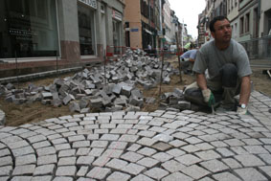
Summary: EU projects are helping paving the way
toward Energy and Intensity Frontier with p-colliders
Thanks in particular to the fantastic Energy and Intensity of …

Slide 19
To be able to build future accelerators, a strong
sustainable R&D program is indispensible
Exploratory R&D
Assessment of new ideas
Demonstration of conceptual feasibility of new and innovative principles
Targeted R&D
Demonstration of the Technical feasibility of all critical components
Demonstration of the feasibility of fully engineered system
Industrialization R&D
Transfer of technology
Large scale production and cost optimization
Diversification of Applications
It includes 3 levels of R&D
It requires large and costly infrastructures
We have to think at the European level, at least

Slide 20
Carrying the needed R&D requires
Strong expertise and skilled personnel
Large variety of infrastructures
Training of young accelerator scientists
Large/Medium
Size labs
University
Industry
The potential
partners
Coordinated R&D Program
Hard to find all this to cover all aspects of accelerator R&D
in a single location or even a single country
We have to think at the European level, at least

Slide 21
Since then, the importance of accelerator R&D has been further emphasized
In 2006
CERN Council, as the HEP European Strategy Body, had endorsed
the needs to develop strongly accelerator R&D and included it
as a high priority item in its Strategy Document.
More recently
CERN Council has included “Advanced Accelerator R&D” in the
Roadmap for Research Infrastructures (ESFRI 2008 Roadmap)
as the second item in list for particle physics, just after LHC
“It is vital to strengthen the advanced accelerator R&D
programme in Europe, providing a strong technological basis
for future projects in particle physics.”

Slide 22
First item in the Strategy Document
The LHC will be the energy frontier machine for the foreseeable future, maintaining
European leadership in the field; the highest priority is to fully exploit the physics
potential of the LHC, resources for completion of the initial programme have to be
secured such that machine and experiments can operate optimally at their design
performance. A subsequent major luminosity upgrade (SLHC), motivated by
physics results and operation experience, will be enabled by focussed R&D; to this
end, R&D for machine and detectors has to be vigorously pursued now and centrally
organized towards a luminosity upgrade by around 2015.
Second item in the Strategy Document
In order to be in the position to push the energy and luminosity frontier even further
it is vital to strengthen the advanced accelerator R&D programme; a coordinated
programme should be intensified, to develop the CLIC technology and highperformance
magnets for future accelerators, and to play a significant role in the study
and development of a high-intensity neutrino facility.

Slide 23
We have to think beyond
ESGARD is already carrying out a coordination leading to development
of well organized European wide integrated R&D project for Particle Physics
(see the high success rate of FP proposals).
Building on this experience, we can and need to go further
A structure and mechanism that ensures the sustainability of accelerator R&D useful for many fields, which includes
The integration of R&D infrastructures and offered services
within a general framework (including industry)
The development of a joint R&D program and the launching
of a set of consistent integrated accelerator R&D projects
The promotion of the education and training for accelerator sciences
A model for financing all of the above

Slide 24

TIARA website: http://www.eu-tiara.eu
Test Infrastructure and Accelerator Research Area
A multi-field, coordinated pan-European distributed infrastructure
Joint particle accelerator R&D programming in Europe and the integration of the required infrastructures

Slide 25
The Virtuous Triangle
R&D projects
Test Infrastructures
Education and Training
Innovations for
Cultural, Medical,
Industrial…
applications
Innovations for
Fundamental
Research
Infrastructures
Coordination and Funding Mechanism

Slide 26


Creation of a coordinated panEuropean multi-purpose distributed Test Infrastructure
Joint Strategic Analysis of the accelerator needs
and perspective for the development of R&D RI
Joint R&D programming and launching of a set
of consistent integrated accelerator R&D projects
Promotion of the education and training for accelerator science
Strengthening the collaboration with the industry

Slide 27
Needed Infrastructures
Test accelerators
for carrying accelerator R&D
10-100M€
TIER1
Specific large scale equipments
1-10M€
TIER2
Laboratory equipments
0.1-1M€
TIER3
A rough estimate of all these infrastructure is 500-1000 M€
These infrastructures need to be upgraded and/or new infrastructures are necessary

Slide 28
Creation of a coordinated panEuropean
multi-purpose distributed Test Infrastructure
Monitoring and coordinating the use and the development of the
European test infrastructures for accelerator R&D
Facilitating accesses to R&D RIs, including industry involvement
Identifying weaknesses and needed upgrades/investments and
assessing their costs
Making recommendations and contributing to upgrade
and/or construction of new R&D Infrastructures as well as
their corresponding R&D programs

Slide 29
Joint Strategic Analysis
Elaborating a common European strategy toward the development
of accelerators , i.e.
Carrying a shared strategic analysis of the accelerator needs and perspectives
Developing a common strategy toward the development of accelerators
Developing a common accelerator R&D strategy based on a
continuous survey and evaluation of the European R&D needs

Slide 30
Joint R&D programming and the launching of a set of
consistent integrated accelerator R&D projects
Defining procedures for launching of collaborative accelerator R&D projects and providing partial funding
Overseeing the progress of the accelerator R&D projects
Monitoring and promoting the exchange of information and personnel within and across fields
Establishing a partnership with the European industry to share
mature technology driven R&D and hand over production of industrialized components

Slide 31
Promotion of the education and
training for accelerator science
After a survey of the education and training for accelerator science in Europe, encouraging the development of support programs to strengthen further this area, such as,
for example promoting and facilitating
the organization of summer school,
internship for master students,
the creation of European accelerator masters,
training on accelerator operation,
exchange of scientists…
Integration of accelerator science lecture halls and accelerator R&D complex should also be investigated

Slide 32
Strengthening the collaboration with the industry
Understanding the industry needs for accelerators and related accelerator R&D infrastructures and Programs
Developing joint R&D projects and/or providing access to R&D infrastructures
Encouraging the industrialization of recent technologies (TT)
Establishing a Technology Roadmap for industrial development of future accelerator components.

Slide 33
11 participants (8 countries + 1 int. organisation)
Number | Organization Name | Country
1(coordinator) | CEA | France
2 | CERN | International
3 | CNRS | France
4 | CIEMAT | Spain
5 | DESY | Germany
6 | GSI | Germany
7 | INFN | Italy
8 | PSI | Switzerland
9 | STFC | UK
10 | Uppsala University (rep. Nordic Consortium) | Sweden
11 | IPJ-PAN | Poland

Slide 34
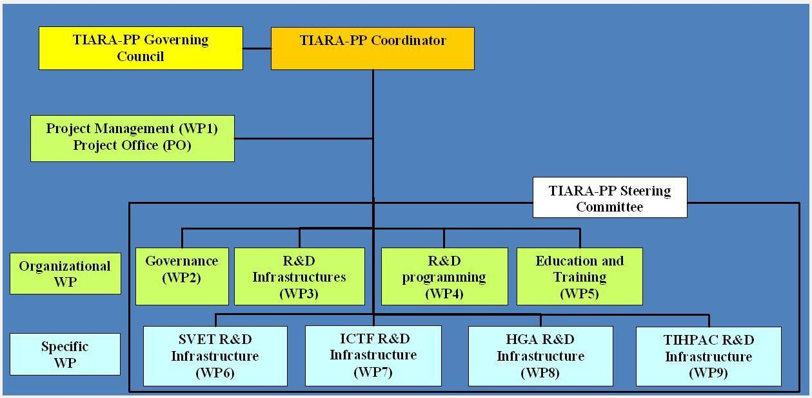
http://www.eu-tiara.eu
September 18th : TIARA has been presented and approved by the
CERN Council at the European session of the Council
TIARA proposed to the PP call in Dec. 2009 and accepted in 2010
Start: 1/1/2011
Duration: 3 years
R. A.
F. Kircher
C. Tanguy
R. A.
A. Unnervik
P. Pierini
P. Burrows
Y. Papaphilippou
K. Long
M. Biagini
S. Bousson
Total Cost: € 9 139 196 EC contribution: € 3 900 000

Slide 35
Organization (cont’d)
1. Management of TIARA-PP
WP1: Management of the consortium (MGT)
Objective: Organization of the Preparatory Phase work,
Dissemination and outreach
2. General Coordination and Support Work Packages
WP2: Governance of TIARA (SUPP)
Objective: Developing governance allowing one to involve as many fields as possible
WP3: Accelerator R&D Infrastructures in Europe (COORD)
Objective: Integrating and optimizing European Infrastructures for accelerator R&D
WP4: Joint R&D programming (COORD)
Objective: Defining a Joint R&D Programme in the field of accelerator science
WP5: Education and Training for accelerator sciences (SUPP)
Objective: Promoting education and training for accelerator research in Europe

Slide 36
Industry
One of the goals of TIARA is to strengthen relations with industry.
Several aspects of TIARA concern industry
WP2:
How should we associate the industrial sector in TIARA Governance
WP3:
Study options for sharing R&D infrastructures and developing joint R&D Infrastructures with the industry
Define technology roadmap for the development of future accelerator components in industry.
WP4:
Develop an accelerator R&D programme in Europe
WP5:
Survey of the numbers of students, courses, and teaching resources
Evaluation and Study of the development of the market for Accelerator Sciences
Establish a plan of action for promoting Accelerator Science and Technology

Slide 37
Organization (cont’d)
3. Specific RTD Work Packages
WP6: SLS Emittance Tuning System Infrastructure (SVET)
Objective: Upgrade of SLS at PSI for very low emittance studies
Main interested projects: CLIC, Light Sources, SuperB
WP7: Ionisation Cooling Test Facility (ICTF)
Objective: Upgrade of Test Infrastructure at RAL for ionisation cooling studies
Main interested projects: Neutrino Factory
WP8: High Gradiant Acceleration Infrastrcuture (HGA)
Objective: Construction at LNF of SC C-Band High Gradiant Test Infrastructure
Main interested projects: SuperB, FEL
WP9: Test Infrastructure for High Power Accelerator Components (TIHPAC)
Objective: Design of infrastructures for multi MW target complex tests and of test cryostat for SC low beta SC cavity tests
Main interested projects: EURISOL, ESS, MYRRHA

Slide 38
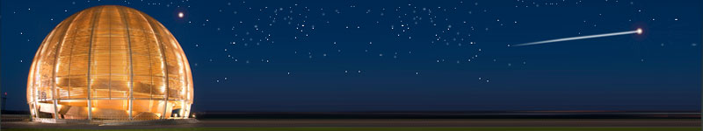
Conclusions
HiLumi is an important focal point in the European strategy for
particles physics and well embedded in the European objective
to strengthen accelerator R&D with the support of the EC.
After having established an accelerator R&D strategy,
implemented through several projects in FP6 & FP7,
ESGARD proposed to go one step further with the TIARA
Concept.
TIARA will hopefully establish the groundbase for supporting
sustainably Accelerator R&D and infrastructures in Europe through “program funding” in FP8
Accelerator science is a powerful mean
toward scientific, technical and
industrial breakthroughs and innovations…
TIARA will strengthen significantly this potential

