Slide 1
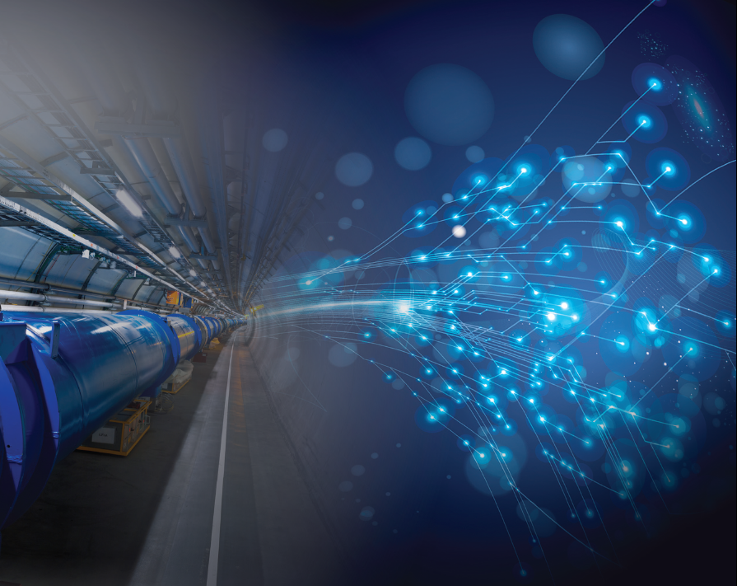

Superconductivity and the quest for the fundamental laws of Universe
Roy Aleksan
CEA
Introduction
The world of PP
PP challenges: A matter of broken symmetries
The Frontiers of PP
Next Accelerator Technology Challenges for PP
Conclusion

Slide 2
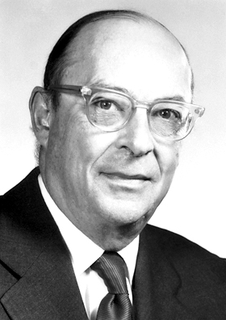
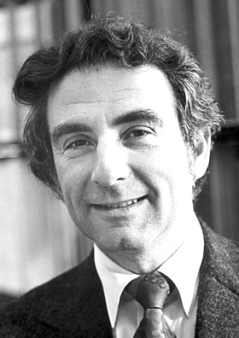
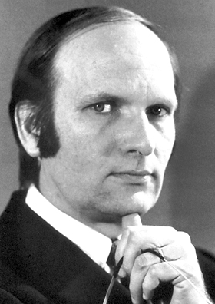
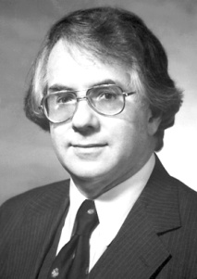
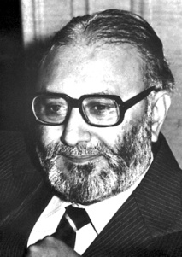

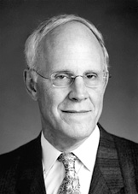
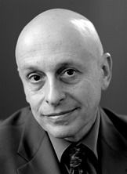
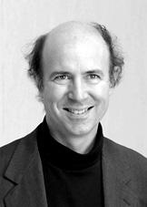
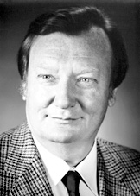
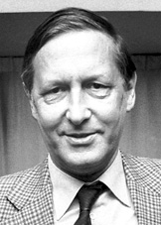
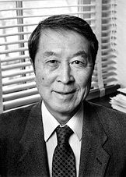
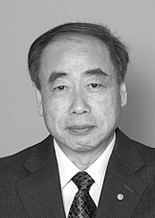
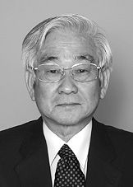
Nobels
J. Bardeen
L. N. Cooper
J. R. Schrieffer
for Nobels
S. L. Glashow
A. Salam
S. Weinberg
D. Gross
D. Politzer
F. Wilczek
And many others …
C. Rubbia
S. Van der Meer
Y. Nambu
M. Kobayashi
T. Maskawa

Slide 3
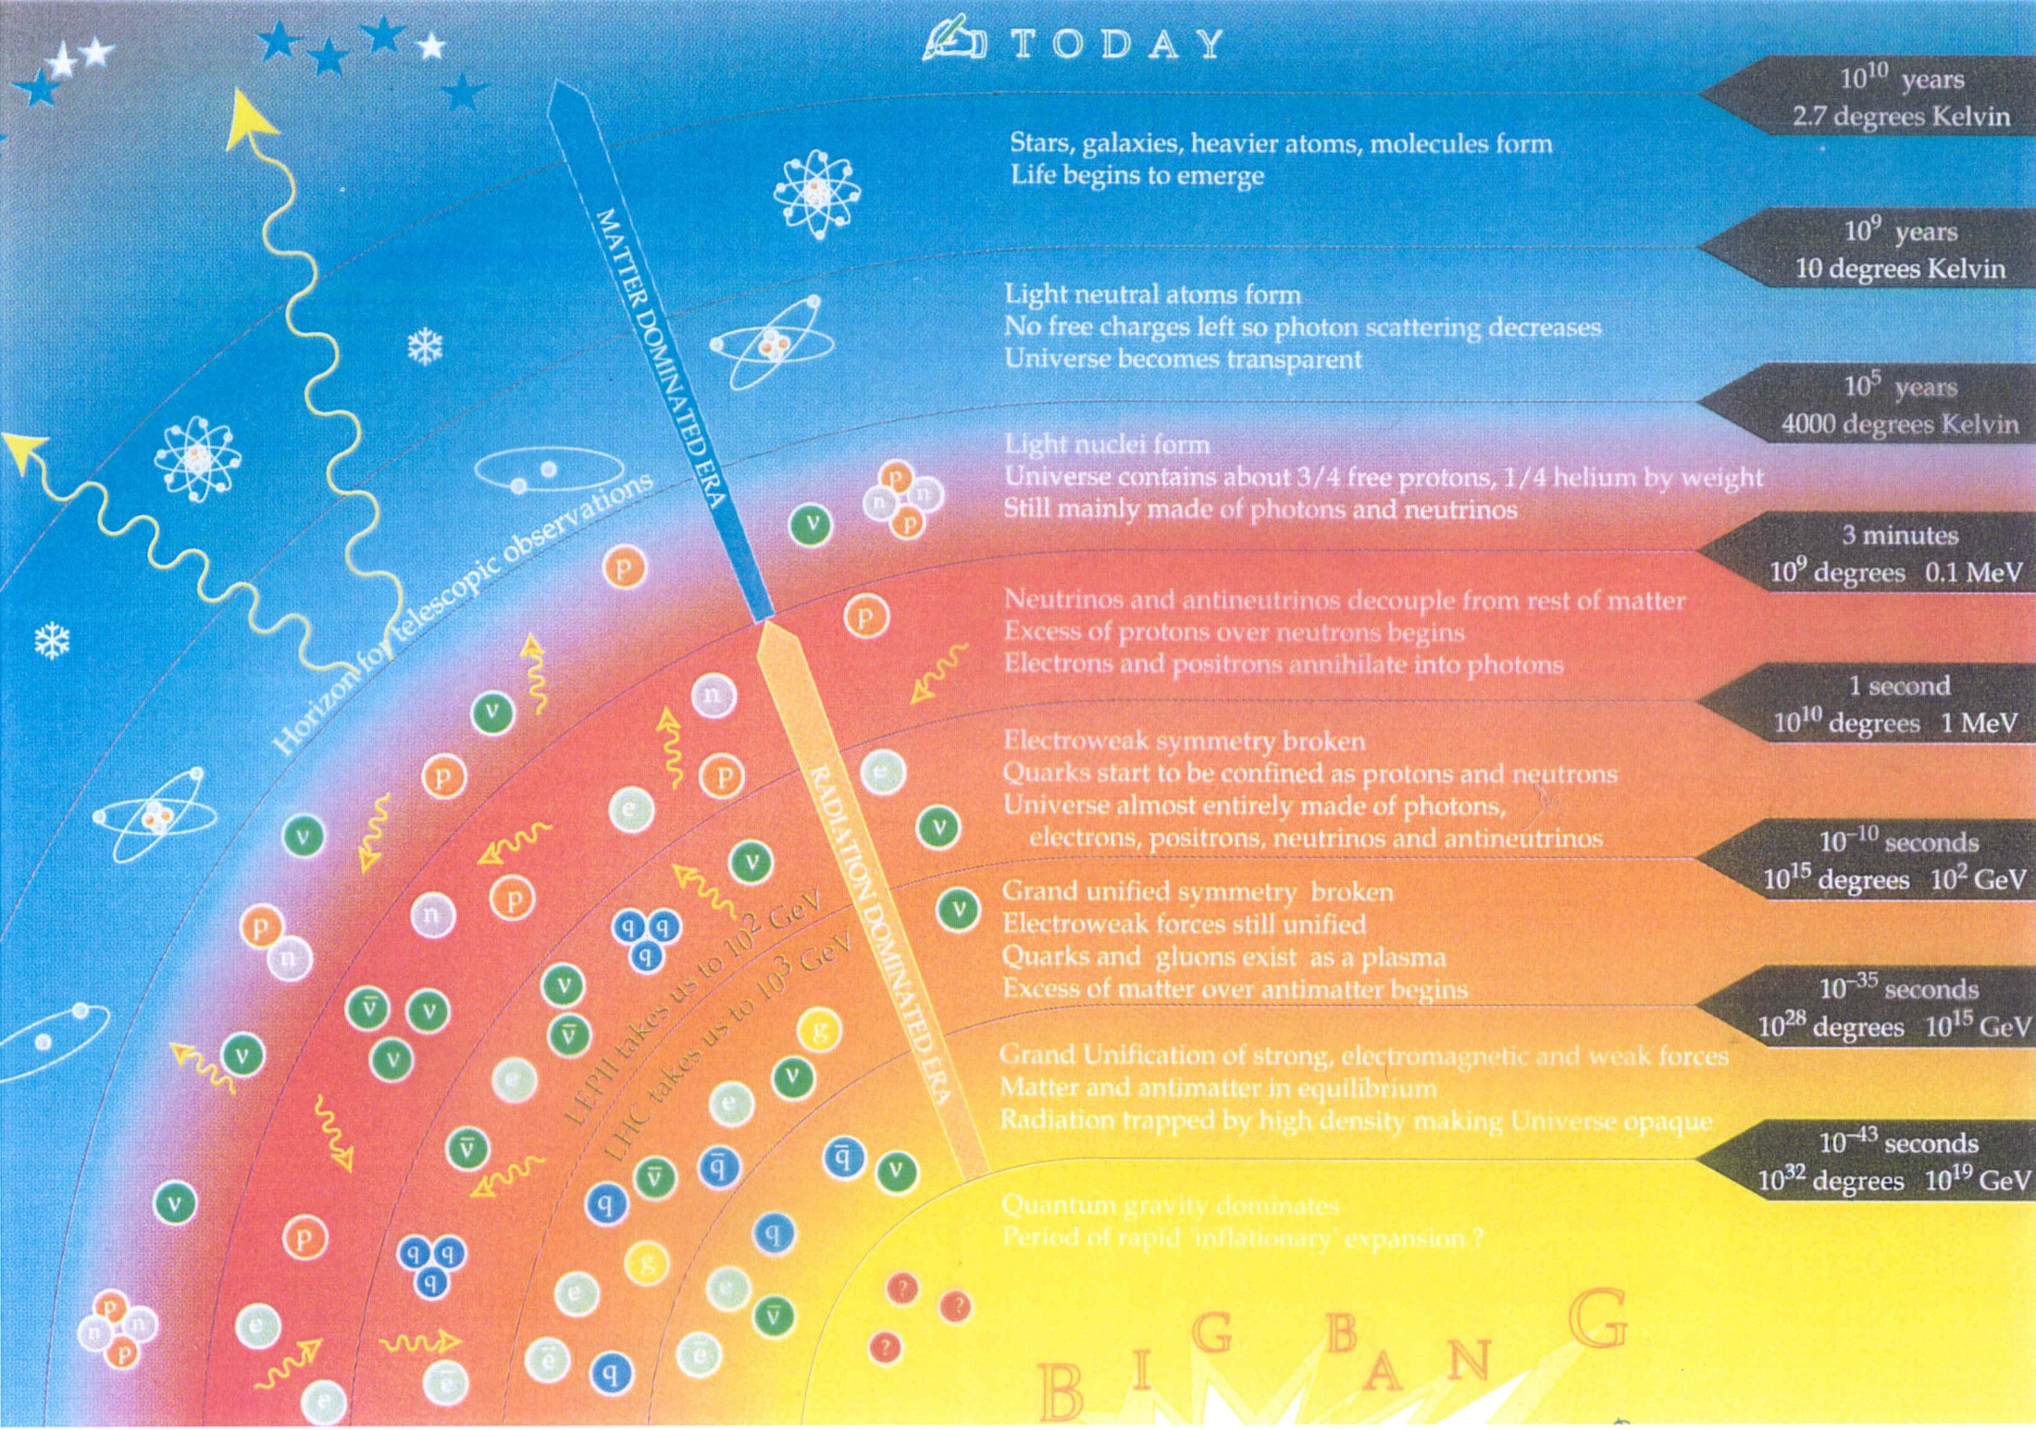
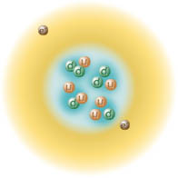
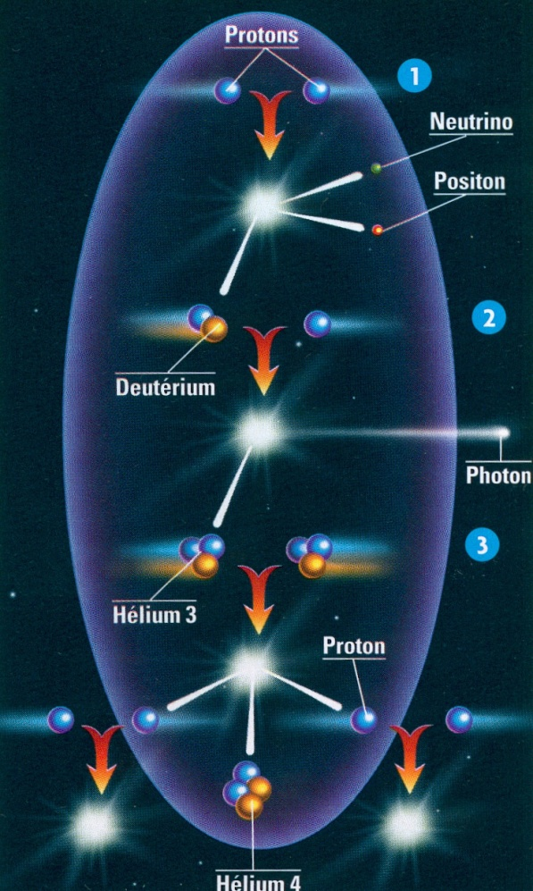
Universe Story in a slide
Cosmos is
Stars are born, live and die
… and life appears
Our Univers is on its way
Atoms form
Transparent Universe (our horizon 380 000 year)
Nucléosynthèse
Nuclei form
Neutrinos escape from dense universe (1 mn)
Baryogénese (some 10s)
Protons and neutrons are formed
u
10⁻¹³ m
u
d
Symmetries break (<nanosecond)
Various interactions appear
Antimatter disappears
Particles acquire mass
10⁻¹⁸ m
10⁻³¹ m
Particle Physics is all about this first
« nanoseconde »
10⁻³⁵ m
« Symmetric Universe »

Slide 4
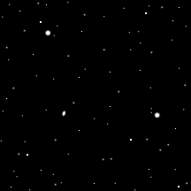

What is at stake?
Understanding what happened in the very early Universe (<10⁻⁹s)
In particular,
Knowing the fundamental/primordial constituent of the Universe
Understanding their properties (type, mass, quantum properties)
Understanding the forces and mechanisms governing the interactions
Understanding the origin of the masses
Understanding the origin and the mechanism leading to matter/antimatter asymmetry
Building a general predictive theory describing and unifying all the above

Slide 5
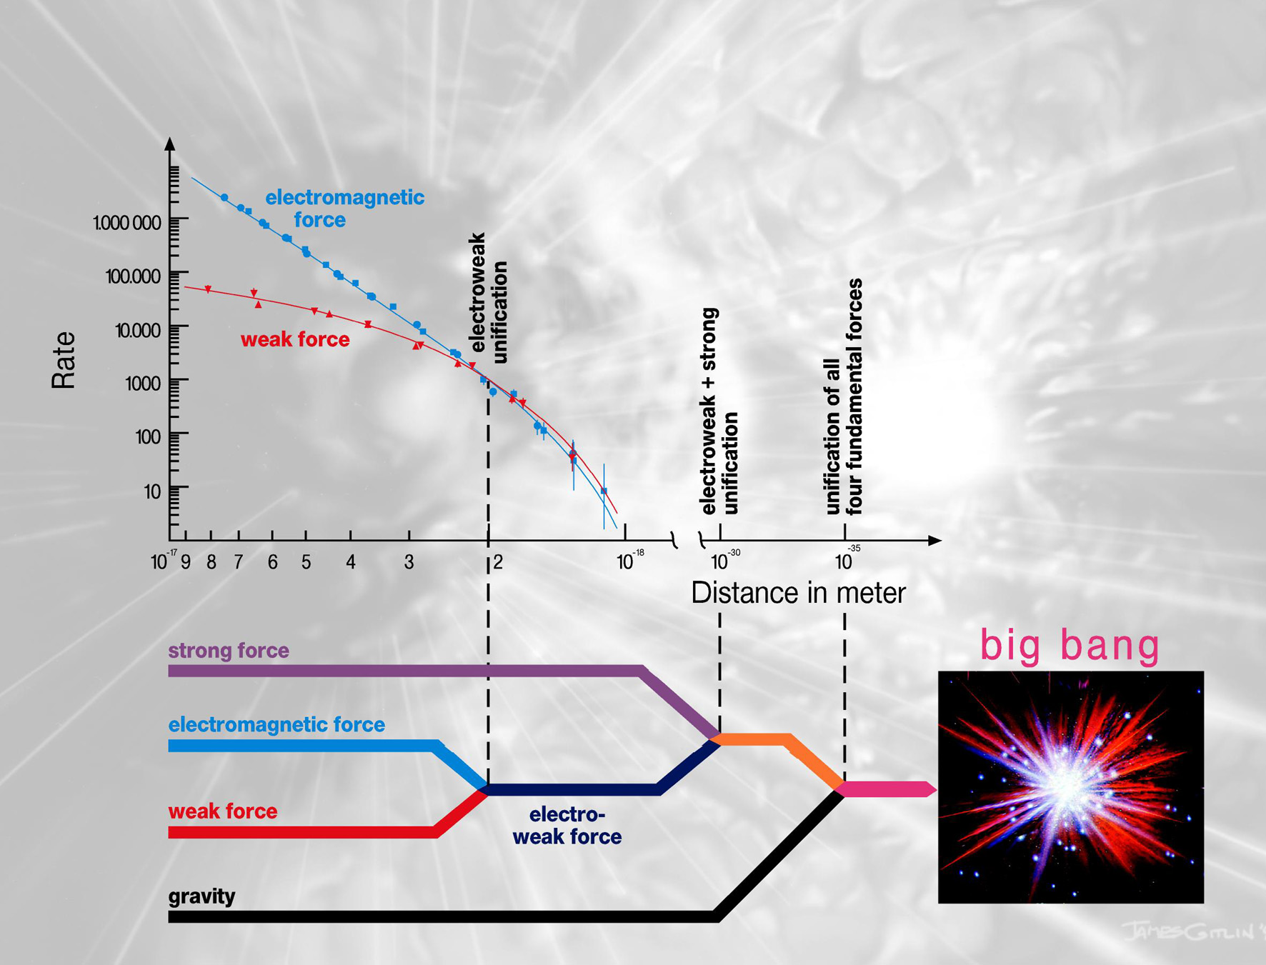


BEH mechanism at the origin of symmetry breaking, mass of bosons Z,W and fermions, and CP Violation
Hard to understand such a large gap
New interactions and particles expected,
such as Supersymetry linking fermions and
bosons
~100 GeV
~10¹⁵ GeV
~10¹⁹ GeV
Standard
Model

Slide 6

The World (« Standard Model ») of Particle Physics in a slide
All particles (antiparticles)
initially massless
M
ν_{e}
ν_{μ}
ν_{τ}
γ
H
leptons
e
μ
SU(3)xSU(2)xU(1)
Z⁰ , W⁺ ,W⁻
Higgs Mechanism does it all … at first look:
Brakes interaction symmetry
Generates masses
Enables particle/antiparticle symmetry breaking
τ
Mass (eV)
Everyday’s world
g
u
c
t
quarks
G
d
s
b
But
Only Electroweak symmetry SU(2)xU(1) is broken
Does not explain the >15 order of magnitude of masses
Enabled particle/antiparticle asymmetry not enough to explain absence of antimatter
3 fermions
(antifermions) families
Interactions
SU(3)xU(1)
… and does not say anything about 95% of Universe

Slide 7
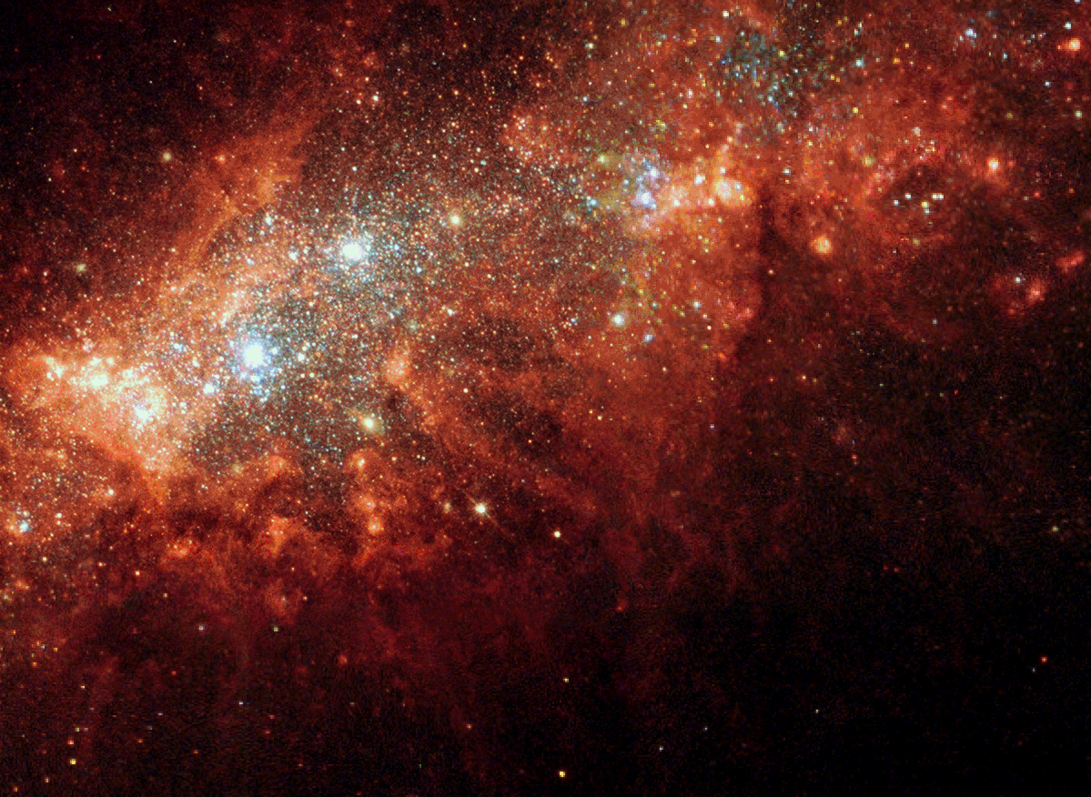
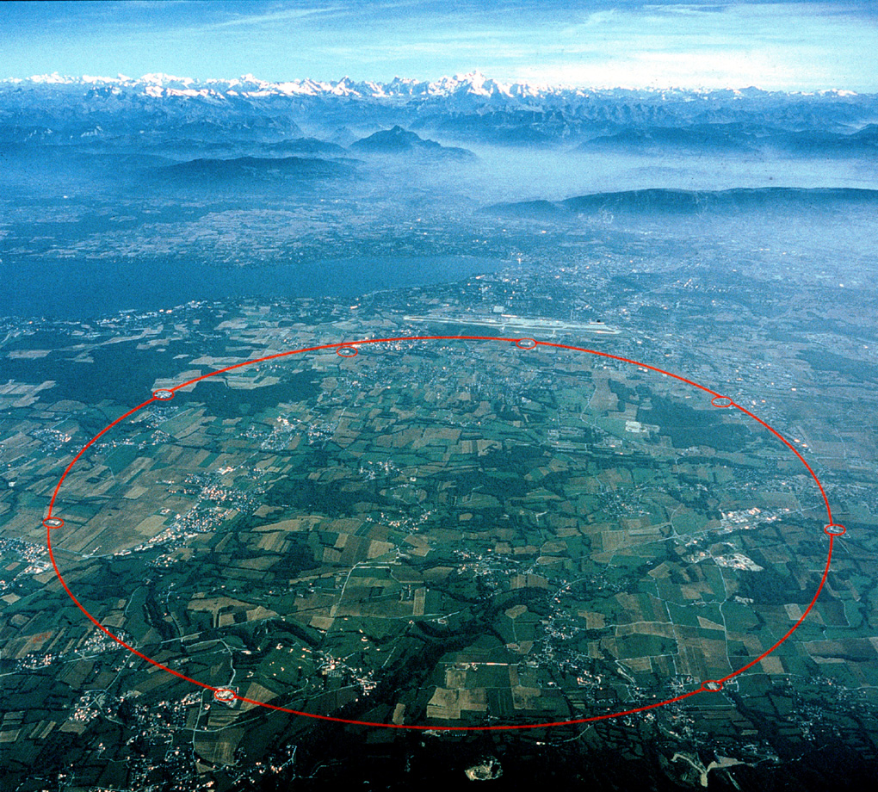
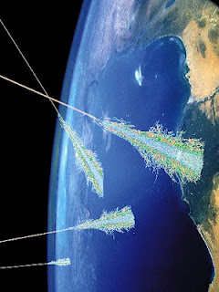
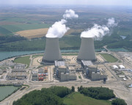
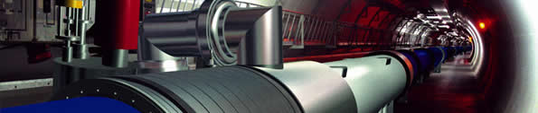
Main tools: Sources of particles
The Universe
But in most cases, need to build
our own tools: Accelerators
The LHC at CERN (Geneva)
Most powerful example
Proton
Photon
Neutrino
(muon)
WIMPS?
…
up to 10²⁰ eV
27 km
…also in some particular cases
p
p
14 x 10¹² eV
Proton, electron, muon, neutrino
… but also neutron, pion, kaon
Neutrino, neutron … up to few 10⁶ eV

Slide 8


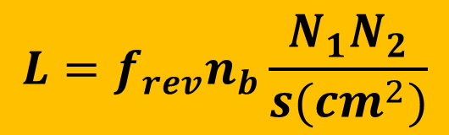
Indeed, most of the fundamental particles (14/18) have been
discovered thanks to accelerators
u
g
Z⁰ W⁺ W⁻
d
τ
ν_{μ}
?
μ
ν_{e}
s
c
b
t
ν_{τ}
H
1930 |  | 1940 |  | 1950 |  | 1960 |  | 1970 |  | 1980 |  | 1990 |  | 2000 |  | 2010 |  | 2020
Accelerator era
Superconductivity era
Both energy and intensity frontiers had to be challenged in past 50 Years
Today
E_{max}=8 TeV @ LHC(pp collider)
L_{max}=2x10³⁴ cm⁻²s⁻¹ @ KEKB (ee collider)
$$L=f_{rev}n_{b}\frac{N_{1}N_{2}}{s(cm^{2})}$$
$$S=4πσ_{x}σ_{y}$$

Slide 9
Indeed, most of the fundamental particles (14/18) have been
discovered thanks to accelerators
Both energy and intensity frontiers had to be challenged in past 50 Years
SC Era
>3 orders of magnitude in Energy and Luminosity
>2(5) orders of magnitude in Energy(Luminosity)

Slide 10
In past 50 years, >2(3) orders of magnitude in Energy in e(p) colliders
and >5 (3) orders of magnitude in Luminosity for e (p) colliders
e+e-
pp,ep

Slide 11
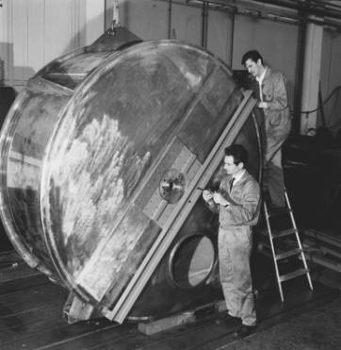

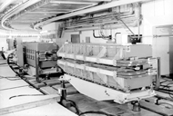
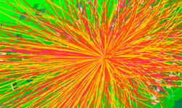
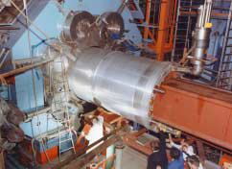
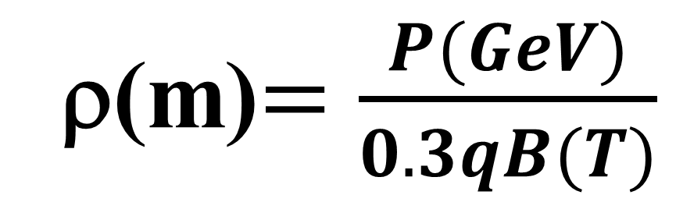
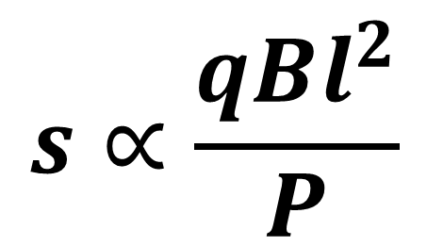
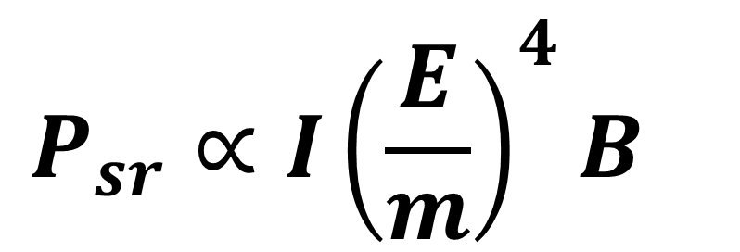
Why is SC needed in accelerators & detectors?
$$P_{sr}∝I{\left(\frac{E}{m}\right)}^{4}B^{}$$
PS 19MHz cavity
Make B small! Possibly 0
or use large m particles
ρ(m)$=\frac{P(GeV)}{0.3qB(T)}$
PS 19MHz cavity
First PS dipole
Make B as large as possible
$$s∝\frac{qBl^{2}}{P}$$
CELLO detector

Slide 12
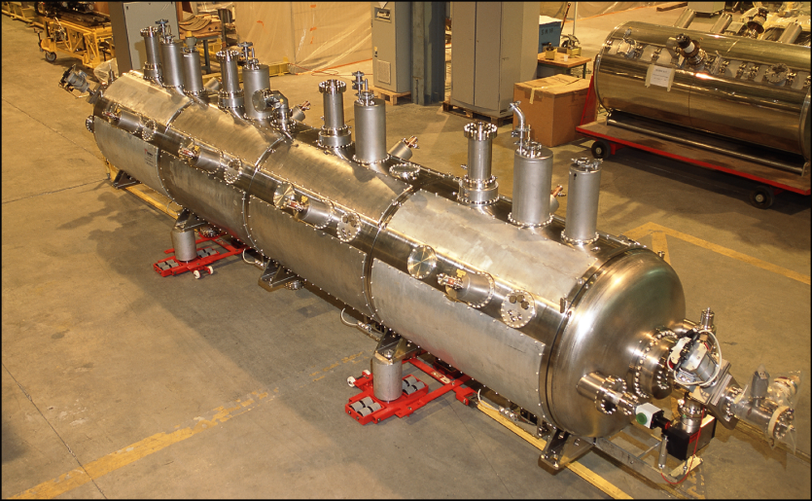
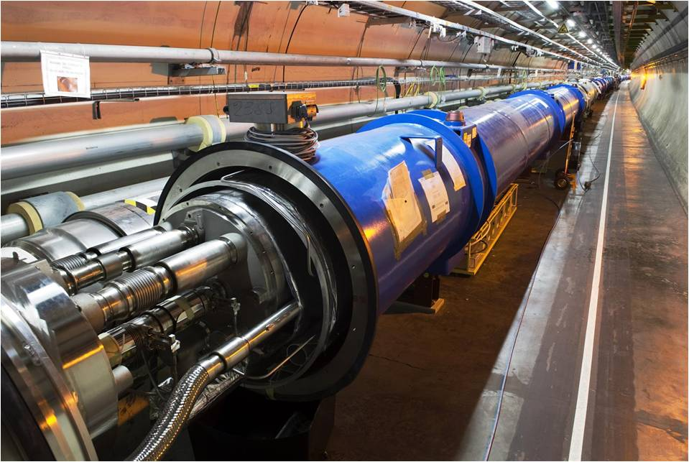
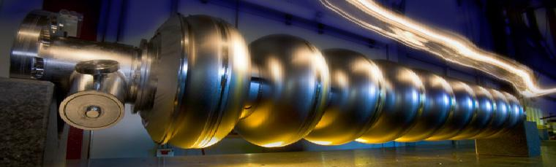
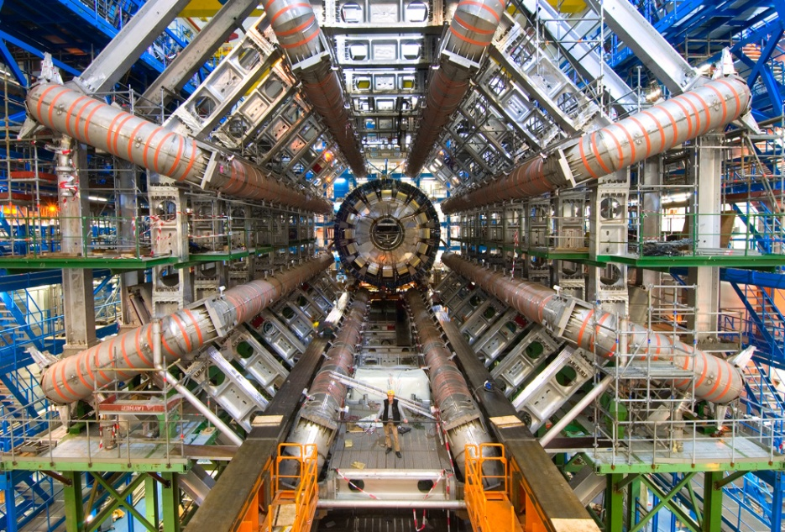
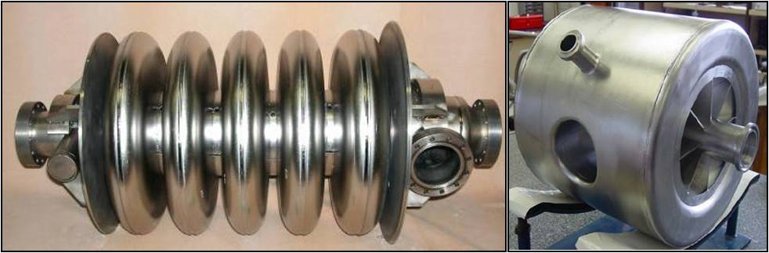
How is SC used in HEP so far?
Two main areas: Magnets and RF cavities
LHC Cavity cryomodule
XFEL Cavity
LHC dipole
ATLAS Toroid
ESS type elliptical & spoke Cavities

Slide 13
Most of the fundamental particles have been discovered
thanks to accelerators
SC (NbTi)
Era
x2 in ~20 years
6,9 km
6,3 km
6,3 km
3,8 km
27 km
~4 T
1-2 T

Slide 14
Main Advantages/Disadvantages of Superconducting Magnets
SC allows to reach much higher fields essentially with no dissipation
=> Smaller accelerator rings and “low power” consumption
LHC: 40MW for 1200 dipoles
“conventional LHC”: ~4GW and 6000 dipoles (120 km)
Huge cryogenic system
Cost

Slide 15

Main Advantages/Disadvantages of Superconducting Cavities
SC cavity reduces the wall dissipation by many orders of magnitude over copper cavity
=> Affordable higher CW/long pulse gradients => robust operation
Larger aperture cavity geometry for better beam quality
$$Q_{0}=\frac{G}{R_{S}}$$
Gradient limitation (Nb)
Cost

Slide 16
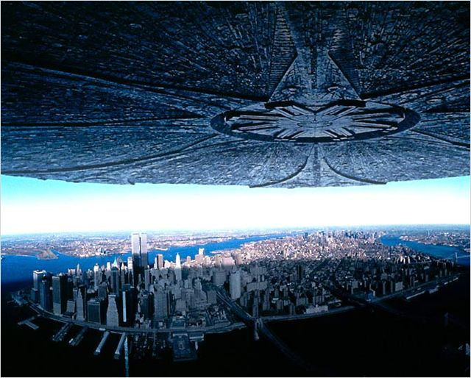
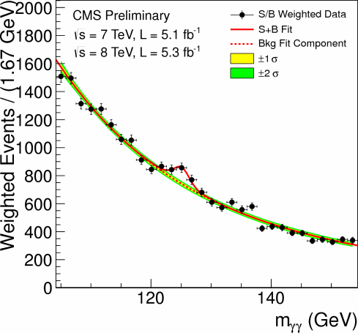
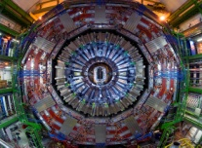
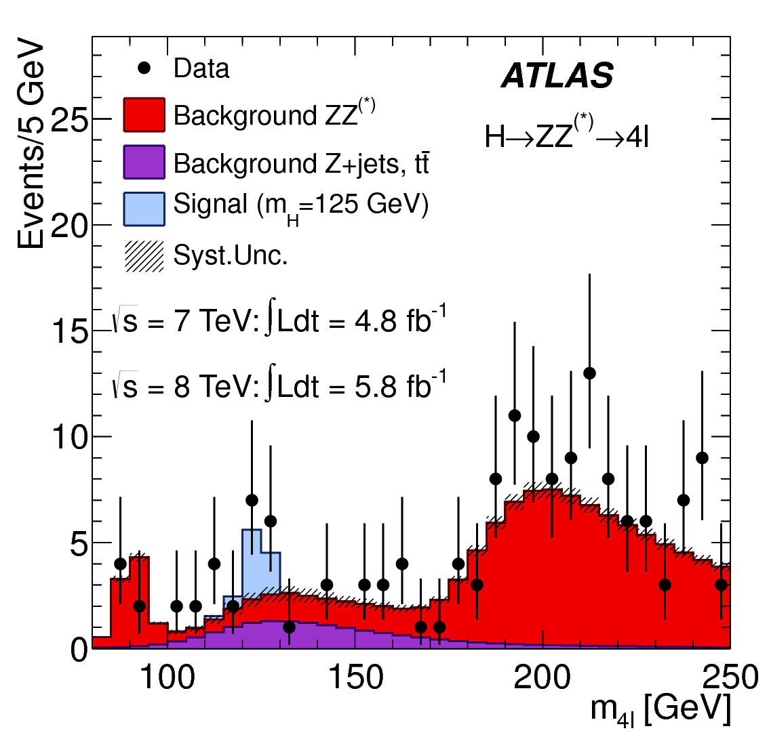
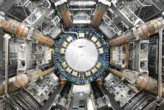
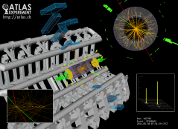
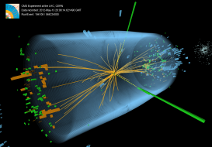


Back to the Future
July 4th:
the Day H came to Geneva
$$m_{H}→γγ$$
$$S=0, 2$$
H
m_{H}=125.7 ± 0.5 GeV

Slide 17
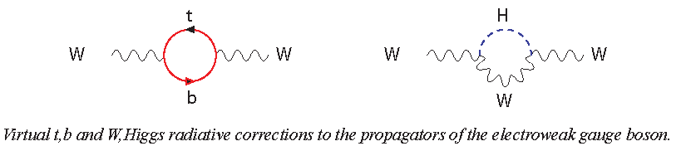
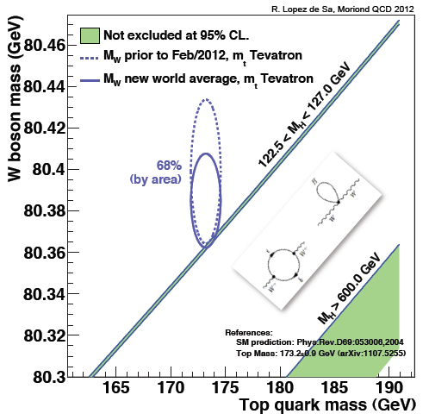
…What next
Verify further the consistency of the Standard Model
∝ M_{t}²
∝ ln(M_{H})
M_{W}= 80.385 ± 0.015 GeV
M_{t}= 173.5 ± 1.0 GeV
Need to improve
M_{w} and M_{t}
M_{H}

Slide 18
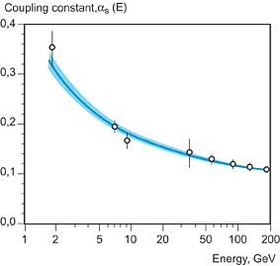
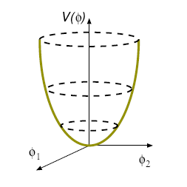
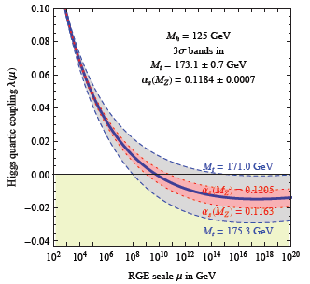






Study of the Higgs properties, its couplings and the potential
$V_{Higgs}={−μ}^{2}$ $φ^{†}φ+λ{φ^{†}φ}^{2}$
Interaction strength varies with energy scale, depends on quantum numbers and particle species
field self coupling
$$φ_{min}=v=0$$
H potential
Strong coupling
H
H
∝ λ
H
$${φ_{min}=v=\sqrt{\frac{μ^{2}}{2λ}}e}^{−iδ}$$
H
H
∝ λ^{1/2}M_{H}
H
λ runs too
H
$$υ=246 GeV$$
Consistency
Check
Vaccuum instability
$$M_{H}=\sqrt{{2λv}^{2}}$$

Slide 19



Study further the Higgs properties and couplings
$V_{Higgs}={−μ}^{2}$ $φ^{†}φ+λ{φ^{†}φ}^{2}$
$$+\left[\overline{ψ_{Li}}Y_{ij}ψ_{Rj}φ+h.c.\right]$$
$${m_{ij}^{}≡ Y}_{ij}v$$
H coupling to fermions ∝ m_{f}²
H
∝ Yν
f
f
Do we have the technology to Study Higgs properties
Upgrade LHC luminosity (by factor ~10)
  Improve current and focussing
Build a dedicated « Higgs factory »
  e+e- linear or circular collider

Slide 20


Upgrading LHC luminosity early 2020’s
Increase beam current a protect SC dipole (diffracted protons)
Reduce beam size at IP a Stronger focussing quads near IP
8T-15m a 11T-11m dipoles
5.5 m Nb₃Sn
3.5 m Collim
5.5 m Nb₃Sn
Fermilab/CERN Collaboration
Demo single bore 11T , 2m
Test: very good to 10.4 T
Next model by beginning of 2013
Change Quadrupole Triplets
200T/m, 70mm (~8T, <6m>)
a 140T/m, 150mm (13T, 8m)

Slide 21

Target parameters for
HL-LHC run
Efficiency is defined as the ratio between the annual luminosity target of 250 fb⁻¹ over the potential luminosity that can be reached with an ideal cycle run time with no stop for 150 days: t_{run}= t_{lev}+t_{dec}+t_{turn}. The turnaround time after a beam dump is taken as 5 hours, t_{decay} is 3 h while t_{lev} depends on the total beam current
baseline

Slide 22




LQS-4m
LARP (US LHC program) Magnets
Test:~220T/m
~11T
G.L. Sabbi , LBNL
HQ
Test:~200T/m
13T

Slide 23



HTS links
Protection of Electrical Distribution Feedbox’s (DFBX)
In the tunnel, feed power from room temperature power converters to
the « cold world » of LHC. Actual LHC use short Nb-Ti links.
4.5 K
1.9 K
D1
DFBX
Q3,Q2,Q1
IP5
∼3 m
Need to be protected against radiation and provide easier access
Move DFBX on surface
To be decided
2×100 kA
~500m HTS links
Note: LHC uses 1400 Bi-2223
current leads

Slide 24




On going HTS link test at CERN
2m long MgB₂ cables tested
at 2x4500A
HTS cabling
Possible cable configuration for high current :
7 × 14 kA, 7 × 3 kA and 8 × 0.6 kA cables
Itot∼120 kA @ 30 K
Φ = 62 mm
Nexan Cryoflex® line (20 m long semi-flexible cryostat of link) procured and installed in the CERN SM-18 laboratory
20 kA – 4 to 80 K test
MgB₂, YBCO… tests
starting end 2012
A. Ballarino, CERN

Slide 25

« Crab » Crossing
Improving further the luminosity by better overlap of the 2 beams
SC RF «Crab» Cavity, for p-beam rotation at fs level!
Technology pioneered successfully
on KEKB, Japan
Effort at SLAC-ODO and in BNL, USA
Effort in Daresbury (Cockcroft Institute and STCF) with CERN.
Also help to adjust the luminosity to ease
experiments’ life (Luminosity levelling)
Z→ μμ event from 2012 data with 25 reconstructed vertices

Slide 26




Progress in SC « Crab » Cavities
UK - Cockcroft
USA (ODU)
Several types
of prototypes
being designed
and made…
… as well as cryomodule
L. Xiao et al.
~250 mm outer radius
Y. Yakovlev et al.

Slide 27
e⁺e⁻ colliders «clean HIGGS FACTORIES»
e⁺ e⁻
Linear
Colliders
CLIC
Circular Colliders
CERN
Super
TRISTAN
ILC
250 GeV + Klystron based
500 GeV
250 GeV– 40, 60 km tunnel
400
500
250 GeV
500 GeV
LEP3 at LHC tunnel
> 500 GeV
DLEP – New tunnel, 53 km
TLEP – New tunnel, 80 km

Slide 28

ILC Gradient: Primary Cost Driver
Linac and Civil: ~75% cost
Well extablished SC RF technology (FLASH, XFEL…)
Cavities (1.3 GHz, 31.5 MV/m)
Phase I(II) at 0.25(0.5) TeV CM (Maximum energy 1 TeV)
GDE (Global Design Effort) - International collaboration
Feasibility almost demonstrated (TDR being prepared)
Challenge: deploy and industrialize technology in each region
Prepare for project approval process in each region
R & D objectives:
SC High Gradient
Transfer technology
Industrialization

Slide 29


ILC
Gradient Range Yield Gain
Upgrade LHC luminosity
  Improve current and focussing
Build a dedicated « Higgs factory »
  e+e- linear or circular collider
~30km
+~15%
500GeV
Energy CM (GeV) | 250 | 500
Luminosity (x10³⁴cm⁻²s⁻¹) | 0.75 | 1.8
Beam size (σ_{x}/σ_{y} nm) | 730/8 | 470/6
Pulse duration (ms) | 0.75 | 0.75
Beam power (MW) | 5.2 | 10,5
Total AC power (MW) | 128 | 162
Cavity Gradient (MV/m) | 31.5
#9-Cell cavities | ~16000
#Cryomodules (2K) | ~1800
#RF units (10MW Kly) | ~560

Slide 30








Global SCRF Technology
FNAL, ANL
◉
Cornell
DESY
◉
JLAB
◉
KEK, Japan
SLAC
◉
LAL
Saclay
◉
◉
◉
◉
INFN Milan
30

Slide 31






Two Candidate Sites in
Japanese mountainous locations
5 m
SEFURI

Slide 32


TLEP Ring e⁺e⁻ collider: Primary Cost Driver Tunnel: ~70% cost
Building on existing technologies and experience (LEP, KEKB, PEPII…)
LEP/LHC
80 km tunnel
Using SC cavities
Energy CM (GeV) | 90 | 240 | 350
Luminosity (x10³⁴cm⁻²s⁻¹) | 100 | ~5 | ~0.7
Cavity Gradient (MV/m) | 20 | 20 | 20
#5-cell SC cavities | 100 | 300 | 600
Total AC power (MW) | 100 | 100 | 100
Could cover a wide range of energy up to 350 Gev collision energy.

Slide 33



Particle – antiparticle Asymmetry
Any interaction able to differentiate a particle and its antiparticle?
Essential to generate a Universe dominated by matter (over antimatter)!
Phenomenon initially observed in s quark decays in 1964 but underlying process was not experimentally understood
Observation of dissymmetric behavior in 2001 in b quark decays (BaBar, Belle) a Electroweak interactions are responsible
$e.g. B^{0}(\overline{b}d)→K^{+}(\overline{s}u)π^{−}(\overline{u}d)>$ $\overline{B^{0}} (b\overline{d})→K^{−}(s\overline{u})π^{+}(u\overline{d}$)
$$particle ≠antiparticle$$
Explained through interference mechanisms because:
Physical quarks are superpositions of flavor states
e.g. $m_{"b"}^{phys}=c_{1}m_{b}+{c_{2}m}_{s}+c_{3}m_{d}$
Thanks to H
All quark masses $≠0$
∃ at least 3 families of quarks !!!

Slide 34






Unfortunately the particle/antiparticle asymmetry generated at the electroweak scale by the SM in quark sector is too small to explain matter/antimatter asymmetry in Universe
Good news is however that mechanisms exist in Nature
May be different in lepton sector?
Physical neutrinos are superpositions of flavor states (neutrino mixing observed with cosmics, reactors and accel.)
∃ at least 3 families of leptons !!!
All lepton masses possibly $≠0$
ν are their own antiparticle
Scenario 1
Scenario 2
H
H
H
$$m_{ν}∝Yv$$
ν
$$m_{ν}∝Y^{2}\frac{v^{2}}{Λ}$$
ν
ν
ν
New particles @ high energy scale
Not possible with charged fermions
Search for asymmetric behavior of neutrino vs antineutrino
Search for heavy neutrinos (at high energy accelerators)

Slide 35





From neutrino superBeams toward ν-factories
Fast
5-10 GeV
ν,μ
$$τ_{μ}=2.2μs$$
Multi-MW
SC cavities
Goal: >10²¹ μ/year
stored
Do we have technology for multiMW proton driver ?
Indeed, see for example
ESS
5MW
~300K
~2 K
Cavity type | Gradient | #cav.(cell) | #cryomod.
Spoke | 8 MV/m | 48(2) | 16
Ellip. 1 | ~14 MV/m | 36(5) | 9
Ellip. 2 | ~21 MV/m | 112(5) | 14

Slide 36

More generally, we are going toward very high power proton accelerators a useful to many applications
SC cavities are vital
Courtesy of Mike Seidel, PSI

Slide 37




Do we have technology for cooling the muons?
Ionization cooling
Demonstrator being constructed
Cooling section consists of 100 cells 0.75m in length (total length 75m)
100 RF cavities (15MV/m) operating in high magnetic field
100 superconducting 0.15m coils (2.8T)
MICE @RAL
From ν-factories toward the “dream” of muon collider
Some ultra-challenging components:
Very high field solenoids (>30T)
High gradient cavities in multi-Tesla field
$$φ≈5km$$
Require much smaller beam size (i.e. low emittance)
Very efficient cooling

Slide 38


Grand unification of Interactions (Strong, Weak, Electromagnetic)
Interaction strength varies with energy scale
depending on quantum numbers and particle species
Strong
Interaction strength
Weak
Electromagnetic
Energy (GeV)

Slide 39




Grand unification of Interactions (Strong, Weak, Electromagnetic)
Additionnal particles (such as supersymmetric partners) with energy scales of TeVs affect the running of the coupling constants
$$\frac{1}{α_{1}}$$
$$\frac{1}{α_{2}}$$
$$\frac{1}{α_{3}}$$
Need to explore higher energy regions (up to ~10 TeV)

Slide 40


L. Rossi (CERN)
Either using existing
LEP/LHC tunnel to reach 26-32 TeV collisions
Or build (or reuse) a 80km tunnel to reach 80-100 TeV collisions
In both cases, SC challenge to develop 16-20 Tesla magnets!

Slide 41


First consistent conceptual design
Using multiple SC material
L. Rossi
20 T field!
Magnet design: 40 mm bore (depends on injection energy: > 1 Tev)
Approximately 2.5 times more SC than LHC: 3000 tonnes! (~4000 long magnets)
Multiple powering in the same magnet for FQ (and more sectioning for energy)
Only a first attempt: cosϑ and other shapes will be also investigated

Slide 42
Performance Summary
HE-LHC
VE-LHC
16 TeV
40 TeV?
HL-LHC
LHC
7 TeV
LHC
3,5 & 4 TeV

Slide 43
…toward new frontiers

Slide 44

Conclusion
Superconductivity has been instrumental for completing and verifying the Standard Model of Particle Physics in the past 40 years
For example, the recent discovery of the « Higgs » would not have been possible with Superconductivity
A new area opens now: SM is complete but does not explain very crucial issues, like dark matter and energy, matter/antimatter asymmetry in Universe, unification of interactions including Gravitation…
Past century was marked by the development and consolidation of SM
This century will be marked by development of
the underlying theory up to the Plank scale
To answer those questions in this century, superconductivity will play a major role, for example by developing and/or mastering new materials
for very high field magnets
for higher gradient in RF cavities
… and other yet unsought applications
We need You and in You, we thrust … but, please, do it fast

Slide 45





… but most of the composition of universe is unknown
Neutrino?
Supersymetry?
Axions?
other?
?
Axion search with ADMX

Slide 46

Back to the Future (2)
Should we have the technology in 1980’s for SC high gradient cavities, we would have changed the world!!!
LEP is build to reach 250 GeV, the Higgs is discovered in 1992
Democrats in US understand the importance of Science, SSC is not canceled
Many of my friends do not leave PP to go to wall street: they would not imagine crazy things like “subprimes” or “junk” a no crisis later
SSC discovers supersymmetry, heavy neutrinos, we understand what is dark matter and energy in 1999
Science becomes a major topic in 2000’s campaign Al Gore becomes the 43rd US president
no war in Afghanistan nor in Iraq
We find a way to use the energy of dark matter; no need of oil any more
Energy is not an issue for the planet, and we build even larger accelerators
Europe has almost completed the VLHC (100TeV) this year, Japan is building a 3 TeV linear collider and US a neutrino factory
These machines will make outstanding new discoveries that will revolutionize our society… and so on … and so on …

Slide 47

Little delay … but large consequences!!!
In any case…
PP
SC

